Slide 1



__________________________________________________ Code Author: Daniel Sanchez Velasquez - TakuSan. Email: daniel.sanchez.velasquez090@gmail.com __________________________________________________
Trend Analysis of Netflix Content
Exploration of the most and least viewed, popularity by genres and countries, and the relationship between views and playback time.

Slide 2
This project offers a comprehensive, automated solution for analyzing Netflix's vast catalog of audiovisual content. Leveraging the Netflix Data Dump, introduced in the second half of 2023, the program provides a thorough exploration of titles, viewing metrics, and additional metadata. Given the limited data provided by Netflix—title name, total views, and hours watched—the program seamlessly integrates with the TMDb API to enrich the dataset with genres, production countries, and other essential details. The workflow is fully automated and designed to deliver reliable, well-presented insights. It begins with downloading and storing raw data in JSON format, followed by normalization and a robust analytical process. This culminates in the creation of an organized and visually engaging PowerPoint presentation, offering a clear and comprehensive overview of the findings. Key features of this analysis include: - Identification of the **50 most and least-watched titles**, separated into movies and series. - Detailed visualizations of genre popularity, including **bar charts for total views** and **pie charts for percentage shares**, presented separately for movies and series. - Insights into the popularity of production countries, supported by **heatmaps** and bar charts, categorized by type of content. - Examination of trends in viewing habits relative to content duration, highlighting durations associated with higher or lower viewership. - Comprehensive exploration of the overall popularity of genres and production countries, incorporating both movies and series into unified visualizations. By simply providing the Netflix Data Dump for the desired year—starting from the second half of 2023—the program delivers a polished and up-to-date presentation. The results are designed to be not only visually appealing but also insightful for understanding trends and patterns within Netflix's vast library. It is important to note that the program's functionality relies on Netflix maintaining its current format for data sharing. If this format changes in the future, adjustments to the code may be required, particularly in the data selection process. However, as long as the format remains consistent, this tool provides a powerful and fully automated solution for analyzing Netflix's content library efficiently.

Slide 3
Netflix publishes semiannual reports detailing the number of views and hours of playback of its audiovisual content. These reports provide basic information on the popularity of movies and TV shows, but they only include the title names, the number of views, and the hours played. You can check this data at: Second half of 2023 report: https://about.netflix.com/es/news/what-we-watched-the-second-half-of-2023?utm_source=chatgpt.com First half of 2024 report: https://about.netflix.com/es/news/what-we-watched-the-first-half-of-2024?utm_source=chatgpt.com For more recent versions, you can search Google for Netflix data dump or What we watch followed by the year youre interested in Disclaimer: The functionality of the code depends on Netflix continuing to provide the information in the same manner as it does in 2024. If the format or structure of the data delivery changes in the future, the code may require a rewrite in the section responsible for data selection.

Slide 4
I would like to express my sincere gratitude to **The Movie Database (TMDb)** and its API for allowing me to use their valuable services in the development of my application. The integration of the TMDb API has been crucial in enhancing the functionality and user experience by providing access to an extensive and up-to-date database of audiovisual content. This tool has made it easier to incorporate relevant information about movies, TV shows, and other content, significantly enriching the project. I deeply appreciate the work TMDb does in maintaining such a comprehensive and accessible platform, and I acknowledge the positive impact it has had on the performance and quality of my application. I am very grateful for the opportunity to use their service. For more information, you can visit their official website at: https://www.themoviedb.org/ This service uses TMDB and the TMDB APIs but is not endorsed or certified by TMDB

Slide 5
INDEX
Titles analyzed: 16,160
Trend Analysis of Netflix Content
Analysis of Tv/Series. Total Views: 9,715,600,000 Total Time Played: 68,260,000,000 Average Votes: 7.29 Top50 Most Viewed.-----------------------------------------Page: 6 Top50 Most Watched by Time Played.-------------------------Page: 9 Top50 Less Viewed.-----------------------------------------Page: 12 Top50 Less Watched by Time Played.-------------------------Page: 15 Genres Popularity.-----------------------------------------Page: 18 Producing Countries Popularity.----------------------------Page: 21 Relationship Between Duration and Playback Populariry.-----Page: 28 Analysis of Movies. Total Views: 14,488,400,000 Total Time Played: 25,742,200,000 Average Votes: 6.4 Top50 Most Viewed.-----------------------------------------Page: 32 Top50 Most Watched by Time Played.-------------------------Page: 35 Top50 Less Viewed.-----------------------------------------Page: 38 Top50 Less Watched by Time Played.-------------------------Page: 41 Genres Popularity.-----------------------------------------Page: 44 Producing Countries Popularity.----------------------------Page: 47 Relationship Between Duration and Playback Populariry.-----Page: 55 Analysis of Global content. Analysis of Global Content.--------------------------------Page: 59 Genres Popularity.-----------------------------------------Page: 60 Producing Countries Popularity.----------------------------Page: 63 Top50 Most Viewed.-----------------------------------------Page: 74
The voting data reflects a public score provided by TMDb, not Netflix. For this reason, it is not considered in the popularity measurements.

Slide 6

6
Analysis of Tv/Series Content Top50_Most_Viewed
This analysis highlights the 50 most-viewed titles on Netflix, offering insights into the platform's top-performing content. These selections reflect audience preferences and showcase the titles that have captivated viewers worldwide.

Slide 7























7
1
Views: 107,500,000 Title: Fool Me Once: Limited Series Runtime: 6:25 Votes: 7.242 Reproduced Hours: 689,500,000 Country: United Kingdom Genres: Drama, Crime, Mystery
2
Views: 91,900,000 Title: Bridgerton: Season 3 Runtime: 7:59 Votes: 8.1 Reproduced Hours: 733,800,000 Country: United States of America Genres: Drama
3
Views: 87,600,000 Title: Baby Reindeer: Limited Series Runtime: 3:58 Votes: 7.624 Reproduced Hours: 347,600,000 Country: United Kingdom Genres: Drama
4
Views: 75,900,000 Title: The Gentlemen: Season 1 Runtime: 6:41 Votes: 7.887 Reproduced Hours: 507,300,000 Country: United Kingdom Genres: Drama, Crime, Comedy
5
Views: 71,100,000 Title: Avatar The Last Airbender: Season 1 Runtime: 7:15 Votes: 7.931 Reproduced Hours: 515,300,000 Country: United States of America Genres: Drama, Sci-Fi & Fantasy, Action & Adventure
6
Views: 69,200,000 Title: Griselda: Limited Series Runtime: 5:32 Votes: 7.322 Reproduced Hours: 383,000,000 Country: United States of America Genres: Drama, Crime
7
Views: 55,000,000 Title: American Nightmare: Season 1 Runtime: 2:15 Votes: 7.394 Reproduced Hours: 123,700,000 Country: United Kingdom Genres: Crime, Documentary
8
Views: 52,400,000 Title: 3 Body Problem: Season 1 Runtime: 7:24 Votes: 7.496 Reproduced Hours: 388,100,000 Country: United States of America Genres: Drama, Mystery, Sci-Fi & Fantasy
9
Views: 48,500,000 Title: Berlin: Season 1 // Berlín: Temporada 1 Runtime: 6:34 Votes: 7.646 Reproduced Hours: 318,400,000 Country: Spain Genres: Drama, Crime, Action & Adventure
10
Views: 39,400,000 Title: One Day: Limited Series Runtime: 6:40 Votes: 6.7 Reproduced Hours: 263,000,000 Country: United States of America Genres: Comedy
11
Views: 38,400,000 Title: Bridgerton: Season 1 Runtime: 8:12 Votes: 8.1 Reproduced Hours: 314,500,000 Country: United States of America Genres: Drama
12
Views: 34,200,000 Title: Bridgerton: Season 2 Runtime: 8:30 Votes: 8.1 Reproduced Hours: 290,900,000 Country: United States of America Genres: Drama
13
Views: 30,700,000 Title: The Asunta Case: Limited Series // El caso Asu Runtime: 5:25 Votes: 7.6 Reproduced Hours: 166,300,000 Country: Spain Genres: Drama, Crime
14
Views: 29,200,000 Title: Queen of Tears: Limited Series // 눈물의 여왕: 리미티드 Runtime: 23:22 Votes: 8.36 Reproduced Hours: 682,600,000 Country: South Korea Genres: Drama, Comedy, Family
15
Views: 27,500,000 Title: Peppa Pig: Season 6 Runtime: 2:02 Votes: 6.6 Reproduced Hours: 56,000,000 Country: United Kingdom Genres: Animation, Kids
16
Views: 27,200,000 Title: My Life With the Walter Boys: Season 1 Runtime: 7:37 Votes: 7.9 Reproduced Hours: 206,800,000 Country: United States of America Genres: Drama
17
Views: 26,400,000 Title: Eric: Limited Series Runtime: 5:21 Votes: 7.072 Reproduced Hours: 141,200,000 Country: United Kingdom Genres: Drama, Mystery
18
Views: 26,300,000 Title: Testament: The Story of Moses: Season 1 Runtime: 4:16 Votes: None Reproduced Hours: 112,400,000 Country: United States of America Genres: Documentary
19
Views: 25,400,000 Title: Raising Voices: Season 1 // Ni una más: Tempor Runtime: 6:03 Votes: 7.8 Reproduced Hours: 153,800,000 Country: Spain Genres: Drama
20
Views: 25,400,000 Title: Parasyte: The Grey: Limited Series // 기생수: 더 그 Runtime: 5:00 Votes: 7.6 Reproduced Hours: 126,800,000 Country: South Korea Genres: Drama, Sci-Fi & Fantasy, Action & Adventure
21
Views: 24,400,000 Title: Queen Charlotte: A Bridgerton Story Runtime: 6:29 Votes: 8.095 Reproduced Hours: 158,000,000 Country: United States of America Genres: Drama
22
Views: 23,900,000 Title: The Brothers Sun: Season 1 Runtime: 7:20 Votes: 7.7 Reproduced Hours: 175,600,000 Country: United States of America Genres: Drama, Crime, Action & Adventure
23
Views: 23,900,000 Title: CoComelon Lane: Season 1 Runtime: 3:55 Votes: 7.6 Reproduced Hours: 93,600,000 Country: United States of America Genres: Animation, Kids
24
Views: 23,300,000 Title: Furies: Season 1 Runtime: 6:00 Votes: 7.3 Reproduced Hours: 139,900,000 Country: France Genres: Crime, Action & Adventure
25
Views: 23,000,000 Title: Young Sheldon: Season 1 Runtime: 7:13 Votes: 8.074 Reproduced Hours: 166,000,000 Country: United States of America Genres: Drama, Comedy, Family

Slide 8


















8
26
Views: 22,400,000 Title: The Roast of Tom Brady Runtime: 3:04 Votes: 6.992 Reproduced Hours: 68,700,000 Country: Genres: Action, Thriller
27
Views: 22,100,000 Title: Hot Wheels Let's Race: Season 1 Runtime: 4:02 Votes: 8.0 Reproduced Hours: 89,300,000 Country: United States of America Genres: Action & Adventure, Animation, Kids
28
Views: 21,000,000 Title: Triviaverse Runtime: 0:06 Votes: 6.992 Reproduced Hours: 2,100,000 Country: Genres: Action, Thriller
29
Views: 20,900,000 Title: Love Is Blind: Season 6 Runtime: 14:19 Votes: 6.5 Reproduced Hours: 299,300,000 Country: United States of America Genres: Reality
30
Views: 20,800,000 Title: The Tourist: Season 1 Runtime: 5:42 Votes: 6.8 Reproduced Hours: 118,700,000 Country: United Kingdom Genres: Drama, Mystery
31
Views: 20,800,000 Title: Ashley Madison: Sex, Lies & Scandal: Season 1 Runtime: 2:36 Votes: 6.7 Reproduced Hours: 54,200,000 Country: United Kingdom Genres: Documentary
32
Views: 20,600,000 Title: Peppa Pig: Season 3 Runtime: 2:02 Votes: 6.6 Reproduced Hours: 41,900,000 Country: United Kingdom Genres: Animation, Kids
33
Views: 19,800,000 Title: Dancing for the Devil: The 7M TikTok Cult: Sea Runtime: 2:41 Votes: 6.8 Reproduced Hours: 53,000,000 Country: United States of America Genres: Documentary
34
Views: 19,500,000 Title: A Man in Full: Limited Series Runtime: 4:28 Votes: 6.5 Reproduced Hours: 87,300,000 Country: United States of America Genres: Drama
35
Views: 19,500,000 Title: Peppa Pig: Season 1 Runtime: * Votes: 6.6 Reproduced Hours: 79,300,000 Country: United Kingdom Genres: Animation, Kids
36
Views: 19,400,000 Title: Bad Dinosaurs: Season 1 Runtime: 2:50 Votes: 10.0 Reproduced Hours: 54,900,000 Country: United Kingdom Genres: Comedy, Animation, Kids
37
Views: 19,300,000 Title: The Signal: Limited Series // Das Signal: Limi Runtime: 4:09 Votes: 6.5 Reproduced Hours: 80,200,000 Country: Germany Genres: Drama, Mystery, Sci-Fi & Fantasy
38
Views: 19,000,000 Title: Peppa Pig: Season 4 Runtime: 2:03 Votes: 6.6 Reproduced Hours: 39,000,000 Country: United Kingdom Genres: Animation, Kids
39
Views: 18,800,000 Title: You Are What You Eat: A Twin Experiment: Limit Runtime: 3:20 Votes: 6.5 Reproduced Hours: 62,500,000 Country: United States of America Genres: Documentary
40
Views: 18,700,000 Title: CoComelon: Season 1 Runtime: 2:58 Votes: 7.1 Reproduced Hours: 55,400,000 Country: United Kingdom, United States of America Genres: Animation, Kids
41
Views: 18,200,000 Title: Geek Girl: Season 1 Runtime: 5:38 Votes: 7.323 Reproduced Hours: 102,300,000 Country: United Kingdom Genres: Drama, Comedy, Family
42
Views: 18,000,000 Title: Young Sheldon: Season 2 Runtime: 7:10 Votes: 8.074 Reproduced Hours: 128,800,000 Country: United States of America Genres: Drama, Comedy, Family
43
Views: 17,700,000 Title: My Demon: Limited Series // 마이 데몬: 리미티드 시리즈 Runtime: 17:35 Votes: 8.544 Reproduced Hours: 311,200,000 Country: South Korea Genres: Drama, Comedy, Sci-Fi & Fantasy
44
Views: 17,400,000 Title: Masha and the Bear: Season 5 Runtime: * Votes: 6.9 Reproduced Hours: 56,900,000 Country: Russia Genres: Comedy, Family, Animation, Kids
45
Views: 17,400,000 Title: Dave Chappelle: The Dreamer Runtime: 0:57 Votes: 7.486 Reproduced Hours: 16,500,000 Country: United States of America Genres: Comedy
46
Views: 16,900,000 Title: Homicide: New York Runtime: 4:31 Votes: 4.3 Reproduced Hours: 76,300,000 Country: Australia Genres: Drama, Crime, Action & Adventure
47
Views: 16,800,000 Title: Young Sheldon: Season 3 Runtime: 6:47 Votes: 8.074 Reproduced Hours: 113,900,000 Country: United States of America Genres: Drama, Comedy, Family
48
Views: 16,300,000 Title: Sweet Tooth: Season 3 Runtime: 6:18 Votes: 7.841 Reproduced Hours: 102,800,000 Country: United States of America Genres: Drama, Sci-Fi & Fantasy
49
Views: 16,300,000 Title: Young Sheldon: Season 4 Runtime: 5:33 Votes: 8.074 Reproduced Hours: 90,300,000 Country: United States of America Genres: Drama, Comedy, Family
50
Views: 16,200,000 Title: Suits (2011): Season 1 Runtime: * Votes: 8.231 Reproduced Hours: 149,500,000 Country: United States of America Genres: Drama

Slide 9
9
Analysis of Tv/Series Content Top50_Most_Watched_by_Time_Played
This analysis highlights the 50 most-watched titles on Netflix by hours played, showcasing the content that keeps audiences engaged the longest. These titles reveal trends in viewer commitment and platform engagement.

Slide 10





10
1
Views: 91,900,000 Title: Bridgerton: Season 3 Runtime: 7:59 Votes: 8.1 Reproduced Hours: 733,800,000 Country: United States of America Genres: Drama
2
Views: 107,500,000 Title: Fool Me Once: Limited Series Runtime: 6:25 Votes: 7.242 Reproduced Hours: 689,500,000 Country: United Kingdom Genres: Drama, Crime, Mystery
3
Views: 29,200,000 Title: Queen of Tears: Limited Series // 눈물의 여왕: 리미티드 Runtime: 23:22 Votes: 8.36 Reproduced Hours: 682,600,000 Country: South Korea Genres: Drama, Comedy, Family
4
Views: 71,100,000 Title: Avatar The Last Airbender: Season 1 Runtime: 7:15 Votes: 7.931 Reproduced Hours: 515,300,000 Country: United States of America Genres: Drama, Sci-Fi & Fantasy, Action & Adventure
5
Views: 75,900,000 Title: The Gentlemen: Season 1 Runtime: 6:41 Votes: 7.887 Reproduced Hours: 507,300,000 Country: United Kingdom Genres: Drama, Crime, Comedy
6
Views: 52,400,000 Title: 3 Body Problem: Season 1 Runtime: 7:24 Votes: 7.496 Reproduced Hours: 388,100,000 Country: United States of America Genres: Drama, Mystery, Sci-Fi & Fantasy
7
Views: 69,200,000 Title: Griselda: Limited Series Runtime: 5:32 Votes: 7.322 Reproduced Hours: 383,000,000 Country: United States of America Genres: Drama, Crime
8
Views: 87,600,000 Title: Baby Reindeer: Limited Series Runtime: 3:58 Votes: 7.624 Reproduced Hours: 347,600,000 Country: United Kingdom Genres: Drama
9
Views: 48,500,000 Title: Berlin: Season 1 // Berlín: Temporada 1 Runtime: 6:34 Votes: 7.646 Reproduced Hours: 318,400,000 Country: Spain Genres: Drama, Crime, Action & Adventure
10
Views: 38,400,000 Title: Bridgerton: Season 1 Runtime: 8:12 Votes: 8.1 Reproduced Hours: 314,500,000 Country: United States of America Genres: Drama
11
Views: 17,700,000 Title: My Demon: Limited Series // 마이 데몬: 리미티드 시리즈 Runtime: 17:35 Votes: 8.544 Reproduced Hours: 311,200,000 Country: South Korea Genres: Drama, Comedy, Sci-Fi & Fantasy
12
Views: 20,900,000 Title: Love Is Blind: Season 6 Runtime: 14:19 Votes: 6.5 Reproduced Hours: 299,300,000 Country: United States of America Genres: Reality
13
Views: 14,700,000 Title: True Beauty: Limited Series // 여신강림: 리미티드 시리즈 Runtime: 20:01 Votes: 8.324 Reproduced Hours: 293,500,000 Country: South Korea Genres: Drama, Comedy
14
Views: 34,200,000 Title: Bridgerton: Season 2 Runtime: 8:30 Votes: 8.1 Reproduced Hours: 290,900,000 Country: United States of America Genres: Drama
15
Views: 39,400,000 Title: One Day: Limited Series Runtime: 6:40 Votes: 6.7 Reproduced Hours: 263,000,000 Country: United States of America Genres: Comedy
16
Views: 14,400,000 Title: Doctor Slump: Limited Series // 닥터슬럼프: 리미티드 시리 Runtime: 17:57 Votes: 8.401 Reproduced Hours: 258,100,000 Country: South Korea Genres: Drama, Comedy
17
Views: 27,200,000 Title: My Life With the Walter Boys: Season 1 Runtime: 7:37 Votes: 7.9 Reproduced Hours: 206,800,000 Country: United States of America Genres: Drama
18
Views: 10,700,000 Title: Welcome to Samdal-ri: Limited Series // 웰컴투 삼달 Runtime: 18:35 Votes: 8.473 Reproduced Hours: 199,200,000 Country: South Korea Genres: Drama
19
Views: 10,400,000 Title: King the Land: Limited Series // 킹더랜드: 리미티드 시리 Runtime: 19:00 Votes: 8.16 Reproduced Hours: 198,200,000 Country: South Korea Genres: Drama, Comedy
20
Views: 23,900,000 Title: The Brothers Sun: Season 1 Runtime: 7:20 Votes: 7.7 Reproduced Hours: 175,600,000 Country: United States of America Genres: Drama, Crime, Action & Adventure
21
Views: 30,700,000 Title: The Asunta Case: Limited Series // El caso Asu Runtime: 5:25 Votes: 7.6 Reproduced Hours: 166,300,000 Country: Spain Genres: Drama, Crime
22
Views: 23,000,000 Title: Young Sheldon: Season 1 Runtime: 7:13 Votes: 8.074 Reproduced Hours: 166,000,000 Country: United States of America Genres: Drama, Comedy, Family
23
Views: 10,300,000 Title: House, M.D.: Season 1 Runtime: 16:00 Votes: 8.591 Reproduced Hours: 165,400,000 Country: United States of America Genres: Drama, Mystery, Comedy
24
Views: 24,400,000 Title: Queen Charlotte: A Bridgerton Story Runtime: 6:29 Votes: 8.095 Reproduced Hours: 158,000,000 Country: United States of America Genres: Drama
25
Views: 25,400,000 Title: Raising Voices: Season 1 // Ni una más: Tempor Runtime: 6:03 Votes: 7.8 Reproduced Hours: 153,800,000 Country: Spain Genres: Drama

Slide 11













11
26
Views: 16,200,000 Title: Suits (2011): Season 1 Runtime: * Votes: 8.231 Reproduced Hours: 149,500,000 Country: United States of America Genres: Drama
27
Views: 2,700,000 Title: Pablo Escobar, el patrón del mal: Season 1 Runtime: 53:53 Votes: 7.626 Reproduced Hours: 144,000,000 Country: Colombia Genres: Drama, Crime
28
Views: 12,300,000 Title: Suits (2011): Season 2 Runtime: 11:30 Votes: 8.231 Reproduced Hours: 141,800,000 Country: United States of America Genres: Drama
29
Views: 26,400,000 Title: Eric: Limited Series Runtime: 5:21 Votes: 7.072 Reproduced Hours: 141,200,000 Country: United Kingdom Genres: Drama, Mystery
30
Views: 23,300,000 Title: Furies: Season 1 Runtime: 6:00 Votes: 7.3 Reproduced Hours: 139,900,000 Country: France Genres: Crime, Action & Adventure
31
Views: 13,800,000 Title: PAW Patrol: Season 4 Runtime: 10:03 Votes: 7.0 Reproduced Hours: 139,100,000 Country: United States of America Genres: Animation, Kids
32
Views: 13,900,000 Title: Wrong Side of the Tracks: Season 3 // Entrevía Runtime: 9:53 Votes: 6.7 Reproduced Hours: 137,100,000 Country: Spain Genres: Drama, Crime
33
Views: 11,700,000 Title: Gyeongseong Creature: Season 1 // 경성크리처: 시즌 1 Runtime: 11:32 Votes: 8.1 Reproduced Hours: 134,400,000 Country: South Korea Genres: Drama, Mystery, Sci-Fi & Fantasy, Action & Adventure
34
Views: 8,000,000 Title: Law & Order: Special Victims Unit: The Sixth Y Runtime: 16:35 Votes: 7.391 Reproduced Hours: 133,200,000 Country: United States of America Genres: Drama, Crime
35
Views: 16,200,000 Title: The Night Agent: Season 1 Runtime: 8:11 Votes: 7.838 Reproduced Hours: 132,800,000 Country: United States of America Genres: Drama, Mystery, Action & Adventure
36
Views: 5,800,000 Title: Crash Landing on You: Limited Series // 사랑의 불시 Runtime: 22:28 Votes: 8.6 Reproduced Hours: 131,200,000 Country: South Korea Genres: Drama, Comedy
37
Views: 8,200,000 Title: S.W.A.T. (2017): Season 1 Runtime: 15:49 Votes: 8.1 Reproduced Hours: 129,900,000 Country: United States of America Genres: Drama, Crime, Action & Adventure
38
Views: 18,000,000 Title: Young Sheldon: Season 2 Runtime: 7:10 Votes: 8.074 Reproduced Hours: 128,800,000 Country: United States of America Genres: Drama, Comedy, Family
39
Views: 25,400,000 Title: Parasyte: The Grey: Limited Series // 기생수: 더 그 Runtime: 5:00 Votes: 7.6 Reproduced Hours: 126,800,000 Country: South Korea Genres: Drama, Sci-Fi & Fantasy, Action & Adventure
40
Views: 55,000,000 Title: American Nightmare: Season 1 Runtime: 2:15 Votes: 7.394 Reproduced Hours: 123,700,000 Country: United Kingdom Genres: Crime, Documentary
41
Views: 6,400,000 Title: Captivating the King: Limited Series // 세작, 매혹 Runtime: 19:05 Votes: 7.9 Reproduced Hours: 122,000,000 Country: South Korea Genres: Drama, War & Politics
42
Views: 10,400,000 Title: Suits (2011): Season 3 Runtime: 11:41 Votes: 8.231 Reproduced Hours: 121,900,000 Country: United States of America Genres: Drama
43
Views: 11,700,000 Title: Physical: 100: Season 2 // 피지컬: 100: 시즌 2 Runtime: 10:23 Votes: 6.5 Reproduced Hours: 121,300,000 Country: United States of America Genres: Drama, Comedy
44
Views: 6,800,000 Title: House, M.D.: Season 2 Runtime: 17:35 Votes: 8.591 Reproduced Hours: 119,500,000 Country: United States of America Genres: Drama, Mystery, Comedy
45
Views: 20,800,000 Title: The Tourist: Season 1 Runtime: 5:42 Votes: 6.8 Reproduced Hours: 118,700,000 Country: United Kingdom Genres: Drama, Mystery
46
Views: 16,800,000 Title: Young Sheldon: Season 3 Runtime: 6:47 Votes: 8.074 Reproduced Hours: 113,900,000 Country: United States of America Genres: Drama, Comedy, Family
47
Views: 15,900,000 Title: Young Sheldon: Season 5 Runtime: 7:09 Votes: 8.074 Reproduced Hours: 113,400,000 Country: United States of America Genres: Drama, Comedy, Family
48
Views: 300,000 Title: Chiquititas (2013) Runtime: 331:47 Votes: 5.1 Reproduced Hours: 113,300,000 Country: Argentina Genres: Family, Kids, Soap
49
Views: 8,000,000 Title: The Atypical Family: Limited Series // 히어로는 아닙 Runtime: 14:12 Votes: 8.3 Reproduced Hours: 113,100,000 Country: South Korea Genres: Drama, Sci-Fi & Fantasy
50
Views: 15,900,000 Title: House of Ninjas: Season 1 // 忍びの家 House of Nin Runtime: 7:07 Votes: 7.147 Reproduced Hours: 112,900,000 Country: Japan Genres: Drama, Action & Adventure

Slide 12
12
Analysis of Tv/Series Content Top50_Less_Viewed
This analysis highlights the 50 least-viewed titles on Netflix, offering a unique perspective on content that struggles to capture audience attention. These selections provide insights into underperforming trends on the platform.

Slide 13

























13
1
Views: 100,000 Title: As Aventuras de Poliana: Season 1 Runtime: 397:33 Votes: 7.8 Reproduced Hours: 51,700,000 Country: Brazil Genres: Soap
2
Views: 100,000 Title: Cúmplices de um Resgate: Season 1 Runtime: 219:12 Votes: 6.5 Reproduced Hours: 28,700,000 Country: Brazil Genres: Drama, Family, Soap
3
Views: 100,000 Title: Pedro el escamoso: Season 1 Runtime: 230:05 Votes: 7.5 Reproduced Hours: 23,700,000 Country: Colombia Genres: Drama, Comedy, Family, Soap
4
Views: 100,000 Title: A Clean Sweep: Part 2 // 최강야구: Part 2 Runtime: 93:44 Votes: 5.0 Reproduced Hours: 9,800,000 Country: South Korea Genres: Reality
5
Views: 100,000 Title: El final del paraíso: Season 1 Runtime: 66:22 Votes: 7.123 Reproduced Hours: 8,400,000 Country: Mexico Genres: Drama, Action & Adventure
6
Views: 100,000 Title: Homemade Love Story: Limited Series // 오! 삼광빌라 Runtime: 56:43 Votes: 6.0 Reproduced Hours: 8,400,000 Country: South Korea Genres: Drama, Comedy, Family
7
Views: 100,000 Title: Deadly Sins: Season 1 // Pecados capitales: Te Runtime: 117:07 Votes: 8.5 Reproduced Hours: 7,700,000 Country: Japan Genres: Sci-Fi & Fantasy, Action & Adventure, Animation
8
Views: 100,000 Title: Malverde, el santo patrón: Season 1 Runtime: 57:42 Votes: 8.5 Reproduced Hours: 7,500,000 Country: United States of America Genres: Drama, Crime, Soap
9
Views: 100,000 Title: Teenage Parents: Season 4 // 어른들은 모르는 고딩엄빠: 시즌 Runtime: 59:59 Votes: None Reproduced Hours: 7,300,000 Country: South Korea Genres: Reality
10
Views: 100,000 Title: Beautiful Love, Wonderful Life: Limited Series Runtime: 57:20 Votes: 6.2 Reproduced Hours: 6,300,000 Country: South Korea Genres: Drama, Comedy
11
Views: 100,000 Title: The Gentlemen's League: Season 3 // 뭉쳐야 찬다: 시즌 Runtime: * Votes: 5.0 Reproduced Hours: 6,300,000 Country: South Korea Genres: Reality
12
Views: 100,000 Title: Once Again: Limited Series // 한 번 다녀왔습니다: 리미티드 Runtime: 58:17 Votes: 10.0 Reproduced Hours: 6,000,000 Country: Philippines Genres: Drama, Sci-Fi & Fantasy, Family
13
Views: 100,000 Title: Doraemon: Season 1 // ドラえもん: シーズン1 Runtime: 41:13 Votes: 8.0 Reproduced Hours: 5,700,000 Country: Japan Genres: Comedy, Sci-Fi & Fantasy, Action & Adventure, Family, Animation, Kids
14
Views: 100,000 Title: Till The End of The Moon // 長月燼明 // 长月烬明 Runtime: 36:31 Votes: 8.2 Reproduced Hours: 5,100,000 Country: China Genres: Drama, Sci-Fi & Fantasy
15
Views: 100,000 Title: Maria Clara and Ibarra: Season 1 // Maria Clar Runtime: 43:53 Votes: 6.9 Reproduced Hours: 4,900,000 Country: Philippines Genres: Drama, Comedy, Sci-Fi & Fantasy
16
Views: 100,000 Title: ONE PIECE: Wano Country (Ep.1001 - ) // ワンピース: Runtime: 34:33 Votes: 8.174 Reproduced Hours: 4,600,000 Country: United States of America Genres: Sci-Fi & Fantasy, Action & Adventure
17
Views: 100,000 Title: Wildflower: Season 1 Runtime: 53:20 Votes: 8.0 Reproduced Hours: 4,600,000 Country: Philippines Genres: Drama, Crime, Mystery, Action & Adventure
18
Views: 100,000 Title: Miss Trot: Season 3 // 미스트롯: 시즌3 Runtime: 30:46 Votes: None Reproduced Hours: 4,400,000 Country: South Korea Genres: Reality
19
Views: 100,000 Title: Find Yourself: Season 1 // 下一站是幸福: 第 1 季 Runtime: 30:38 Votes: 7.6 Reproduced Hours: 4,300,000 Country: China Genres: Drama
20
Views: 100,000 Title: The Story of Minglan // 知否知否應是綠肥紅瘦 // 知否知否应是绿肥 Runtime: 55:12 Votes: 7.4 Reproduced Hours: 4,300,000 Country: China Genres: Drama
21
Views: 100,000 Title: You Are My Hero // 你是我的城池營壘 // 你是我的城池营垒 Runtime: 31:04 Votes: 8.0 Reproduced Hours: 4,300,000 Country: China Genres: Drama
22
Views: 100,000 Title: The Blood of Youth: Season 1 // 少年歌行: 第1季 Runtime: 29:28 Votes: 7.9 Reproduced Hours: 4,200,000 Country: China Genres: Drama, Action & Adventure
23
Views: 100,000 Title: Forged in Fire: Season 8 Runtime: 31:25 Votes: 7.918 Reproduced Hours: 4,100,000 Country: United States of America Genres: Reality
24
Views: 100,000 Title: The Prince of Tennis ~ Match! Tennis Juniors ~ Runtime: 30:02 Votes: 8.1 Reproduced Hours: 4,100,000 Country: China Genres: Drama
25
Views: 100,000 Title: The Starry Love: Season 1 // 星落凝成糖: 第1季 Runtime: 29:41 Votes: 7.2 Reproduced Hours: 4,100,000 Country: China Genres: Drama, Comedy, Sci-Fi & Fantasy

Slide 14


















14
26
Views: 100,000 Title: Love Destiny: Season 2 // บุพเพสันนิวาส: ซีซั่ Runtime: 30:50 Votes: 5.0 Reproduced Hours: 3,800,000 Country: Japan Genres: Drama
27
Views: 100,000 Title: Hi! Come in: Season 3 // 嗨! 營業中: 第 3 季 Runtime: 26:57 Votes: 10.0 Reproduced Hours: 3,600,000 Country: Taiwan Genres: Reality
28
Views: 100,000 Title: The King's Avatar: Season 1 // 全職高手: 第 1 季 // Runtime: 27:38 Votes: 8.1 Reproduced Hours: 3,600,000 Country: China Genres: Action & Adventure, Animation
29
Views: 100,000 Title: A Clean Sweep: Part 1 // 최강야구: Part 1 Runtime: 65:27 Votes: 5.0 Reproduced Hours: 3,500,000 Country: South Korea Genres: Reality
30
Views: 100,000 Title: New Life Begins: Season 1 // 卿卿日常: 第 1 季 Runtime: 31:25 Votes: 6.1 Reproduced Hours: 3,500,000 Country: China Genres: Drama, Comedy
31
Views: 100,000 Title: Space Brothers: Season 1 // 宇宙兄弟: シーズン1 Runtime: 38:53 Votes: 8.1 Reproduced Hours: 3,400,000 Country: Japan Genres: Drama, Sci-Fi & Fantasy, Animation
32
Views: 100,000 Title: Be Your Own Light: Season 1 // 做自己的光: 第1季 Runtime: 30:11 Votes: 6.0 Reproduced Hours: 3,300,000 Country: China Genres: Drama
33
Views: 100,000 Title: Love After Divorce: Season 4 // 돌싱글즈: 시즌4 Runtime: 22:25 Votes: 9.0 Reproduced Hours: 3,300,000 Country: South Korea Genres: Reality
34
Views: 100,000 Title: Love Like the Galaxy // 星漢燦爛·月升滄海 // 星汉灿烂·月升沧海 Runtime: 42:35 Votes: 7.5 Reproduced Hours: 3,300,000 Country: China Genres: Drama
35
Views: 100,000 Title: ONE PIECE: Wano Country (Ep.892 - Ep.1000) // Runtime: 42:54 Votes: 8.174 Reproduced Hours: 3,200,000 Country: United States of America Genres: Sci-Fi & Fantasy, Action & Adventure
36
Views: 100,000 Title: Ordinary Glory // 平凡的榮耀 // 平凡的荣耀 Runtime: 31:00 Votes: None Reproduced Hours: 3,200,000 Country: China Genres: Drama
37
Views: 100,000 Title: Meet Yourself // 去有風的地方 // 去有风的地方 Runtime: 30:47 Votes: 8.1 Reproduced Hours: 3,100,000 Country: China Genres: Drama
38
Views: 100,000 Title: 2 Good 2 Be True Runtime: 59:41 Votes: 7.7 Reproduced Hours: 3,000,000 Country: Philippines Genres: Drama, Comedy
39
Views: 100,000 Title: Love Naggers: 2024 // 연애의 참견: 2024 Runtime: 24:26 Votes: 2.0 Reproduced Hours: 3,000,000 Country: South Korea Genres: Reality, Talk
40
Views: 100,000 Title: Pasta: Season 1 // 파스타: 시즌 1 Runtime: 21:42 Votes: None Reproduced Hours: 3,000,000 Country: India Genres: Drama
41
Views: 100,000 Title: Wildflower: Season 2 Runtime: 52:47 Votes: 8.0 Reproduced Hours: 3,000,000 Country: Philippines Genres: Drama, Crime, Mystery, Action & Adventure
42
Views: 100,000 Title: Go Ahead // 以家人之名 Runtime: 29:25 Votes: 8.4 Reproduced Hours: 2,900,000 Country: China Genres: Drama, Comedy, Family
43
Views: 100,000 Title: Star Trek: Season 2 Runtime: 21:53 Votes: 8.0 Reproduced Hours: 2,900,000 Country: United States of America Genres: Drama, Sci-Fi & Fantasy
44
Views: 100,000 Title: Star Trek: Deep Space Nine: Season 3 Runtime: 19:48 Votes: 8.0 Reproduced Hours: 2,900,000 Country: United States of America Genres: Drama, Sci-Fi & Fantasy
45
Views: 100,000 Title: Star Trek: Deep Space Nine: Season 4 Runtime: 19:47 Votes: 8.0 Reproduced Hours: 2,900,000 Country: United States of America Genres: Drama, Sci-Fi & Fantasy
46
Views: 100,000 Title: Men on a Mission: 2024 // 아는 형님: 2024 Runtime: * Votes: 7.375 Reproduced Hours: 2,800,000 Country: South Korea Genres: Comedy, Reality
47
Views: 100,000 Title: My Unfamiliar Family // (아는 건 별로 없지만) 가족입니다 Runtime: 19:31 Votes: 7.2 Reproduced Hours: 2,800,000 Country: South Korea Genres: Drama
48
Views: 100,000 Title: ONE PIECE: Dressrosa // ワンピース: ドレスローザ編 Runtime: 46:26 Votes: 8.174 Reproduced Hours: 2,800,000 Country: United States of America Genres: Sci-Fi & Fantasy, Action & Adventure
49
Views: 100,000 Title: Star Trek: Deep Space Nine: Season 5 Runtime: 19:46 Votes: 8.0 Reproduced Hours: 2,800,000 Country: United States of America Genres: Drama, Sci-Fi & Fantasy
50
Views: 100,000 Title: The Legend of Anle // 安樂傳 // 安乐传 Runtime: 29:44 Votes: 7.8 Reproduced Hours: 2,800,000 Country: China Genres: Drama

Slide 15
15
Analysis of Tv/Series Content Top50_Less_Watched_by_Time_Played
This analysis highlights the 50 least-watched titles on Netflix by hours played, focusing on content with the lowest engagement. These titles reflect minimal viewer commitment and provide valuable context on platform trends.

Slide 16





















16
1
Views: 300,000 Title: How do you like Wednesday?: Fisherman Battle i Runtime: 0:23 Votes: 9.2 Reproduced Hours: 100,000 Country: Japan Genres: Comedy
2
Views: 200,000 Title: Bridgerton - The Afterparty Runtime: 0:39 Votes: 6.0 Reproduced Hours: 100,000 Country: Genres: Comedy, Talk
3
Views: 200,000 Title: Elite Short Stories: Guzmán Caye Rebe: Season Runtime: 0:38 Votes: 7.439 Reproduced Hours: 100,000 Country: Spain Genres: Drama
4
Views: 200,000 Title: Elite Short Stories: Nadia Guzmán: Season 1 // Runtime: 0:36 Votes: 7.439 Reproduced Hours: 100,000 Country: Spain Genres: Drama
5
Views: 200,000 Title: Elite Short Stories: Omar Ander Alexis: Season Runtime: 0:37 Votes: 7.439 Reproduced Hours: 100,000 Country: Spain Genres: Drama
6
Views: 200,000 Title: Elite Short Stories: Patrick: Season 1 // Élit Runtime: 0:38 Votes: 7.439 Reproduced Hours: 100,000 Country: Spain Genres: Drama
7
Views: 200,000 Title: Puteri: Season 1 Runtime: 0:37 Votes: None Reproduced Hours: 100,000 Country: Malaysia Genres: Family, Kids
8
Views: 200,000 Title: Violet Evergarden: Special: Extra Episode // ヴ Runtime: 0:35 Votes: 8.5 Reproduced Hours: 100,000 Country: Japan Genres: Drama, Animation
9
Views: 100,000 Title: 30 Minute Workouts: Volume 1 Runtime: 1:23 Votes: None Reproduced Hours: 100,000 Country: United States of America Genres: Reality
10
Views: 100,000 Title: Alfons Åberg: Season 1 Runtime: 2:00 Votes: 5.5 Reproduced Hours: 100,000 Country: Sweden Genres: Animation, Kids
11
Views: 100,000 Title: Alice (2022): Season 1 Runtime: 1:29 Votes: 7.0 Reproduced Hours: 100,000 Country: United States of America Genres: Drama, Comedy
12
Views: 100,000 Title: All The Queens Men (2019) Runtime: 1:05 Votes: 9.31 Reproduced Hours: 100,000 Country: United States of America Genres: Drama
13
Views: 100,000 Title: Ari Shaffir: Double Negative: Collection Runtime: 1:32 Votes: 6.0 Reproduced Hours: 100,000 Country: United States of America Genres: Comedy
14
Views: 100,000 Title: Bill Burr Presents: Friends Who Kill Runtime: 1:13 Votes: 8.0 Reproduced Hours: 100,000 Country: United States of America Genres: Comedy
15
Views: 100,000 Title: Brian Regan: Nunchucks and Flamethrowers Runtime: 1:01 Votes: 6.0 Reproduced Hours: 100,000 Country: United States of America Genres: Comedy
16
Views: 100,000 Title: Cedric the Entertainer: Live from the Ville Runtime: 1:00 Votes: 5.3 Reproduced Hours: 100,000 Country: United States of America Genres: Comedy
17
Views: 100,000 Title: Chris Rock: Tamborine Runtime: 1:05 Votes: 4.4 Reproduced Hours: 100,000 Country: United States of America Genres: Comedy
18
Views: 100,000 Title: Christina P: Mom Genes Runtime: 1:03 Votes: None Reproduced Hours: 100,000 Country: United States of America Genres:
19
Views: 100,000 Title: Christina P: Mother Inferior Runtime: 0:59 Votes: None Reproduced Hours: 100,000 Country: United States of America Genres:
20
Views: 100,000 Title: City of Ghosts: Season 1 Runtime: 1:55 Votes: 6.9 Reproduced Hours: 100,000 Country: France Genres: Animation, Kids
21
Views: 100,000 Title: Club de Cuervos Presents: I, Potro // Club de Runtime: 0:51 Votes: 6.1 Reproduced Hours: 100,000 Country: Mexico Genres: Comedy
22
Views: 100,000 Title: Comopop: Season 1 // 꼬모팝: 시즌 1 Runtime: 1:06 Votes: None Reproduced Hours: 100,000 Country: South Korea Genres:
23
Views: 100,000 Title: Could Hitler Have Been Stopped?: Season 1 Runtime: 1:31 Votes: None Reproduced Hours: 100,000 Country: United Kingdom Genres: Documentary, War & Politics
24
Views: 100,000 Title: Craig Ferguson: Tickle Fight Runtime: 1:07 Votes: 6.763 Reproduced Hours: 100,000 Country: United States of America Genres: Comedy, Talk
25
Views: 100,000 Title: Dana Carvey: Straight White Male, 60 Runtime: 1:04 Votes: 6.1 Reproduced Hours: 100,000 Country: United States of America Genres: Comedy

Slide 17














17
26
Views: 100,000 Title: Dear Sa-chan: Season 1 // さっちゃん、僕は。: シーズン1 Runtime: 1:21 Votes: 7.5 Reproduced Hours: 100,000 Country: Japan Genres: Drama
27
Views: 100,000 Title: Deep in the Rainforest: Season 1 // Tief im Re Runtime: 1:26 Votes: None Reproduced Hours: 100,000 Country: Germany Genres:
28
Views: 100,000 Title: Demetri Martin: Live (At the Time) Runtime: 1:02 Votes: 6.2 Reproduced Hours: 100,000 Country: United States of America Genres: Comedy
29
Views: 100,000 Title: Demetri Martin: The Overthinker Runtime: 0:56 Votes: 6.2 Reproduced Hours: 100,000 Country: United States of America Genres: Comedy
30
Views: 100,000 Title: Der Tatortreiniger: Season 3 Runtime: 1:50 Votes: 8.077 Reproduced Hours: 100,000 Country: Germany Genres: Crime, Comedy
31
Views: 100,000 Title: Der Tatortreiniger: Season 6 Runtime: 1:32 Votes: 8.077 Reproduced Hours: 100,000 Country: Germany Genres: Crime, Comedy
32
Views: 100,000 Title: Elefantastisch: Season 1 Runtime: 0:43 Votes: None Reproduced Hours: 100,000 Country: Germany Genres: Animation, Kids
33
Views: 100,000 Title: Ellen DeGeneres: Relatable: Special Runtime: 1:18 Votes: 5.8 Reproduced Hours: 100,000 Country: United States of America Genres: Comedy, Talk
34
Views: 100,000 Title: Fall in Love with Vinyasa: Volume 1 Runtime: 1:40 Votes: None Reproduced Hours: 100,000 Country: United States of America Genres: Reality
35
Views: 100,000 Title: Fary: Hexagone: Season 1 Runtime: 0:50 Votes: 6.636 Reproduced Hours: 100,000 Country: France Genres: Comedy
36
Views: 100,000 Title: Fary: Hexagone: Season 2 Runtime: 0:57 Votes: 6.636 Reproduced Hours: 100,000 Country: France Genres: Comedy
37
Views: 100,000 Title: First Team: Juventus: Season 1: Part A Runtime: 2:00 Votes: 6.8 Reproduced Hours: 100,000 Country: United Kingdom Genres: Comedy
38
Views: 100,000 Title: Gad Elmaleh: American Dream Runtime: 0:58 Votes: 5.3 Reproduced Hours: 100,000 Country: France Genres: Comedy
39
Views: 100,000 Title: George Lopez: We'll Do It For Half Runtime: 0:52 Votes: 7.6 Reproduced Hours: 100,000 Country: United States of America Genres: Comedy
40
Views: 100,000 Title: George Lopez: Why You Crying? Runtime: 1:00 Votes: 7.6 Reproduced Hours: 100,000 Country: United States of America Genres: Comedy
41
Views: 100,000 Title: Hajime no Ippo: Mashiba vs. Kimura // はじめの一歩 O Runtime: 1:01 Votes: 8.658 Reproduced Hours: 100,000 Country: Japan Genres: Drama, Comedy, Action & Adventure, Animation
42
Views: 100,000 Title: Hannah Gadsby: Douglas Runtime: 1:13 Votes: 1.0 Reproduced Hours: 100,000 Country: Australia Genres: Comedy, Documentary
43
Views: 100,000 Title: Hannah Gadsby: Nanette Runtime: 1:10 Votes: 1.0 Reproduced Hours: 100,000 Country: Australia Genres: Comedy, Documentary
44
Views: 100,000 Title: Haroun Runtime: 1:16 Votes: 5.0 Reproduced Hours: 100,000 Country: Kuwait Genres: Drama
45
Views: 100,000 Title: Hasan Minhaj: Homecoming King Runtime: 1:13 Votes: 7.224 Reproduced Hours: 100,000 Country: United States of America Genres: Comedy, Talk
46
Views: 100,000 Title: Hasan Minhaj: The King's Jester Runtime: 1:08 Votes: 7.224 Reproduced Hours: 100,000 Country: United States of America Genres: Comedy, Talk
47
Views: 100,000 Title: Holiday Secrets: Limited Series // Zeit der Ge Runtime: 1:54 Votes: 6.2 Reproduced Hours: 100,000 Country: Germany Genres: Drama
48
Views: 100,000 Title: How do you like Wednesday?: Let's roll for it! Runtime: 0:46 Votes: 9.2 Reproduced Hours: 100,000 Country: Japan Genres: Comedy
49
Views: 100,000 Title: How do you like Wednesday?: Onsen Journey for Runtime: 0:46 Votes: 9.2 Reproduced Hours: 100,000 Country: Japan Genres: Comedy
50
Views: 100,000 Title: How do you like Wednesday?: Let's roll for it! Runtime: 0:46 Votes: 9.2 Reproduced Hours: 100,000 Country: Japan Genres: Comedy

Slide 18

18
Analysis of Tv/Series Content Genres Popularity
This analysis explores the popularity of genres across Netflix's entire catalog, using comprehensive viewership data. A bar chart highlights the total number of views for each genre, providing a clear comparison of audience preferences. Additionally, a pie chart presents the percentage share of views, offering a visual breakdown of each genre's popularity relative to the platform as a whole.

Slide 19
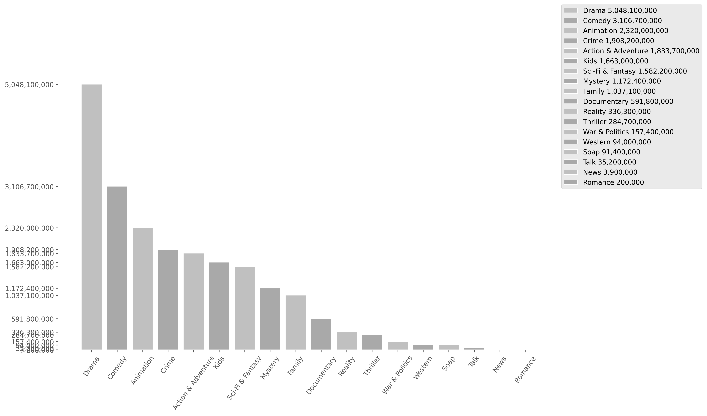
This bar chart shows the popularity of genres based on their total views. There is a small error margin due to titles with missing genre data. (This margin varies depending on the analyzed Data Dump.) Titles With No Genres: 117 Error Margin: 1.720 %
19

Slide 20
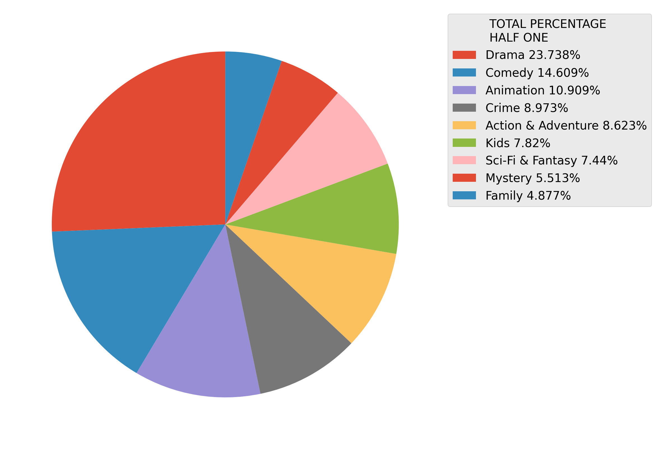
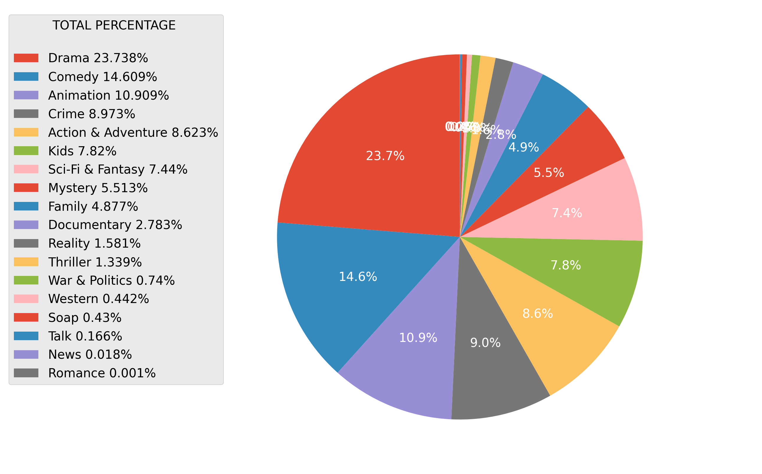
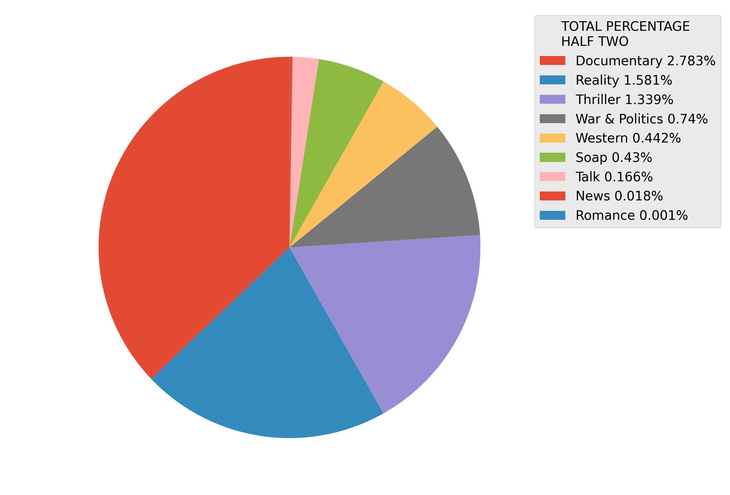
This pie charts shows the popularity of genres based on their total views. There is a full one, and to half of the same information cut in two. There is a small error margin due to titles with missing genre data. (This margin varies depending on the analyzed Data Dump.) Titles With No Genres: 117 Error Margin: 1.720 %
20

Slide 21
21
Analysis of Tv/Series Content Producing Countries Popularity
This analysis examines the popularity of producer countries in Netflix content, highlighting how productions from different countries impact the platform's global audience. Viewing trends and the impact of producer countries on user preferences nwill be analyzed.

Slide 22

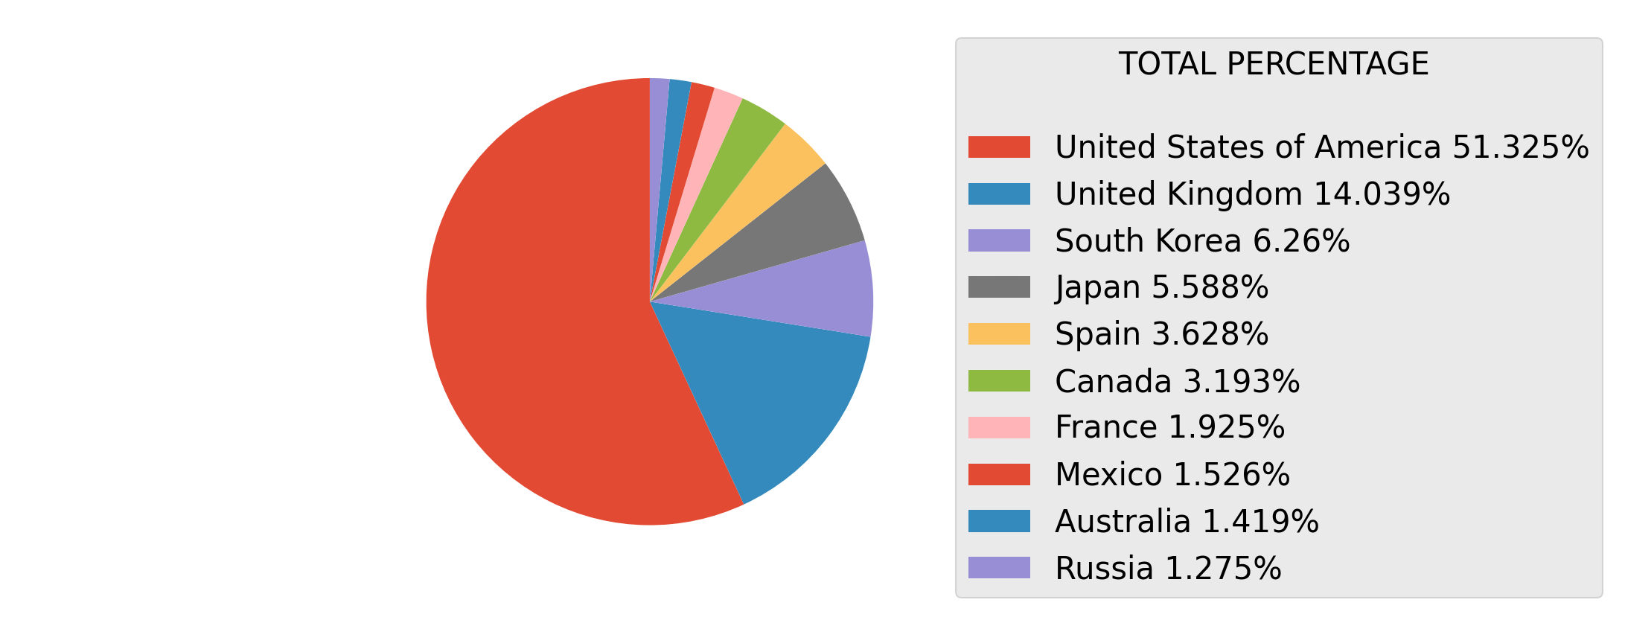
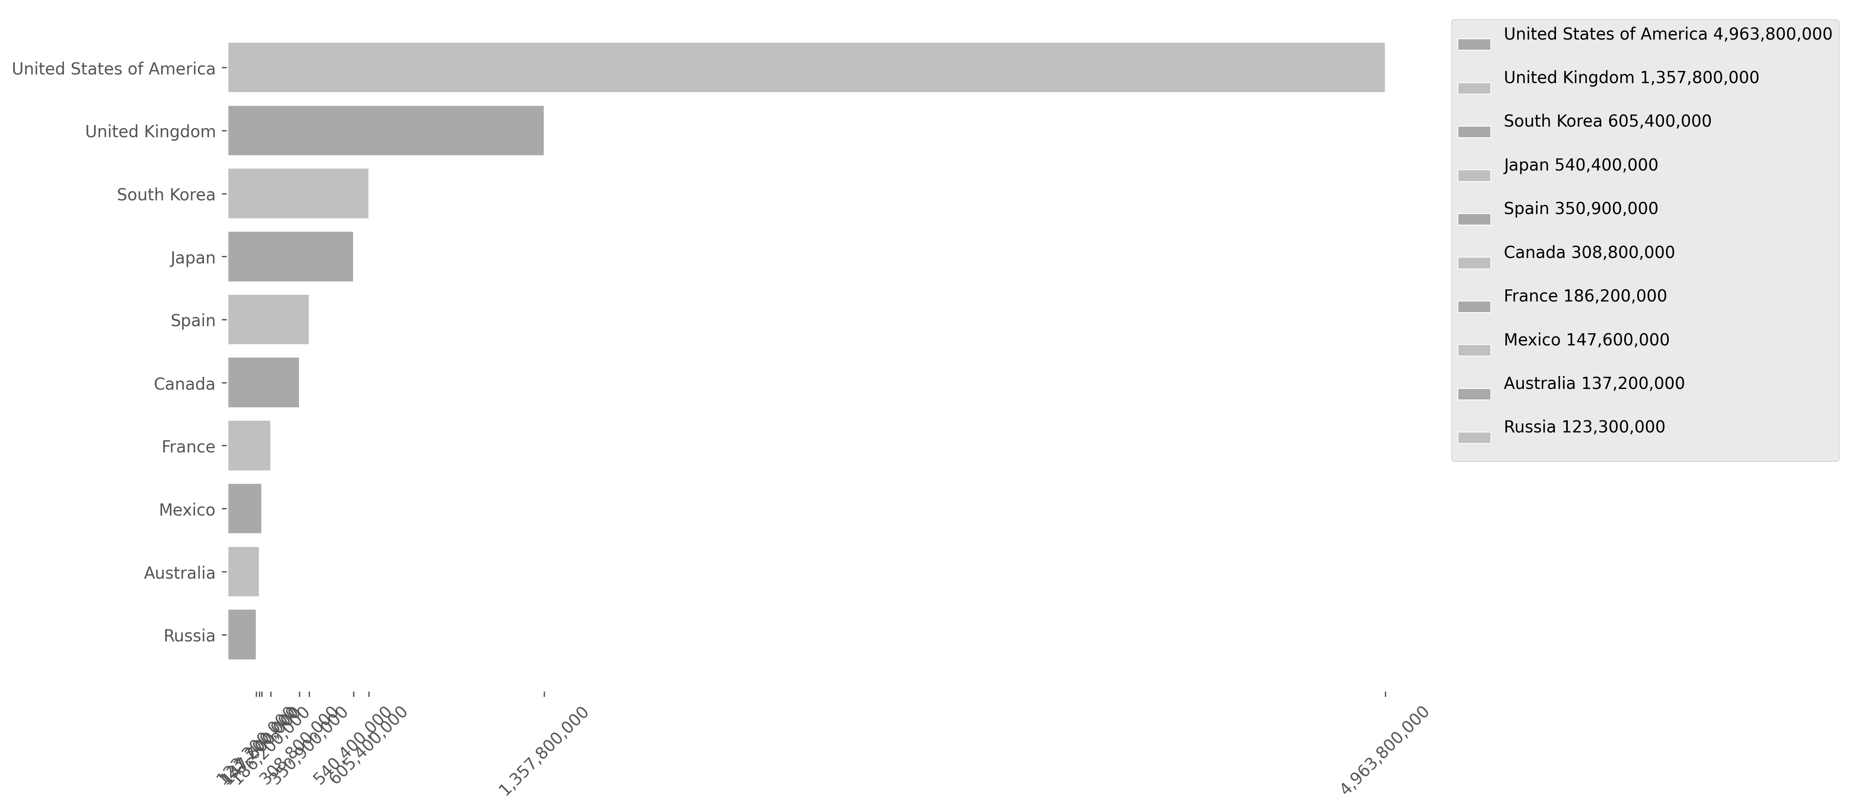
This bar and pie charts shows the popularity of the Producing Countries based on their total views. Keep in mind that the largest chart on one page is smaller than the last one on the previous page. There is a small error margin due to titles with missing countries data. (This margin varies depending on the analyzed Data Dump.) Titles With No Genres: 465 Error Margin: 6.837 %
22

Slide 23
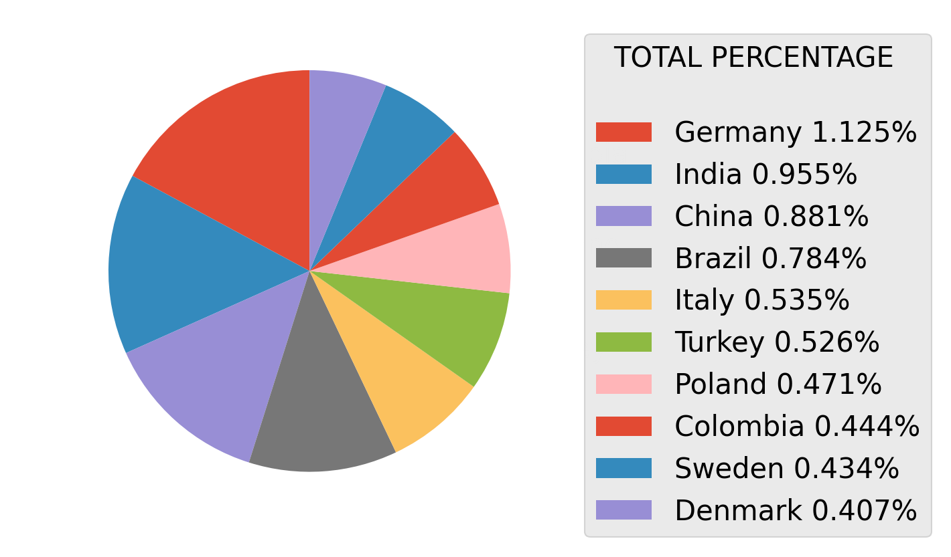
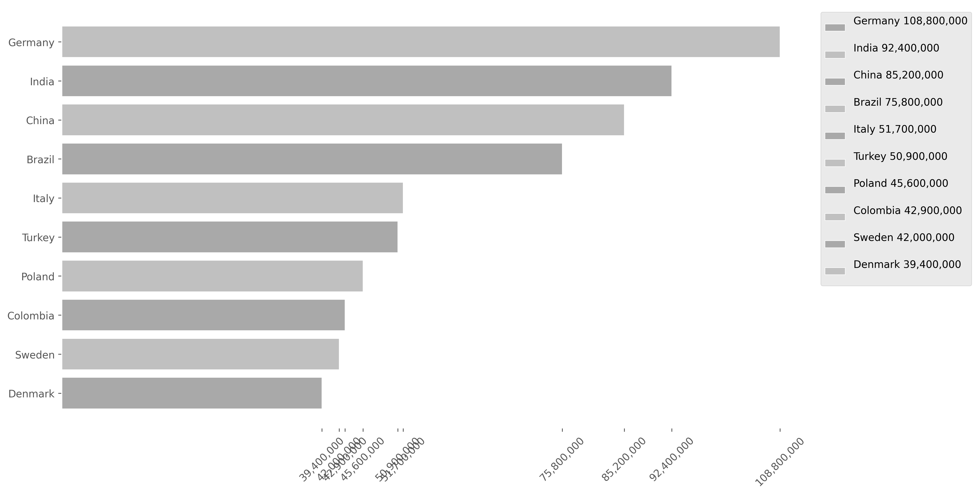
This bar and pie charts shows the popularity of the Producing Countries based on their total views. Keep in mind that the largest chart on one page is smaller than the last one on the previous page. There is a small error margin due to titles with missing countries data. (This margin varies depending on the analyzed Data Dump.) Titles With No Genres: 465 Error Margin: 6.837 %
23

Slide 24
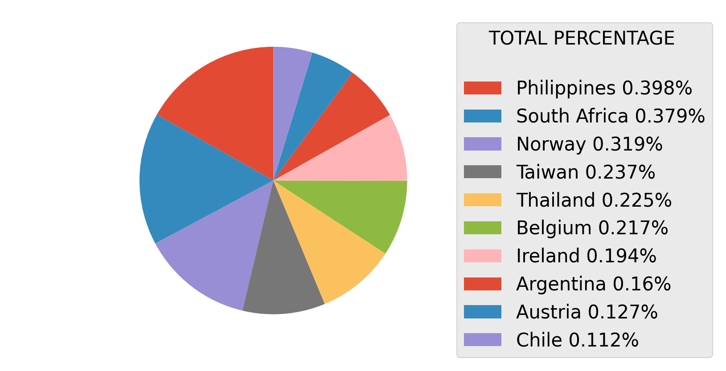
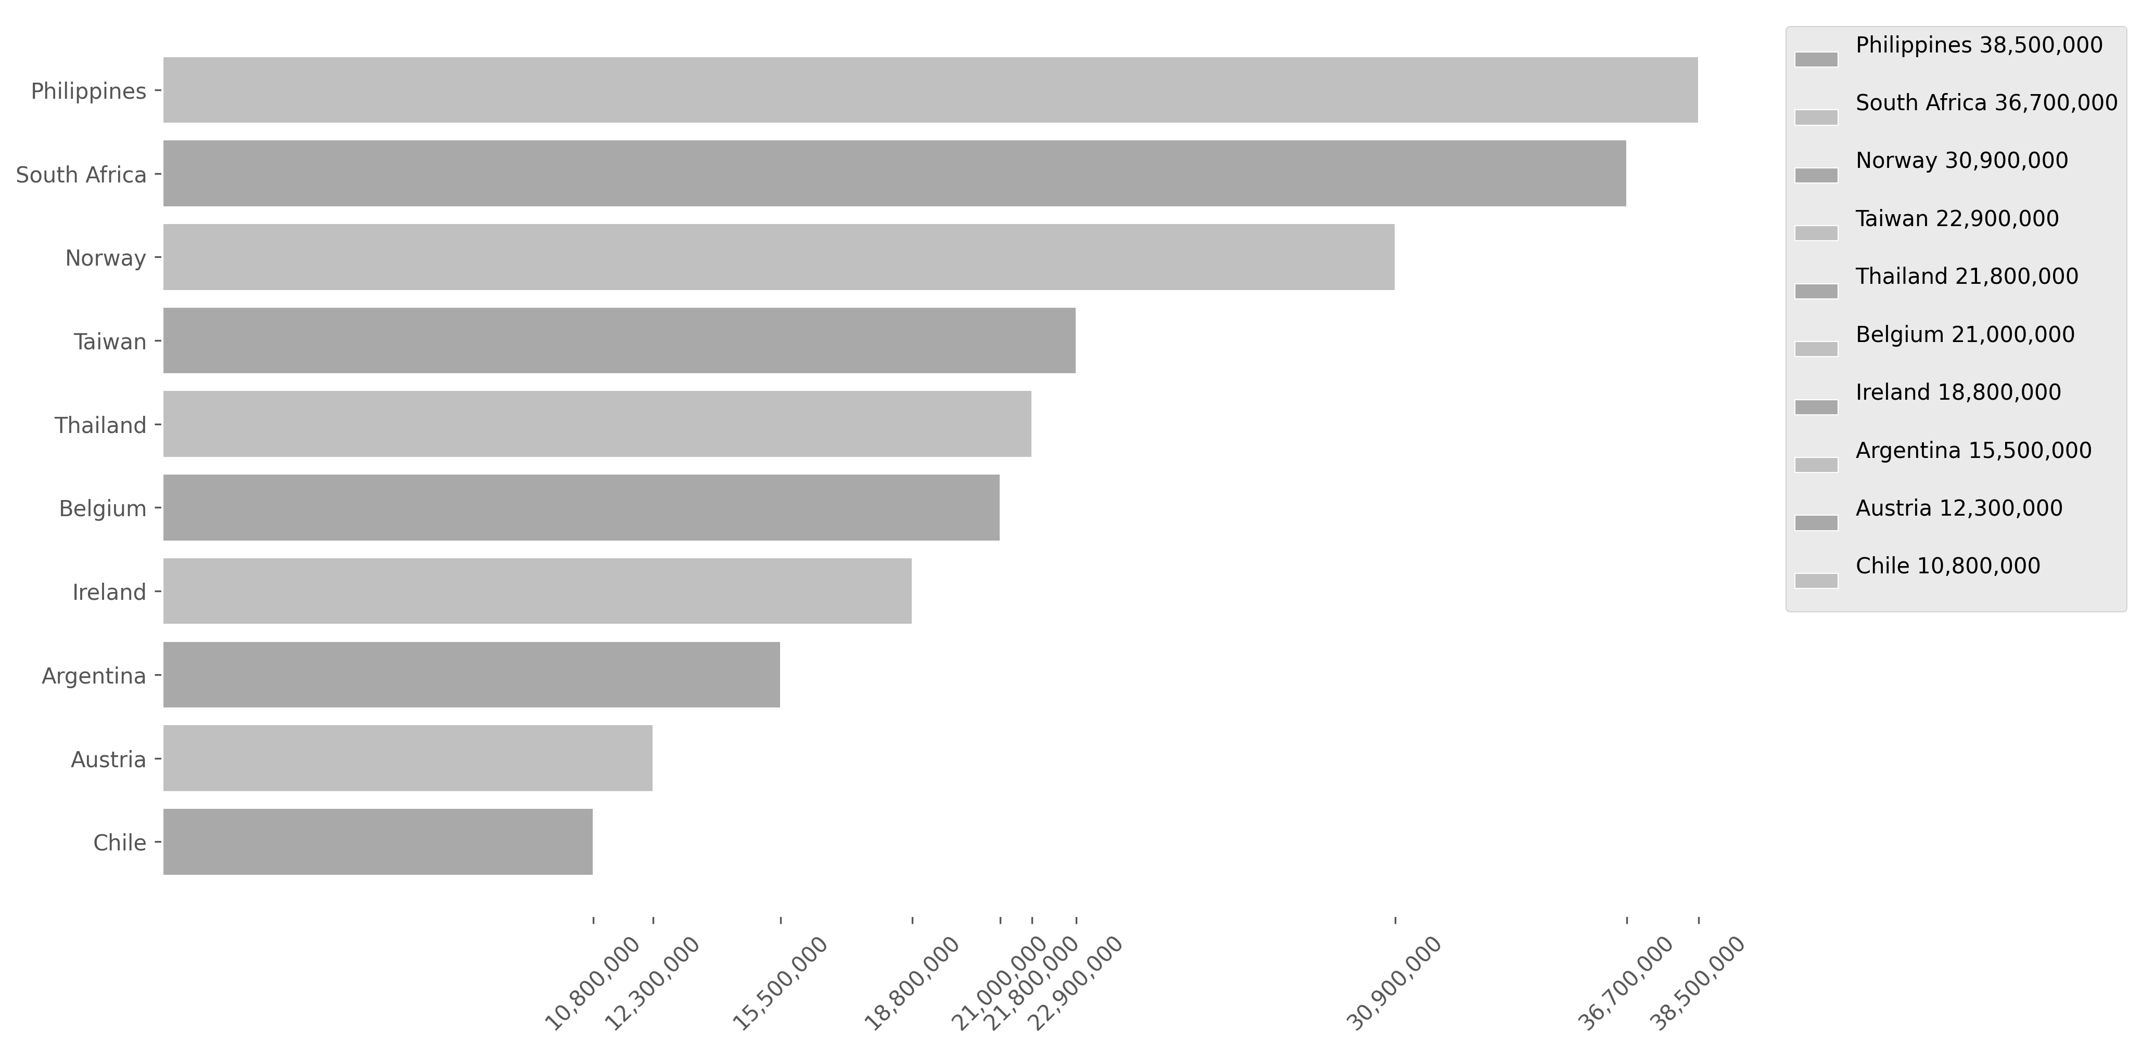
This bar and pie charts shows the popularity of the Producing Countries based on their total views. Keep in mind that the largest chart on one page is smaller than the last one on the previous page. There is a small error margin due to titles with missing countries data. (This margin varies depending on the analyzed Data Dump.) Titles With No Genres: 465 Error Margin: 6.837 %
24

Slide 25
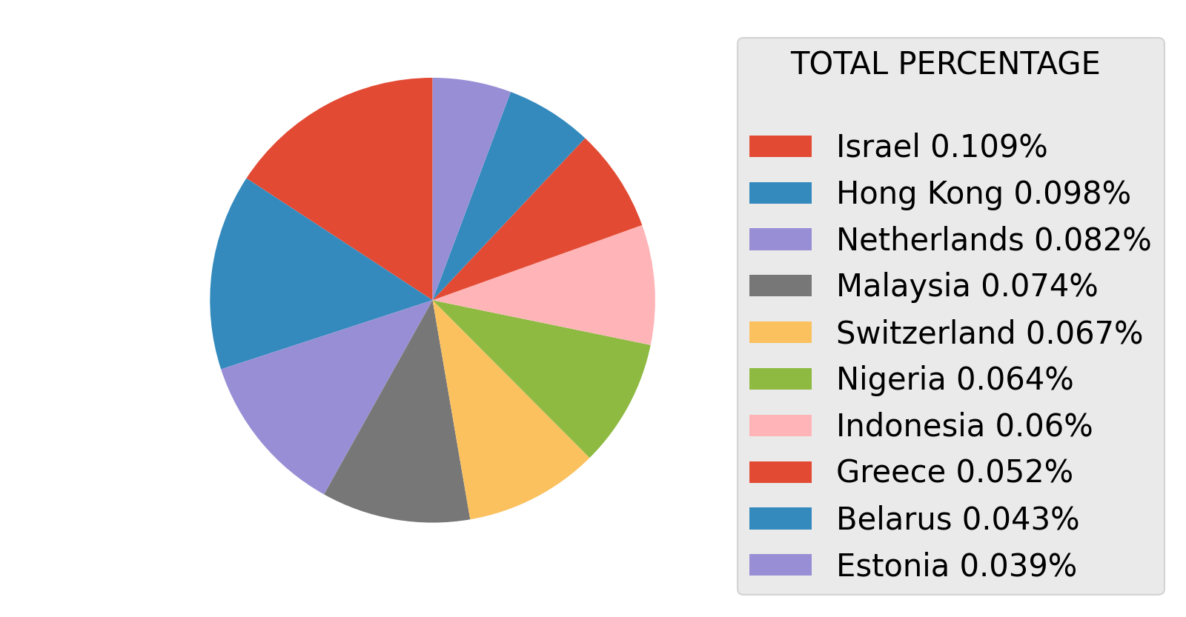
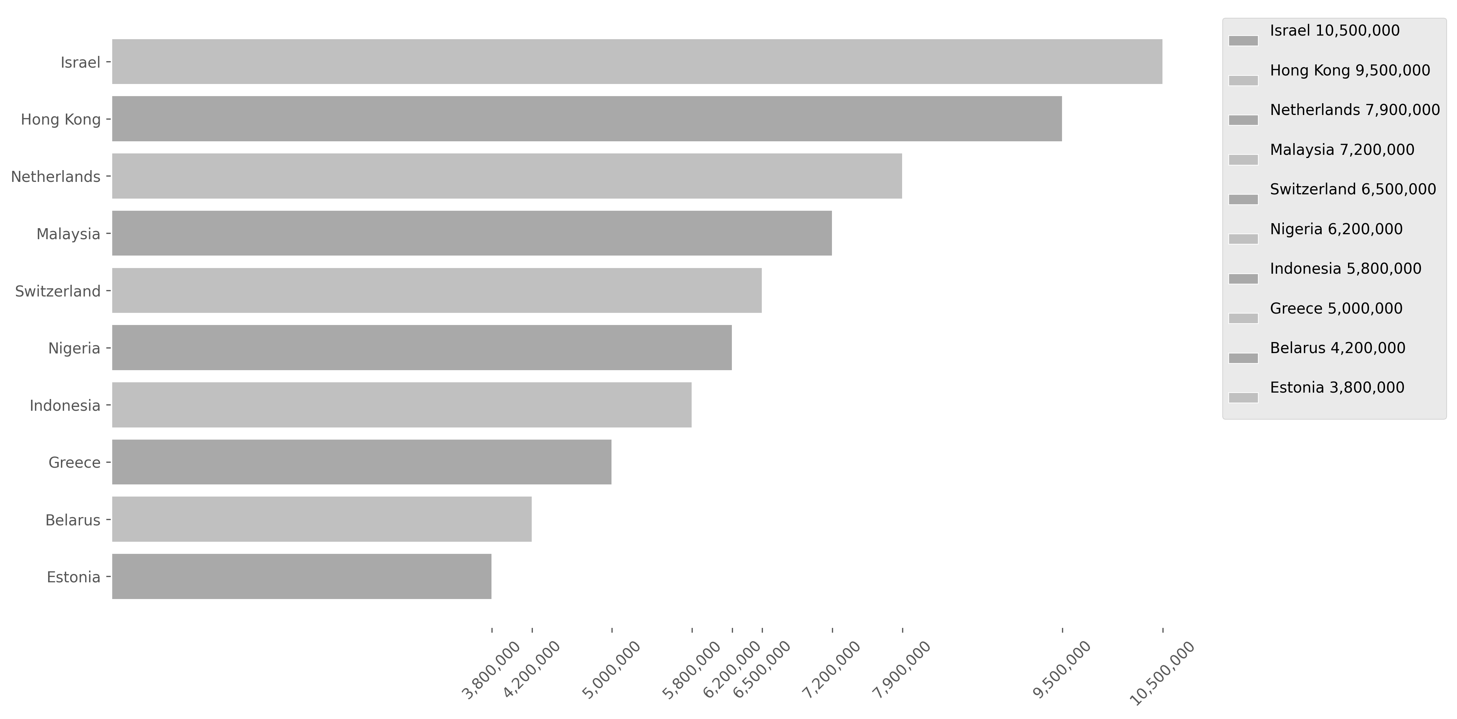
This bar and pie charts shows the popularity of the Producing Countries based on their total views. Keep in mind that the largest chart on one page is smaller than the last one on the previous page. There is a small error margin due to titles with missing countries data. (This margin varies depending on the analyzed Data Dump.) Titles With No Genres: 465 Error Margin: 6.837 %
25

Slide 26
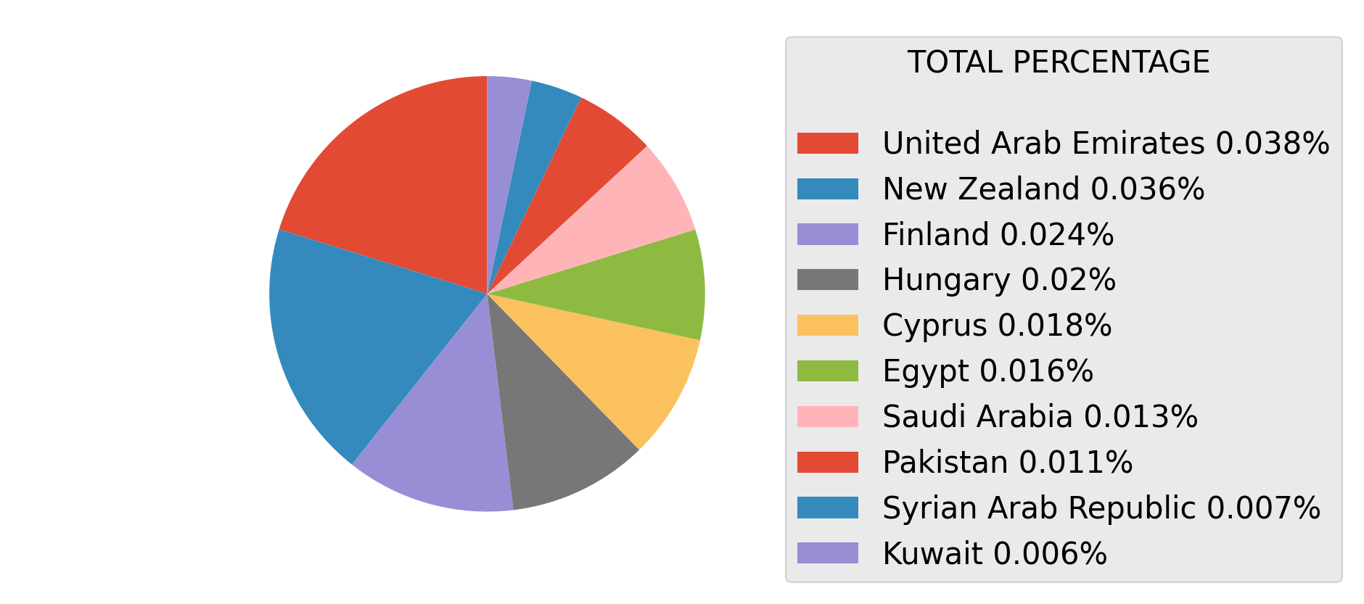
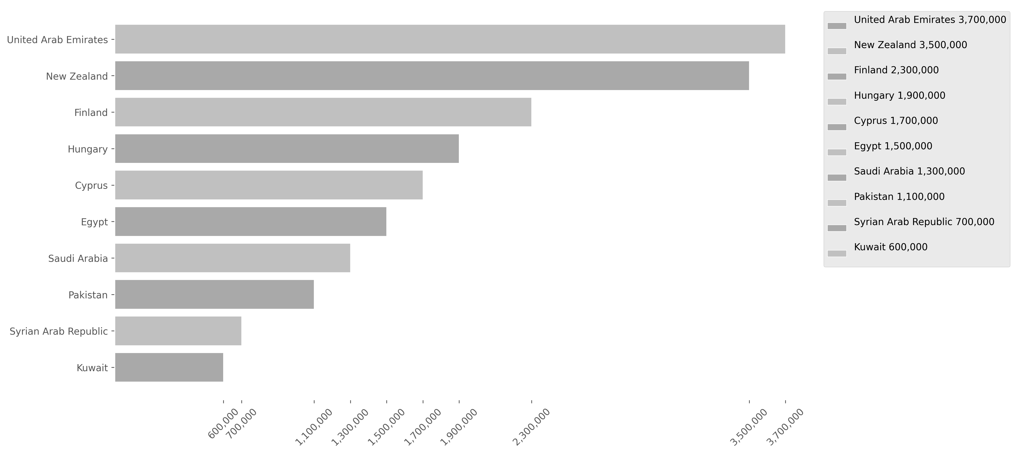
This bar and pie charts shows the popularity of the Producing Countries based on their total views. Keep in mind that the largest chart on one page is smaller than the last one on the previous page. There is a small error margin due to titles with missing countries data. (This margin varies depending on the analyzed Data Dump.) Titles With No Genres: 465 Error Margin: 6.837 %
26

Slide 27
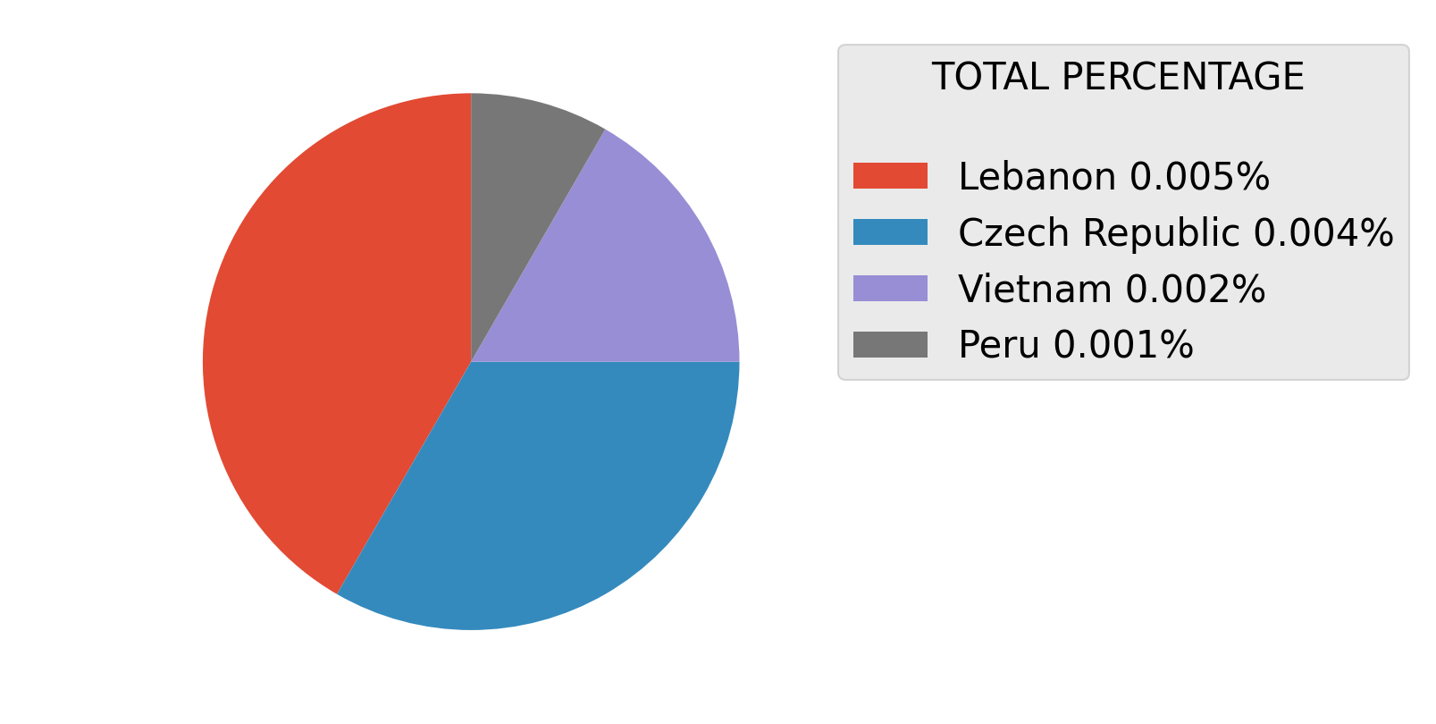
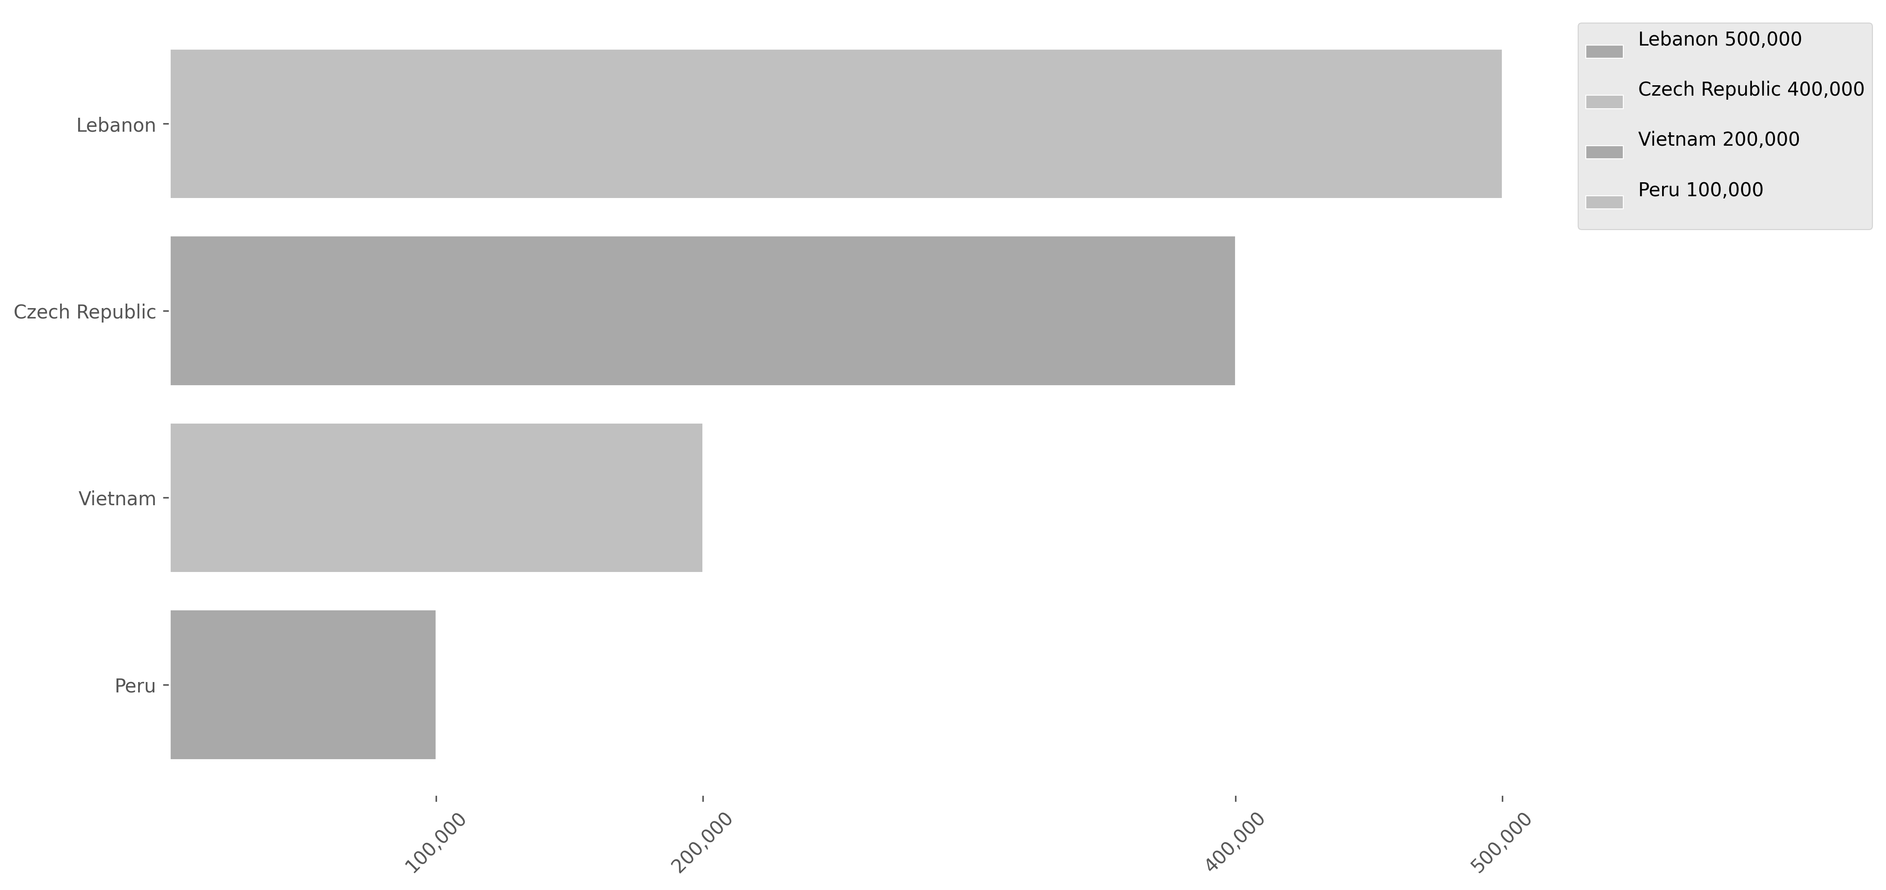
This bar and pie charts shows the popularity of the Producing Countries based on their total views. Keep in mind that the largest chart on one page is smaller than the last one on the previous page. There is a small error margin due to titles with missing countries data. (This margin varies depending on the analyzed Data Dump.) Titles With No Genres: 465 Error Margin: 6.837 %
27

Slide 28

28
Analysis of Tv/Series Content Relationship Between Duration and Playback Popularity
This analysis examines the relationship between content duration and its popularity on Netflix. Averages of playback times will be calculated, and the number of views within each interval will be evaluated. The results will be presented in bar and scatter plots to illustrate these trends.

Slide 29
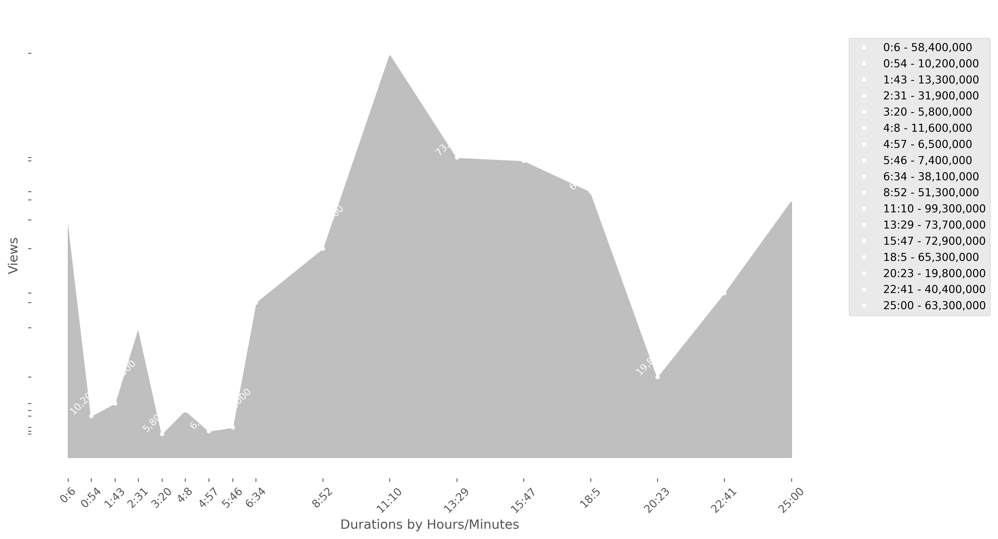
This line chart shows how popularity varies according to content duration, identifying trends as playback times change. It provides a clear view of the relationship between duration and the number of views over time.
29

Slide 30
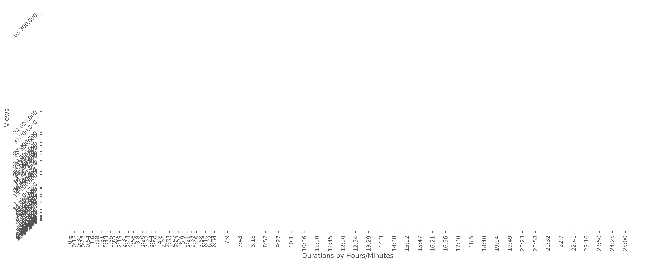
This scatter plot expands the analysis by showing the relationship between popularity and content duration, but with more reference points. By including more averages, it provides a more detailed and precise view of viewing trends across different time intervals.
30

Slide 31
The legend below details the different duration averages analyzed in the scatter plot, associating each point with a specific time interval to facilitate the interpretation of trends. The number of views for each average corresponds to the accumulated views between the previous time in the list and the represented average. - - Time is shownby Hours/Minutes - -
The last average in the list was not included in the charts because it represents extremely long durations with very few views. Its inclusion would distort the tables and make them difficult to read clearly -> 397:33 - 61,600,000
31
0:6 - 24,700,000
2:43 - 1,800,000
5:21 - 1,200,000
10:36 - 17,100,000
18:5 - 21,500,000
397:33 - 61,600,000
0:18 - 16,800,000
2:56 - 23,800,000
5:33 - 1,700,000
11:10 - 27,100,000
18:40 - 22,000,000
0:30 - 8,400,000
3:8 - 3,700,000
5:46 - 1,300,000
11:45 - 18,900,000
19:14 - 10,900,000
0:42 - 8,500,000
3:20 - 1,700,000
5:58 - 1,500,000
12:20 - 19,300,000
19:49 - 10,900,000
0:54 - 1,200,000
3:32 - 1,200,000
6:10 - 2,500,000
12:54 - 34,000,000
20:23 - 6,600,000
1:6 - 2,600,000
3:44 - 1,700,000
6:22 - 2,100,000
13:29 - 9,600,000
20:58 - 4,700,000
1:18 - 1,800,000
3:56 - 1,200,000
6:34 - 12,600,000
14:3 - 21,200,000
21:32 - 1,900,000
1:31 - 4,600,000
4:8 - 2,800,000
7:9 - 7,100,000
14:38 - 15,100,000
22:7 - 6,600,000
1:43 - 1,800,000
4:21 - 1,700,000
7:43 - 7,200,000
15:12 - 27,800,000
22:41 - 2,300,000
1:55 - 7,400,000
4:33 - 1,200,000
8:18 - 11,200,000
15:47 - 16,800,000
23:16 - 31,200,000
2:7 - 1,600,000
4:45 - 5,900,000
8:52 - 9,100,000
16:21 - 16,700,000
23:50 - 2,800,000
2:19 - 2,500,000
4:57 - 2,100,000
9:27 - 4,100,000
16:56 - 16,000,000
24:25 - 4,100,000
2:31 - 2,600,000
5:9 - 1,500,000
10:1 - 21,000,000
17:30 - 23,400,000
25:00 - 63,300,000

Slide 32
32
Analysis of Movies Content Top50_Most_Viewed
This analysis highlights the 50 most-viewed titles on Netflix, offering insights into the platform's top-performing content. These selections reflect audience preferences and showcase the titles that have captivated viewers worldwide.

Slide 33

























33
1
Views: 143,800,000 Title: Damsel Runtime: 1:50 Votes: 7.063 Reproduced Hours: 263,700,000 Country: United States of America Genres: Fantasy, Action, Adventure
2
Views: 129,400,000 Title: Lift Runtime: 1:47 Votes: 6.481 Reproduced Hours: 230,800,000 Country: United States of America Genres: Crime, Comedy, Action
3
Views: 103,800,000 Title: Society of the Snow // La sociedad de la nieve Runtime: 2:26 Votes: 8.021 Reproduced Hours: 252,500,000 Country: Spain Genres: Drama, History
4
Views: 84,700,000 Title: Under Paris // Sous la Seine Runtime: 1:44 Votes: 5.998 Reproduced Hours: 146,800,000 Country: France Genres: Drama, Action, Horror, Thriller
5
Views: 80,300,000 Title: The Super Mario Bros. Movie Runtime: 1:32 Votes: 7.642 Reproduced Hours: 123,100,000 Country: United States of America Genres: Comedy, Family, Animation, Fantasy, Adventure
6
Views: 77,700,000 Title: Mother of the Bride Runtime: 1:30 Votes: 5.907 Reproduced Hours: 116,500,000 Country: United States of America Genres: Comedy, Romance
7
Views: 77,100,000 Title: Atlas Runtime: 2:00 Votes: 6.8 Reproduced Hours: 154,200,000 Country: United States of America Genres: Action, Science Fiction
8
Views: 72,700,000 Title: Minions Runtime: 1:31 Votes: 6.412 Reproduced Hours: 110,200,000 Country: United States of America Genres: Comedy, Family, Animation, Adventure
9
Views: 72,100,000 Title: Irish Wish Runtime: 1:34 Votes: 6.213 Reproduced Hours: 113,000,000 Country: United States of America Genres: Comedy, Romance, Fantasy
10
Views: 63,600,000 Title: The Boss Baby Runtime: 1:38 Votes: 6.4 Reproduced Hours: 103,800,000 Country: United States of America Genres: Comedy, Family, Animation
11
Views: 61,600,000 Title: Despicable Me 3 Runtime: 1:30 Votes: 6.469 Reproduced Hours: 92,400,000 Country: United States of America Genres: Comedy, Family, Animation, Action, Adventure
12
Views: 57,400,000 Title: Woody Woodpecker Goes to Camp Runtime: 1:40 Votes: 6.525 Reproduced Hours: 95,600,000 Country: United States of America Genres: Comedy, Family, Animation
13
Views: 56,900,000 Title: Shrek Runtime: 1:30 Votes: 7.7 Reproduced Hours: 85,300,000 Country: United States of America Genres: Comedy, Family, Animation, Fantasy, Adventure
14
Views: 55,800,000 Title: Rebel Moon — Part Two: The Scargiver Runtime: 2:04 Votes: 6.1 Reproduced Hours: 115,300,000 Country: United States of America Genres: Action, Science Fiction
15
Views: 54,200,000 Title: Rebel Moon — Part One: A Child of Fire Runtime: 2:16 Votes: 6.309 Reproduced Hours: 122,800,000 Country: United States of America Genres: Drama, Action, Science Fiction, War
16
Views: 53,900,000 Title: Leo Runtime: 1:47 Votes: 7.477 Reproduced Hours: 96,200,000 Country: United States of America Genres: Comedy, Family, Animation
17
Views: 53,600,000 Title: Badland Hunters // 황야 Runtime: 1:49 Votes: 6.728 Reproduced Hours: 97,300,000 Country: South Korea Genres: Action, Science Fiction
18
Views: 53,500,000 Title: The Equalizer 3 Runtime: 1:49 Votes: 7.3 Reproduced Hours: 97,200,000 Country: United States of America Genres: Crime, Action, Thriller
19
Views: 52,800,000 Title: Mea Culpa Runtime: 2:00 Votes: 5.7 Reproduced Hours: 105,500,000 Country: United States of America Genres: Drama, Crime, Thriller
20
Views: 52,700,000 Title: The Tearsmith // Fabbricante di lacrime Runtime: 1:45 Votes: 6.526 Reproduced Hours: 92,200,000 Country: Italy Genres: Drama, Romance
21
Views: 52,100,000 Title: Trigger Warning Runtime: 1:47 Votes: 5.795 Reproduced Hours: 92,900,000 Country: United States of America Genres: Action
22
Views: 49,500,000 Title: The Abyss // Avgrunden Runtime: 1:43 Votes: 7.351 Reproduced Hours: 84,900,000 Country: United States of America Genres: Action, Adventure, Thriller, Science Fiction
23
Views: 47,500,000 Title: What Jennifer Did Runtime: 1:27 Votes: 6.3 Reproduced Hours: 68,900,000 Country: United Kingdom Genres: Crime, Documentary
24
Views: 47,300,000 Title: The Wages of Fear // Le salaire de la peur Runtime: 1:46 Votes: 6.231 Reproduced Hours: 83,500,000 Country: France Genres: Action
25
Views: 46,300,000 Title: Orion and the Dark Runtime: 1:33 Votes: 6.583 Reproduced Hours: 71,700,000 Country: United States of America Genres: Comedy, Family, Animation, Fantasy

Slide 34

























34
26
Views: 45,700,000 Title: Code 8 Part II Runtime: 1:40 Votes: 6.396 Reproduced Hours: 76,100,000 Country: United States of America, Canada Genres: Crime, Action, Science Fiction
27
Views: 42,700,000 Title: Trolls Runtime: 1:33 Votes: 6.6 Reproduced Hours: 66,200,000 Country: United States of America Genres: Comedy, Family, Animation, Fantasy, Adventure, Music
28
Views: 42,200,000 Title: Colors of Evil: Red // Kolory zła: Czerwień Runtime: 1:52 Votes: 6.769 Reproduced Hours: 78,700,000 Country: Poland Genres: Crime, Mystery, Thriller
29
Views: 40,500,000 Title: Leave the World Behind Runtime: 2:22 Votes: 6.426 Reproduced Hours: 95,900,000 Country: United States of America Genres: Drama, Mystery, Thriller
30
Views: 40,400,000 Title: Sing 2 Runtime: 1:50 Votes: 7.9 Reproduced Hours: 74,000,000 Country: United States of America Genres: Comedy, Family, Animation, Music
31
Views: 40,100,000 Title: Sixty Minutes // 60 Minuten Runtime: 1:30 Votes: 6.8 Reproduced Hours: 60,100,000 Country: Germany Genres: Action
32
Views: 37,100,000 Title: Top Gun: Maverick Runtime: 2:10 Votes: 7.056 Reproduced Hours: 80,400,000 Country: United States of America Genres: Drama, Action
33
Views: 36,900,000 Title: Lover, Stalker, Killer Runtime: 1:31 Votes: 6.861 Reproduced Hours: 55,900,000 Country: United Kingdom Genres: Crime, Documentary
34
Views: 36,500,000 Title: Hotel Transylvania 2 Runtime: 1:30 Votes: 6.775 Reproduced Hours: 54,700,000 Country: United States of America Genres: Comedy, Family, Animation, Fantasy
35
Views: 34,900,000 Title: Players Runtime: 1:45 Votes: 6.1 Reproduced Hours: 61,100,000 Country: United States of America Genres: Comedy, Romance
36
Views: 34,600,000 Title: Heart of the Hunter Runtime: 1:47 Votes: 6.0 Reproduced Hours: 61,700,000 Country: South Africa Genres: Action
37
Views: 34,200,000 Title: Despicable Me 2 Runtime: 1:38 Votes: 6.9 Reproduced Hours: 55,800,000 Country: United States of America Genres: Comedy, Family, Animation
38
Views: 33,600,000 Title: Sing (2016) Runtime: 1:48 Votes: 7.113 Reproduced Hours: 60,500,000 Country: United States of America Genres: Comedy, Family, Animation, Music
39
Views: 33,400,000 Title: Through My Window 3: Looking at You // A travé Runtime: 1:45 Votes: 6.889 Reproduced Hours: 58,400,000 Country: Spain Genres: Drama, Comedy, Romance
40
Views: 31,300,000 Title: Thelma the Unicorn Runtime: 1:38 Votes: 7.1 Reproduced Hours: 51,200,000 Country: United States of America Genres: Family, Animation, Fantasy
41
Views: 30,900,000 Title: Hit Man Runtime: 1:56 Votes: 6.867 Reproduced Hours: 59,800,000 Country: United States of America Genres: Crime, Comedy, Romance
42
Views: 30,600,000 Title: Dr. Seuss' The Grinch Runtime: 1:26 Votes: 5.1 Reproduced Hours: 43,900,000 Country: United States of America Genres: Family, Music
43
Views: 29,700,000 Title: Spaceman Runtime: 1:49 Votes: 6.761 Reproduced Hours: 54,000,000 Country: United States of America Genres: Drama, Adventure, Science Fiction
44
Views: 29,600,000 Title: Sonic the Hedgehog 2 Runtime: 2:04 Votes: 7.497 Reproduced Hours: 61,200,000 Country: United States of America Genres: Comedy, Family, Action, Adventure
45
Views: 29,200,000 Title: The Croods Runtime: 1:38 Votes: 6.92 Reproduced Hours: 47,700,000 Country: United States of America Genres: Comedy, Family, Animation, Fantasy, Action, Adventure
46
Views: 29,100,000 Title: We Can Be Heroes Runtime: 1:41 Votes: 6.0 Reproduced Hours: 49,000,000 Country: United States of America Genres: Comedy, Family, Fantasy, Action
47
Views: 28,500,000 Title: Ice Age: Dawn of the Dinosaurs Runtime: 1:35 Votes: 7.4 Reproduced Hours: 45,200,000 Country: United States of America Genres: Comedy, Family, Animation, Adventure
48
Views: 27,800,000 Title: No Pressure // Nic na siłę Runtime: 1:53 Votes: 7.0 Reproduced Hours: 52,400,000 Country: United Kingdom Genres: Comedy
49
Views: 27,500,000 Title: Anyone But You Runtime: 1:44 Votes: 6.945 Reproduced Hours: 47,600,000 Country: United States of America Genres: Comedy, Romance
50
Views: 27,400,000 Title: Godzilla Minus One // ゴジラ-1.0 Runtime: 2:06 Votes: 7.6 Reproduced Hours: 57,500,000 Country: Japan Genres: Action, Horror, Science Fiction

Slide 35
35
Analysis of Movies Content Top50_Most_Watched_by_Time_Played
This analysis highlights the 50 most-watched titles on Netflix by hours played, showcasing the content that keeps audiences engaged the longest. These titles reveal trends in viewer commitment and platform engagement.

Slide 36
36
1
Views: 143,800,000 Title: Damsel Runtime: 1:50 Votes: 7.063 Reproduced Hours: 263,700,000 Country: United States of America Genres: Fantasy, Action, Adventure
2
Views: 103,800,000 Title: Society of the Snow // La sociedad de la nieve Runtime: 2:26 Votes: 8.021 Reproduced Hours: 252,500,000 Country: Spain Genres: Drama, History
3
Views: 129,400,000 Title: Lift Runtime: 1:47 Votes: 6.481 Reproduced Hours: 230,800,000 Country: United States of America Genres: Crime, Comedy, Action
4
Views: 77,100,000 Title: Atlas Runtime: 2:00 Votes: 6.8 Reproduced Hours: 154,200,000 Country: United States of America Genres: Action, Science Fiction
5
Views: 84,700,000 Title: Under Paris // Sous la Seine Runtime: 1:44 Votes: 5.998 Reproduced Hours: 146,800,000 Country: France Genres: Drama, Action, Horror, Thriller
6
Views: 80,300,000 Title: The Super Mario Bros. Movie Runtime: 1:32 Votes: 7.642 Reproduced Hours: 123,100,000 Country: United States of America Genres: Comedy, Family, Animation, Fantasy, Adventure
7
Views: 54,200,000 Title: Rebel Moon — Part One: A Child of Fire Runtime: 2:16 Votes: 6.309 Reproduced Hours: 122,800,000 Country: United States of America Genres: Drama, Action, Science Fiction, War
8
Views: 77,700,000 Title: Mother of the Bride Runtime: 1:30 Votes: 5.907 Reproduced Hours: 116,500,000 Country: United States of America Genres: Comedy, Romance
9
Views: 55,800,000 Title: Rebel Moon — Part Two: The Scargiver Runtime: 2:04 Votes: 6.1 Reproduced Hours: 115,300,000 Country: United States of America Genres: Action, Science Fiction
10
Views: 72,100,000 Title: Irish Wish Runtime: 1:34 Votes: 6.213 Reproduced Hours: 113,000,000 Country: United States of America Genres: Comedy, Romance, Fantasy
11
Views: 72,700,000 Title: Minions Runtime: 1:31 Votes: 6.412 Reproduced Hours: 110,200,000 Country: United States of America Genres: Comedy, Family, Animation, Adventure
12
Views: 52,800,000 Title: Mea Culpa Runtime: 2:00 Votes: 5.7 Reproduced Hours: 105,500,000 Country: United States of America Genres: Drama, Crime, Thriller
13
Views: 63,600,000 Title: The Boss Baby Runtime: 1:38 Votes: 6.4 Reproduced Hours: 103,800,000 Country: United States of America Genres: Comedy, Family, Animation
14
Views: 53,600,000 Title: Badland Hunters // 황야 Runtime: 1:49 Votes: 6.728 Reproduced Hours: 97,300,000 Country: South Korea Genres: Action, Science Fiction
15
Views: 53,500,000 Title: The Equalizer 3 Runtime: 1:49 Votes: 7.3 Reproduced Hours: 97,200,000 Country: United States of America Genres: Crime, Action, Thriller
16
Views: 53,900,000 Title: Leo Runtime: 1:47 Votes: 7.477 Reproduced Hours: 96,200,000 Country: United States of America Genres: Comedy, Family, Animation
17
Views: 40,500,000 Title: Leave the World Behind Runtime: 2:22 Votes: 6.426 Reproduced Hours: 95,900,000 Country: United States of America Genres: Drama, Mystery, Thriller
18
Views: 57,400,000 Title: Woody Woodpecker Goes to Camp Runtime: 1:40 Votes: 6.525 Reproduced Hours: 95,600,000 Country: United States of America Genres: Comedy, Family, Animation
19
Views: 52,100,000 Title: Trigger Warning Runtime: 1:47 Votes: 5.795 Reproduced Hours: 92,900,000 Country: United States of America Genres: Action
20
Views: 61,600,000 Title: Despicable Me 3 Runtime: 1:30 Votes: 6.469 Reproduced Hours: 92,400,000 Country: United States of America Genres: Comedy, Family, Animation, Action, Adventure
21
Views: 52,700,000 Title: The Tearsmith // Fabbricante di lacrime Runtime: 1:45 Votes: 6.526 Reproduced Hours: 92,200,000 Country: Italy Genres: Drama, Romance
22
Views: 56,900,000 Title: Shrek Runtime: 1:30 Votes: 7.7 Reproduced Hours: 85,300,000 Country: United States of America Genres: Comedy, Family, Animation, Fantasy, Adventure
23
Views: 49,500,000 Title: The Abyss // Avgrunden Runtime: 1:43 Votes: 7.351 Reproduced Hours: 84,900,000 Country: United States of America Genres: Action, Adventure, Thriller, Science Fiction
24
Views: 47,300,000 Title: The Wages of Fear // Le salaire de la peur Runtime: 1:46 Votes: 6.231 Reproduced Hours: 83,500,000 Country: France Genres: Action
25
Views: 37,100,000 Title: Top Gun: Maverick Runtime: 2:10 Votes: 7.056 Reproduced Hours: 80,400,000 Country: United States of America Genres: Drama, Action

Slide 37






37
26
Views: 42,200,000 Title: Colors of Evil: Red // Kolory zła: Czerwień Runtime: 1:52 Votes: 6.769 Reproduced Hours: 78,700,000 Country: Poland Genres: Crime, Mystery, Thriller
27
Views: 45,700,000 Title: Code 8 Part II Runtime: 1:40 Votes: 6.396 Reproduced Hours: 76,100,000 Country: United States of America, Canada Genres: Crime, Action, Science Fiction
28
Views: 40,400,000 Title: Sing 2 Runtime: 1:50 Votes: 7.9 Reproduced Hours: 74,000,000 Country: United States of America Genres: Comedy, Family, Animation, Music
29
Views: 21,600,000 Title: Animal // ऐनिमल Runtime: 3:21 Votes: 6.441 Reproduced Hours: 72,500,000 Country: India Genres: Drama, Crime, Action
30
Views: 46,300,000 Title: Orion and the Dark Runtime: 1:33 Votes: 6.583 Reproduced Hours: 71,700,000 Country: United States of America Genres: Comedy, Family, Animation, Fantasy
31
Views: 47,500,000 Title: What Jennifer Did Runtime: 1:27 Votes: 6.3 Reproduced Hours: 68,900,000 Country: United Kingdom Genres: Crime, Documentary
32
Views: 42,700,000 Title: Trolls Runtime: 1:33 Votes: 6.6 Reproduced Hours: 66,200,000 Country: United States of America Genres: Comedy, Family, Animation, Fantasy, Adventure, Music
33
Views: 34,600,000 Title: Heart of the Hunter Runtime: 1:47 Votes: 6.0 Reproduced Hours: 61,700,000 Country: South Africa Genres: Action
34
Views: 29,600,000 Title: Sonic the Hedgehog 2 Runtime: 2:04 Votes: 7.497 Reproduced Hours: 61,200,000 Country: United States of America Genres: Comedy, Family, Action, Adventure
35
Views: 34,900,000 Title: Players Runtime: 1:45 Votes: 6.1 Reproduced Hours: 61,100,000 Country: United States of America Genres: Comedy, Romance
36
Views: 33,600,000 Title: Sing (2016) Runtime: 1:48 Votes: 7.113 Reproduced Hours: 60,500,000 Country: United States of America Genres: Comedy, Family, Animation, Music
37
Views: 40,100,000 Title: Sixty Minutes // 60 Minuten Runtime: 1:30 Votes: 6.8 Reproduced Hours: 60,100,000 Country: Germany Genres: Action
38
Views: 30,900,000 Title: Hit Man Runtime: 1:56 Votes: 6.867 Reproduced Hours: 59,800,000 Country: United States of America Genres: Crime, Comedy, Romance
39
Views: 33,400,000 Title: Through My Window 3: Looking at You // A travé Runtime: 1:45 Votes: 6.889 Reproduced Hours: 58,400,000 Country: Spain Genres: Drama, Comedy, Romance
40
Views: 27,400,000 Title: Godzilla Minus One // ゴジラ-1.0 Runtime: 2:06 Votes: 7.6 Reproduced Hours: 57,500,000 Country: Japan Genres: Action, Horror, Science Fiction
41
Views: 22,000,000 Title: Dune (2021) Runtime: 2:35 Votes: 7.8 Reproduced Hours: 56,900,000 Country: United States of America Genres: Adventure, Science Fiction
42
Views: 36,900,000 Title: Lover, Stalker, Killer Runtime: 1:31 Votes: 6.861 Reproduced Hours: 55,900,000 Country: United Kingdom Genres: Crime, Documentary
43
Views: 34,200,000 Title: Despicable Me 2 Runtime: 1:38 Votes: 6.9 Reproduced Hours: 55,800,000 Country: United States of America Genres: Comedy, Family, Animation
44
Views: 26,600,000 Title: Extraction 2 Runtime: 2:04 Votes: 7.444 Reproduced Hours: 55,000,000 Country: United States of America Genres: Action, Thriller
45
Views: 36,500,000 Title: Hotel Transylvania 2 Runtime: 1:30 Votes: 6.775 Reproduced Hours: 54,700,000 Country: United States of America Genres: Comedy, Family, Animation, Fantasy
46
Views: 29,700,000 Title: Spaceman Runtime: 1:49 Votes: 6.761 Reproduced Hours: 54,000,000 Country: United States of America Genres: Drama, Adventure, Science Fiction
47
Views: 19,600,000 Title: Fighter // फ़ाइटर Runtime: 2:44 Votes: 5.0 Reproduced Hours: 53,600,000 Country: Sweden, Denmark Genres: Drama, Romance, Action
48
Views: 27,200,000 Title: The Mother Runtime: 1:57 Votes: 6.7 Reproduced Hours: 53,000,000 Country: United States of America Genres: Action, Thriller
49
Views: 27,200,000 Title: Madame Web Runtime: 1:56 Votes: 5.443 Reproduced Hours: 52,500,000 Country: United States of America Genres: Fantasy, Action
50
Views: 27,800,000 Title: No Pressure // Nic na siłę Runtime: 1:53 Votes: 7.0 Reproduced Hours: 52,400,000 Country: United Kingdom Genres: Comedy

Slide 38
38
Analysis of Movies Content Top50_Less_Viewed
This analysis highlights the 50 least-viewed titles on Netflix, offering a unique perspective on content that struggles to capture audience attention. These selections provide insights into underperforming trends on the platform.

Slide 39
























39
1
Views: 100,000 Title: Once Upon a Time in America Runtime: 3:49 Votes: 8.418 Reproduced Hours: 500,000 Country: United States of America, Italy Genres: Drama, Crime
2
Views: 100,000 Title: Angu Vaikuntapurathu (Malayalam) Runtime: 2:42 Votes: 6.7 Reproduced Hours: 400,000 Country: India Genres: Drama, Comedy, Action
3
Views: 100,000 Title: Baahubali 2: The Conclusion (Tamil Version) Runtime: 2:46 Votes: 7.4 Reproduced Hours: 400,000 Country: India Genres: Fantasy, Action, Adventure
4
Views: 100,000 Title: Blue Is the Warmest Color // La Vie d'Adèle : Runtime: 3:00 Votes: 7.1 Reproduced Hours: 400,000 Country: France Genres: Drama, Romance
5
Views: 100,000 Title: Das Boot: Director's Cut Runtime: 3:28 Votes: 8.1 Reproduced Hours: 400,000 Country: Germany Genres: Drama, History, War
6
Views: 100,000 Title: Jigarthanda DoubleX (Telugu) Runtime: 2:50 Votes: 7.4 Reproduced Hours: 400,000 Country: India Genres: Drama, Comedy, Action
7
Views: 100,000 Title: Petta Runtime: 2:50 Votes: 7.1 Reproduced Hours: 400,000 Country: India Genres: Drama, Action
8
Views: 100,000 Title: 1987: When the Day Comes // 1987 Runtime: 2:09 Votes: 8.1 Reproduced Hours: 300,000 Country: South Korea Genres: Drama, History, Thriller
9
Views: 100,000 Title: 2 Women // あちらにいる鬼 Runtime: 2:20 Votes: 4.5 Reproduced Hours: 300,000 Country: Poland Genres: Drama, Crime, Action
10
Views: 100,000 Title: 3:10 to Yuma Runtime: 2:02 Votes: 5.878 Reproduced Hours: 300,000 Country: Poland Genres: Drama, Romance
11
Views: 100,000 Title: A Beautiful Life // 不再讓你孤單 // 不再让你孤单 Runtime: 2:02 Votes: 6.9 Reproduced Hours: 300,000 Country: Denmark Genres: Drama, Romance, Music
12
Views: 100,000 Title: A Lion in the House: Limited Series Runtime: 3:50 Votes: 5.0 Reproduced Hours: 300,000 Country: China Genres: Drama, Action
13
Views: 100,000 Title: A Second Chance (2015) Runtime: 2:10 Votes: 6.1 Reproduced Hours: 300,000 Country: Australia Genres: Drama, Family
14
Views: 100,000 Title: A Spoiling Rain // 花腐し Runtime: 2:18 Votes: 5.3 Reproduced Hours: 300,000 Country: Japan Genres: Drama
15
Views: 100,000 Title: Aakasam (Telugu) Runtime: 2:26 Votes: None Reproduced Hours: 300,000 Country: United States of America Genres:
16
Views: 100,000 Title: ABCD 2 Runtime: 2:26 Votes: 5.5 Reproduced Hours: 300,000 Country: India Genres: Drama
17
Views: 100,000 Title: Akira (1988) Runtime: 2:04 Votes: 7.947 Reproduced Hours: 300,000 Country: Japan Genres: Animation, Action, Science Fiction
18
Views: 100,000 Title: American Hustle Runtime: 2:18 Votes: 6.853 Reproduced Hours: 300,000 Country: United States of America Genres: Drama, Crime
19
Views: 100,000 Title: Asakusa Kid // 浅草キッド Runtime: 2:03 Votes: 7.1 Reproduced Hours: 300,000 Country: Japan Genres: Drama
20
Views: 100,000 Title: Asura: The City of Madness // 아수라 Runtime: 2:13 Votes: 6.0 Reproduced Hours: 300,000 Country: India Genres: Romance, Action, Thriller
21
Views: 100,000 Title: Attarintiki Daredi Runtime: 2:49 Votes: 6.8 Reproduced Hours: 300,000 Country: India Genres: Drama, Comedy, Action
22
Views: 100,000 Title: Baahubali: The Beginning (English Version) Runtime: 2:18 Votes: 3.0 Reproduced Hours: 300,000 Country: India Genres: Comedy, Romance
23
Views: 100,000 Title: Bad Genius // ฉลาดเกมส์โกง Runtime: 2:10 Votes: 6.133 Reproduced Hours: 300,000 Country: Canada Genres: Drama, Thriller
24
Views: 100,000 Title: Belle // 竜とそばかすの姫 Runtime: 2:01 Votes: 7.2 Reproduced Hours: 300,000 Country: United Kingdom Genres: Drama
25
Views: 100,000 Title: Black Mass Runtime: 2:03 Votes: 6.515 Reproduced Hours: 300,000 Country: United Kingdom, United States of America Genres: Drama, Crime, History

Slide 40























40
26
Views: 100,000 Title: Black Rose (2018) Runtime: 2:01 Votes: 2.6 Reproduced Hours: 300,000 Country: United States of America Genres: Drama, Crime, Action, Thriller
27
Views: 100,000 Title: Blind Witness // 見えない目撃者 Runtime: 2:08 Votes: 6.0 Reproduced Hours: 300,000 Country: United States of America Genres: Mystery, Horror, Thriller, TV Movie
28
Views: 100,000 Title: Boomika (Hindi) Runtime: 2:02 Votes: 6.0 Reproduced Hours: 300,000 Country: India Genres: Mystery, Horror, Thriller
29
Views: 100,000 Title: Brother Of The Year // น้อง.พี่.ที่รัก Runtime: 2:03 Votes: 7.5 Reproduced Hours: 300,000 Country: Thailand Genres: Drama, Comedy, Romance
30
Views: 100,000 Title: Bujjigadu Made In Chennai Runtime: 2:25 Votes: 5.4 Reproduced Hours: 300,000 Country: India Genres: Drama, Romance, Action
31
Views: 100,000 Title: BuyBust Runtime: 2:08 Votes: 5.849 Reproduced Hours: 300,000 Country: Philippines Genres: Drama, Crime, Action, Thriller
32
Views: 100,000 Title: Chocolat (2000) Runtime: 2:02 Votes: 6.973 Reproduced Hours: 300,000 Country: United States of America Genres: Drama, Comedy, Romance
33
Views: 100,000 Title: Cici Runtime: 2:32 Votes: 6.429 Reproduced Hours: 300,000 Country: Turkey Genres: Drama
34
Views: 100,000 Title: Clive Davis: The Soundtrack of Our Lives Runtime: 2:04 Votes: 6.4 Reproduced Hours: 300,000 Country: United States of America Genres: Documentary, Music
35
Views: 100,000 Title: Crows: Episode Zero // クローズZERO Runtime: 2:10 Votes: None Reproduced Hours: 300,000 Country: Canada, Iran Genres: Drama
36
Views: 100,000 Title: Crows: Episode Zero II // クローズZERO II Runtime: 2:13 Votes: None Reproduced Hours: 300,000 Country: Canada, Iran Genres: Drama
37
Views: 100,000 Title: Cut Throat City Runtime: 2:04 Votes: 6.5 Reproduced Hours: 300,000 Country: United States of America Genres: Drama, Crime, Action, Thriller
38
Views: 100,000 Title: Dancing on Glass // Las niñas de cristal Runtime: 2:19 Votes: 6.2 Reproduced Hours: 300,000 Country: Spain Genres: Drama
39
Views: 100,000 Title: Decision to Leave // 헤어질 결심 Runtime: 2:18 Votes: 7.3 Reproduced Hours: 300,000 Country: South Korea Genres: Mystery, Romance, Thriller
40
Views: 100,000 Title: DSP (Telugu) Runtime: 2:24 Votes: 5.9 Reproduced Hours: 300,000 Country: India Genres: Drama, Action
41
Views: 100,000 Title: Duplicate // डुप्लीकेट Runtime: 2:45 Votes: 5.0 Reproduced Hours: 300,000 Country: India Genres: Comedy
42
Views: 100,000 Title: Dwindle Runtime: 2:06 Votes: None Reproduced Hours: 300,000 Country: Nigeria Genres:
43
Views: 100,000 Title: El niño (2014) Runtime: 2:11 Votes: 6.5 Reproduced Hours: 300,000 Country: Spain Genres: Drama, Thriller
44
Views: 100,000 Title: Everything About Her Runtime: 2:07 Votes: 8.2 Reproduced Hours: 300,000 Country: Philippines Genres: Drama, Comedy
45
Views: 100,000 Title: Game // गेम Runtime: 2:15 Votes: 5.8 Reproduced Hours: 300,000 Country: India Genres: Mystery, Thriller
46
Views: 100,000 Title: Ghost (1990) Runtime: 2:07 Votes: 7.22 Reproduced Hours: 300,000 Country: United States of America Genres: Drama, Mystery, Romance, Fantasy, Thriller
47
Views: 100,000 Title: Gonzaga - De Pai pra Filho // Gonzaga - De Pai Runtime: 2:10 Votes: 7.2 Reproduced Hours: 300,000 Country: Brazil Genres: Drama, History, Music
48
Views: 100,000 Title: Goodbye Cruel World // グッバイ・クルエル・ワールド Runtime: 2:07 Votes: 5.8 Reproduced Hours: 300,000 Country: Japan Genres: Drama, Crime, Documentary
49
Views: 100,000 Title: Guntur Kaaram (Kannada) Runtime: 2:36 Votes: 6.0 Reproduced Hours: 300,000 Country: India Genres: Drama, Action
50
Views: 100,000 Title: Guntur Kaaram (Malayalam) Runtime: 2:36 Votes: 6.0 Reproduced Hours: 300,000 Country: India Genres: Drama, Action

Slide 41
41
Analysis of Movies Content Top50_Less_Watched_by_Time_Played
This analysis highlights the 50 least-watched titles on Netflix by hours played, focusing on content with the lowest engagement. These titles reflect minimal viewer commitment and provide valuable context on platform trends.

Slide 42



















42
1
Views: 700,000 Title: Canvas Runtime: 0:09 Votes: 6.37 Reproduced Hours: 100,000 Country: United States of America Genres: Drama, Family, Animation
2
Views: 500,000 Title: Bad Exorcist: Easter // Bogdan Boner: Wielkano Runtime: 0:13 Votes: 5.3 Reproduced Hours: 100,000 Country: Poland Genres: Comedy, Animation
3
Views: 500,000 Title: Buddy Thunderstruck: The Maybe Pile Runtime: 0:12 Votes: 7.0 Reproduced Hours: 100,000 Country: United States of America Genres: Comedy, Family
4
Views: 500,000 Title: Zion Runtime: 0:12 Votes: 6.598 Reproduced Hours: 100,000 Country: United States of America Genres: Documentary
5
Views: 400,000 Title: Bad Exorcist: Christmas Eve // Bogdan Boner: W Runtime: 0:14 Votes: 5.3 Reproduced Hours: 100,000 Country: Poland Genres: Comedy, Animation
6
Views: 400,000 Title: Sitara: Let Girls Dream Runtime: 0:16 Votes: 2.0 Reproduced Hours: 100,000 Country: United States of America Genres: Drama
7
Views: 400,000 Title: The Road to El Camino: Behind the Scenes of El Runtime: 0:14 Votes: 7.0 Reproduced Hours: 100,000 Country: United States of America Genres: Documentary
8
Views: 300,000 Title: Ghosts of Sugar Land Runtime: 0:22 Votes: 5.6 Reproduced Hours: 100,000 Country: United States of America Genres: Documentary
9
Views: 300,000 Title: Heart Shot Runtime: 0:19 Votes: 5.4 Reproduced Hours: 100,000 Country: United States of America Genres: Crime, Romance
10
Views: 300,000 Title: LEGO Friends: Holiday Special Runtime: 0:22 Votes: 5.3 Reproduced Hours: 100,000 Country: United States of America Genres: Family, Animation
11
Views: 300,000 Title: Little Lunch: The Halloween Horror Story Runtime: 0:23 Votes: 3.5 Reproduced Hours: 100,000 Country: United States of America, Australia Genres: Comedy, Horror
12
Views: 300,000 Title: Making All Quiet on the Western Front // Makin Runtime: 0:18 Votes: 6.5 Reproduced Hours: 100,000 Country: Germany Genres: Documentary
13
Views: 300,000 Title: Super Monsters Save Christmas Runtime: 0:24 Votes: 6.1 Reproduced Hours: 100,000 Country: United States of America Genres: Family, Animation
14
Views: 300,000 Title: The Trader (Sovdagari) Runtime: 0:24 Votes: None Reproduced Hours: 100,000 Country: United States of America Genres:
15
Views: 300,000 Title: Thomas & Friends: Digs & Discoveries: All Trac Runtime: 0:23 Votes: 7.4 Reproduced Hours: 100,000 Country: Italy Genres: Drama, Fantasy, TV Movie
16
Views: 300,000 Title: Thomas & Friends: Digs & Discoveries: Mines of Runtime: 0:23 Votes: 7.4 Reproduced Hours: 100,000 Country: Italy Genres: Drama, Fantasy, TV Movie
17
Views: 300,000 Title: Thomas & Friends: Marvelous Machinery: A New A Runtime: 0:23 Votes: 7.4 Reproduced Hours: 100,000 Country: Italy Genres: Drama, Fantasy, TV Movie
18
Views: 300,000 Title: Thomas & Friends: Thomas and the Royal Engine Runtime: 0:23 Votes: 7.4 Reproduced Hours: 100,000 Country: Italy Genres: Drama, Fantasy, TV Movie
19
Views: 300,000 Title: Three Songs for Benazir Runtime: 0:24 Votes: 6.2 Reproduced Hours: 100,000 Country: Palestinian Territory, Afghanistan Genres: Documentary
20
Views: 300,000 Title: Weathering Runtime: 0:21 Votes: 5.1 Reproduced Hours: 100,000 Country: United States of America Genres: Thriller
21
Views: 200,000 Title: Birders // Pajareros Runtime: 0:38 Votes: 6.2 Reproduced Hours: 100,000 Country: United States of America, Mexico Genres: Documentary
22
Views: 200,000 Title: Camp Confidential: America's Secret Nazis Runtime: 0:36 Votes: 6.3 Reproduced Hours: 100,000 Country: United States of America Genres: Documentary, Animation, History
23
Views: 200,000 Title: Elf Pets: Santa’s St. Bernards Save Christmas Runtime: 0:27 Votes: 4.4 Reproduced Hours: 100,000 Country: United States of America Genres: Family, Animation
24
Views: 200,000 Title: Fanatyk Runtime: 0:33 Votes: 6.7 Reproduced Hours: 100,000 Country: Poland Genres: Drama, Comedy
25
Views: 200,000 Title: Guillermo del Toro's Pinocchio: Handcarved Cin Runtime: 0:37 Votes: 8.1 Reproduced Hours: 100,000 Country: United States of America Genres: Drama, Animation, Fantasy

Slide 43
























43
26
Views: 200,000 Title: Making The Witcher: Season 3 Runtime: 0:30 Votes: 7.1 Reproduced Hours: 100,000 Country: United Kingdom Genres: Documentary, TV Movie
27
Views: 200,000 Title: Period. End of Sentence. Runtime: 0:26 Votes: 7.9 Reproduced Hours: 100,000 Country: India Genres: Documentary
28
Views: 200,000 Title: Poacher Runtime: 0:28 Votes: None Reproduced Hours: 100,000 Country: United States of America, Australia Genres: Drama, Crime
29
Views: 200,000 Title: Pororo, Snow Fairy Adventure // 뽀로로 극장판 눈요정 마을 Runtime: 0:36 Votes: 7.5 Reproduced Hours: 100,000 Country: South Korea Genres: Family, Animation, Fantasy, Adventure
30
Views: 200,000 Title: Prince of Peoria: A Christmas Moose Miracle Runtime: 0:29 Votes: 6.1 Reproduced Hours: 100,000 Country: United States of America Genres: Comedy, Family
31
Views: 200,000 Title: Ram Dass, Going Home Runtime: 0:32 Votes: 5.6 Reproduced Hours: 100,000 Country: United States of America Genres: Documentary
32
Views: 200,000 Title: The Dreamlife of Georgie Stone Runtime: 0:30 Votes: 6.2 Reproduced Hours: 100,000 Country: Australia Genres: Documentary
33
Views: 200,000 Title: Waffles + Mochi's Holiday Feast Runtime: 0:28 Votes: 2.0 Reproduced Hours: 100,000 Country: United States of America Genres: Family
34
Views: 200,000 Title: What Would Sophia Loren Do? Runtime: 0:32 Votes: 6.7 Reproduced Hours: 100,000 Country: United States of America Genres: Documentary
35
Views: 100,000 Title: "Sr." Runtime: 1:29 Votes: 7.2 Reproduced Hours: 100,000 Country: United States of America Genres: Documentary
36
Views: 100,000 Title: #Selfie 69 Runtime: 1:59 Votes: 6.6 Reproduced Hours: 100,000 Country: Romania Genres: Comedy, Romance, Action
37
Views: 100,000 Title: 10 giorni con Babbo Natale Runtime: 1:36 Votes: 6.228 Reproduced Hours: 100,000 Country: Italy Genres: Comedy, Family
38
Views: 100,000 Title: 10 giorni senza mamma Runtime: 1:35 Votes: 6.484 Reproduced Hours: 100,000 Country: Italy Genres: Comedy, Family
39
Views: 100,000 Title: 10 Promises to My Dog // 犬と私の10の約束 Runtime: 1:57 Votes: 6.8 Reproduced Hours: 100,000 Country: Japan Genres: Drama
40
Views: 100,000 Title: 100 (2008) Runtime: 1:56 Votes: 6.647 Reproduced Hours: 100,000 Country: India Genres: Action
41
Views: 100,000 Title: 100 Days with Tata // 100 días con la Tata Runtime: 1:24 Votes: 7.1 Reproduced Hours: 100,000 Country: Spain Genres: Documentary
42
Views: 100,000 Title: 100% Coco Runtime: 1:24 Votes: 6.3 Reproduced Hours: 100,000 Country: Netherlands Genres: Comedy, Family
43
Views: 100,000 Title: 100% Coco New York Runtime: 1:22 Votes: 7.1 Reproduced Hours: 100,000 Country: Netherlands Genres: Comedy, Family
44
Views: 100,000 Title: 100% Halal Runtime: 1:41 Votes: 5.0 Reproduced Hours: 100,000 Country: Indonesia Genres: Drama
45
Views: 100,000 Title: 12 Gifts of Christmas Runtime: 1:26 Votes: 6.06 Reproduced Hours: 100,000 Country: United States of America Genres: Comedy, Family, Romance, TV Movie
46
Views: 100,000 Title: 13 Factors that Saved Apollo 13 Runtime: 1:38 Votes: 7.3 Reproduced Hours: 100,000 Country: Italy Genres: Documentary
47
Views: 100,000 Title: 13: Game of Death // 13 เกมสยอง Runtime: 1:49 Votes: 5.836 Reproduced Hours: 100,000 Country: United States of America Genres: Drama, Thriller
48
Views: 100,000 Title: 14 Blades // 錦衣衛 Runtime: 1:53 Votes: 6.3 Reproduced Hours: 100,000 Country: China, Singapore, Hong Kong Genres: Drama, Action, Thriller
49
Views: 100,000 Title: 1976 Runtime: 1:36 Votes: 7.071 Reproduced Hours: 100,000 Country: Chile Genres: Drama
50
Views: 100,000 Title: 1981 Runtime: 1:42 Votes: 6.9 Reproduced Hours: 100,000 Country: Canada Genres: Drama, Comedy, Romance

Slide 44
44
Analysis of Movies Content Genres Popularity
This analysis explores the popularity of genres across Netflix's entire catalog, using comprehensive viewership data. A bar chart highlights the total number of views for each genre, providing a clear comparison of audience preferences. Additionally, a pie chart presents the percentage share of views, offering a visual breakdown of each genre's popularity relative to the platform as a whole.

Slide 45
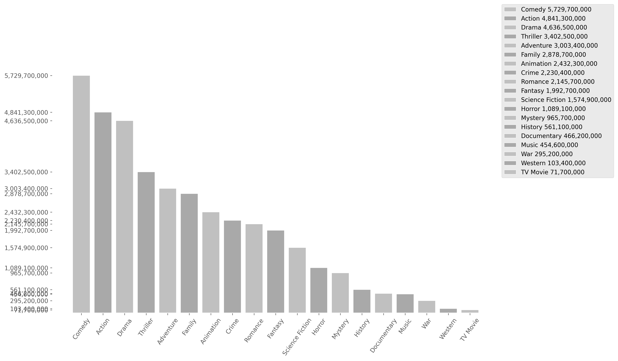
This bar chart shows the popularity of genres based on their total views. There is a small error margin due to titles with missing genre data. (This margin varies depending on the analyzed Data Dump.) Titles With No Genres: 149 Error Margin: 1.592 %
45

Slide 46
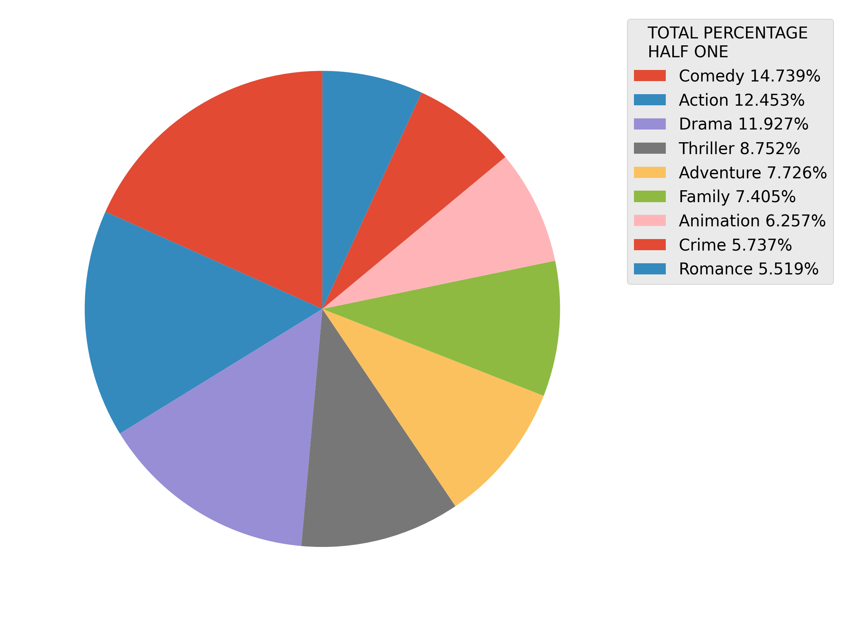
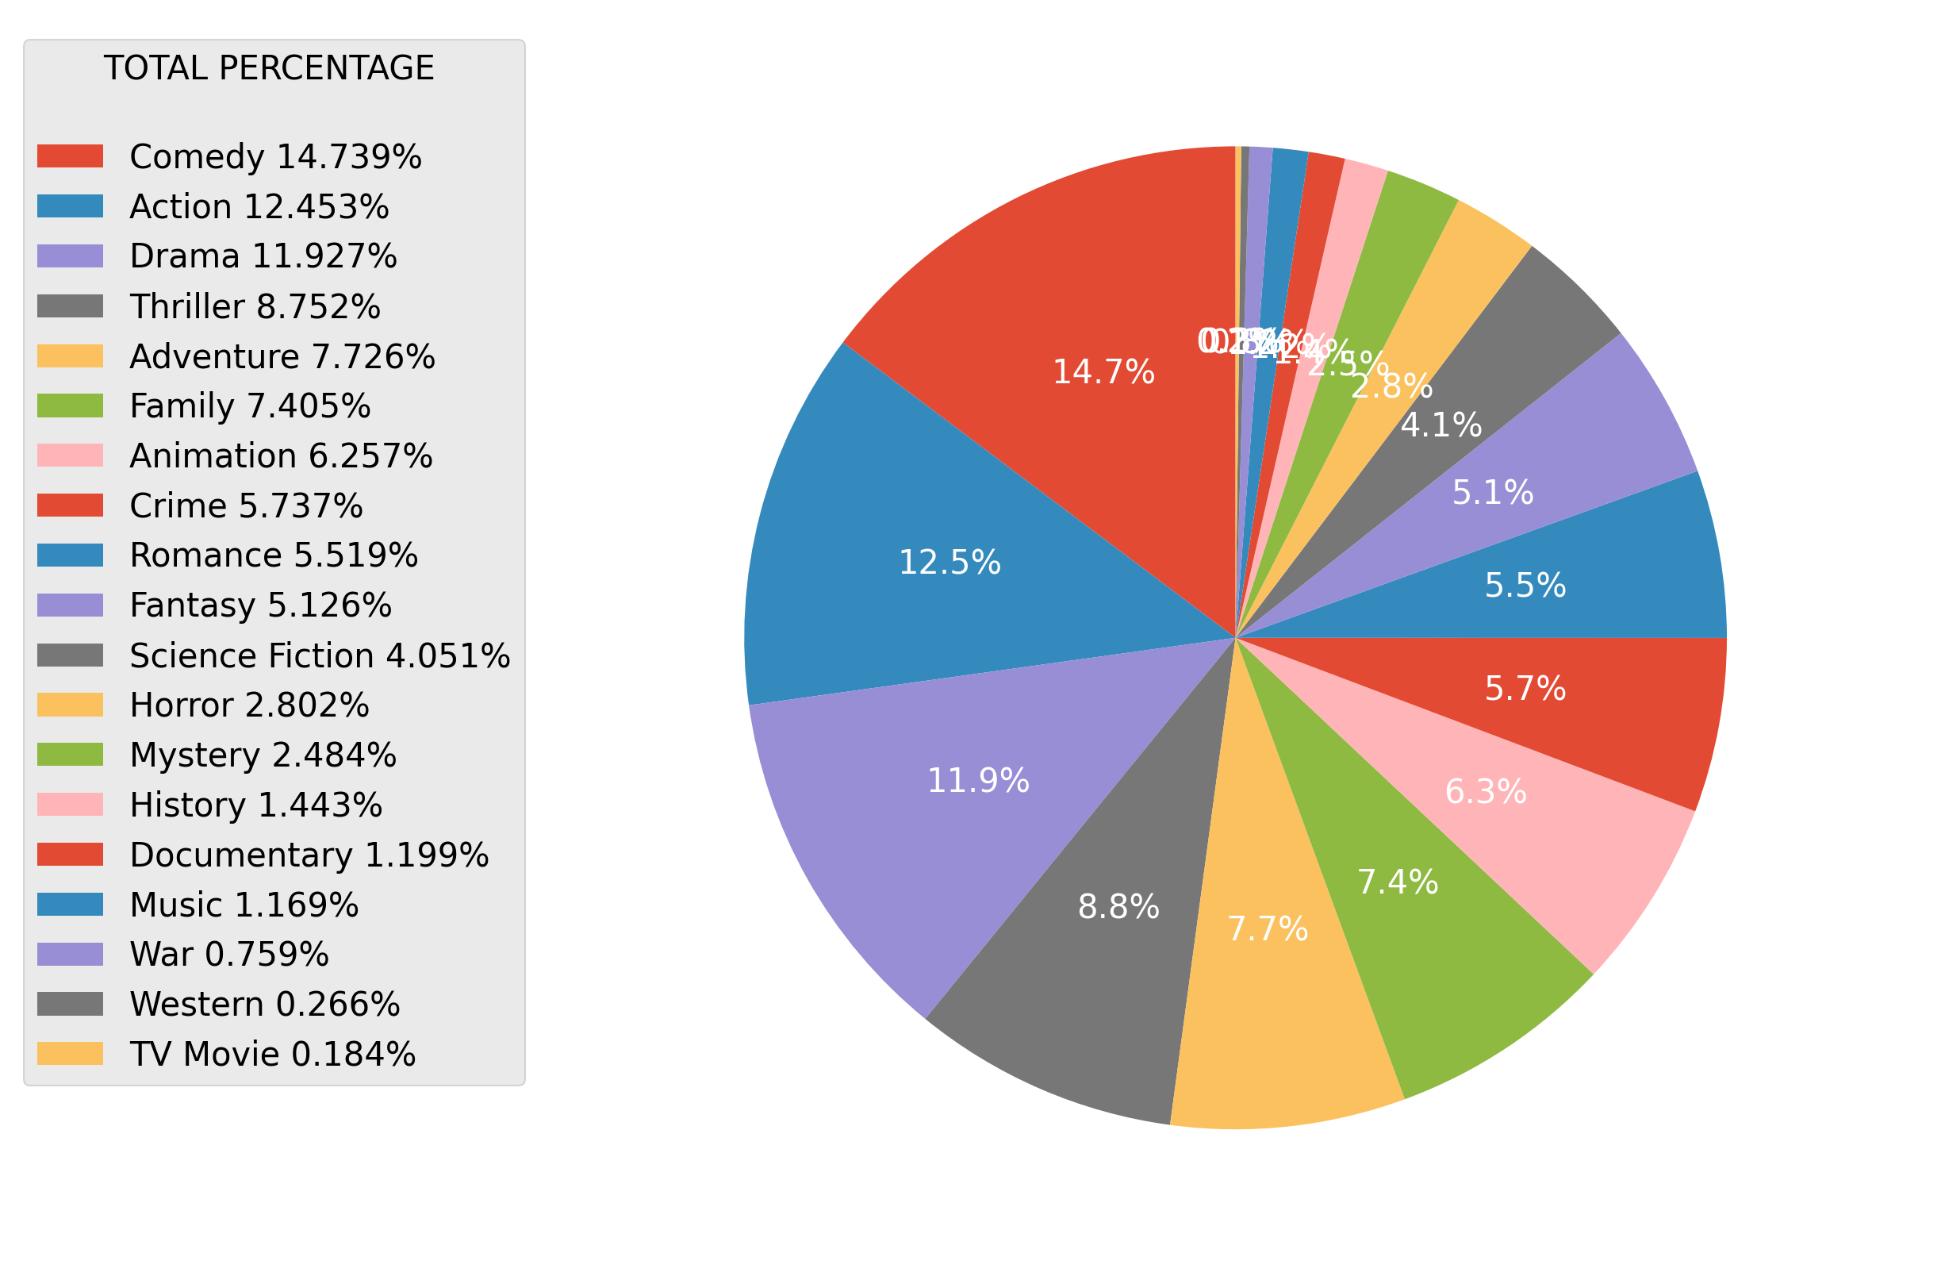
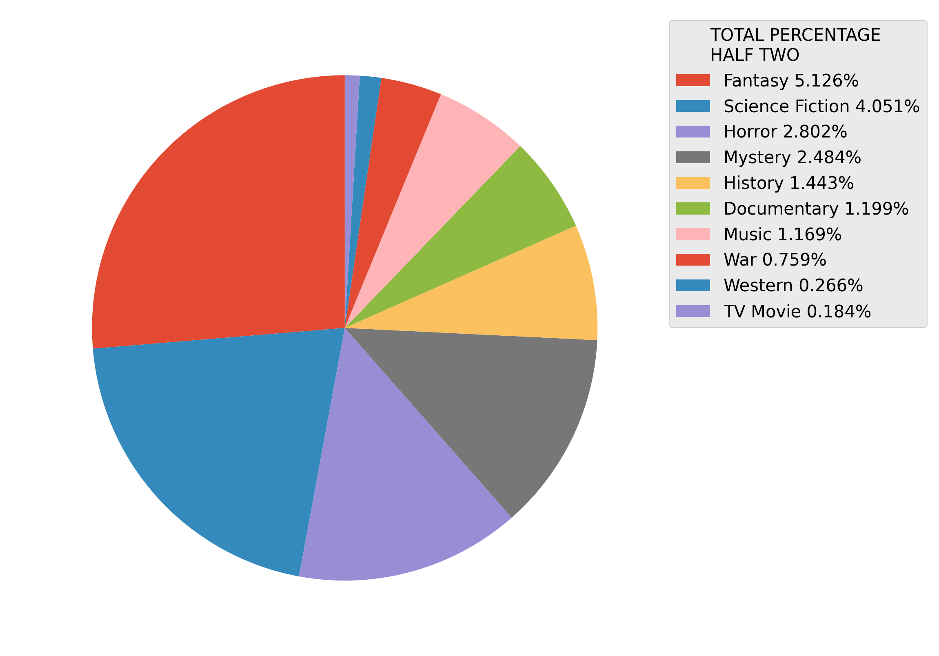
This pie charts shows the popularity of genres based on their total views. There is a full one, and to half of the same information cut in two. There is a small error margin due to titles with missing genre data. (This margin varies depending on the analyzed Data Dump.) Titles With No Genres: 149 Error Margin: 1.592 %
46

Slide 47
47
Analysis of Movies Content Producing Countries Popularity
This analysis examines the popularity of producer countries in Netflix content, highlighting how productions from different countries impact the platform's global audience. Viewing trends and the impact of producer countries on user preferences nwill be analyzed.

Slide 48
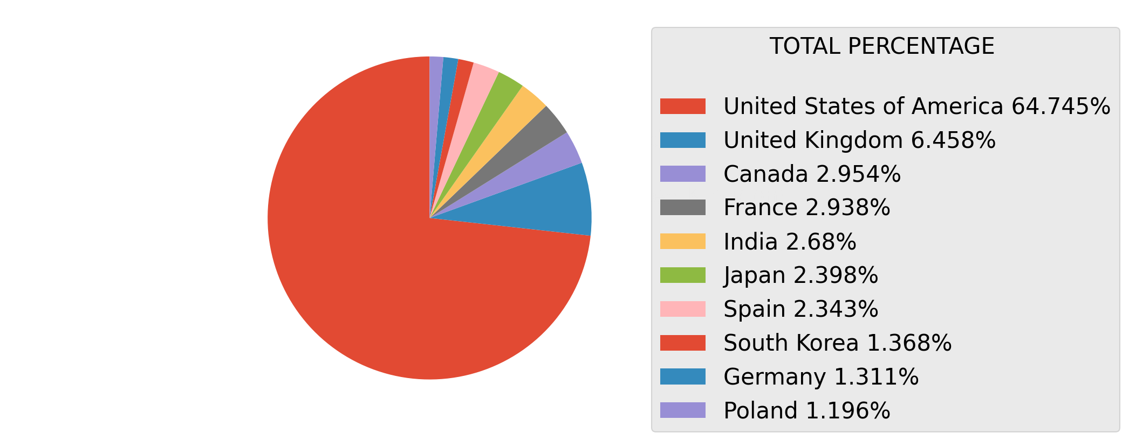
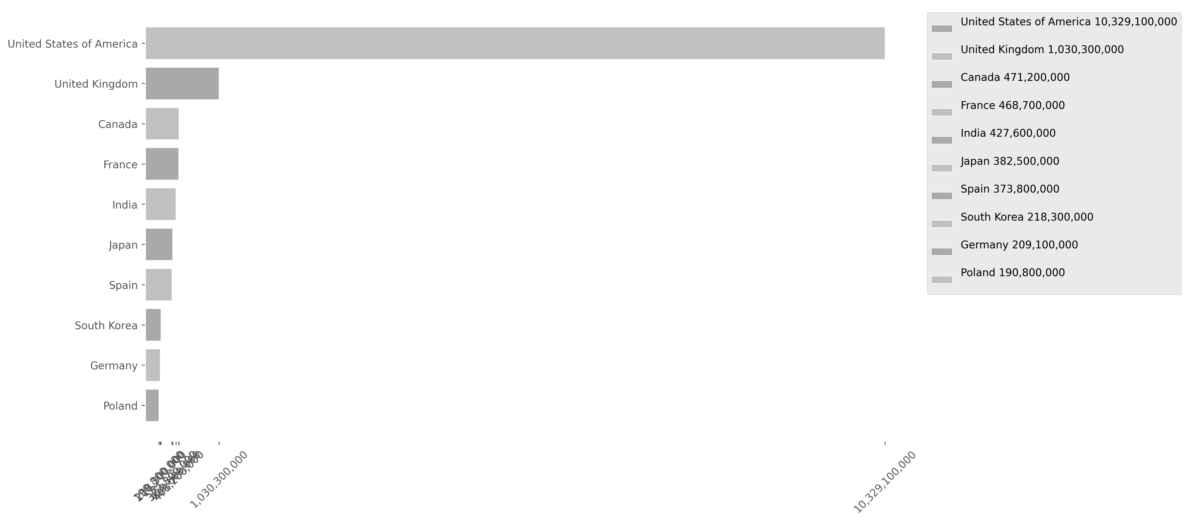
This bar and pie charts shows the popularity of the Producing Countries based on their total views. Keep in mind that the largest chart on one page is smaller than the last one on the previous page. There is a small error margin due to titles with missing countries data. (This margin varies depending on the analyzed Data Dump.) Titles With No Genres: 148 Error Margin: 1.581 %
48

Slide 49
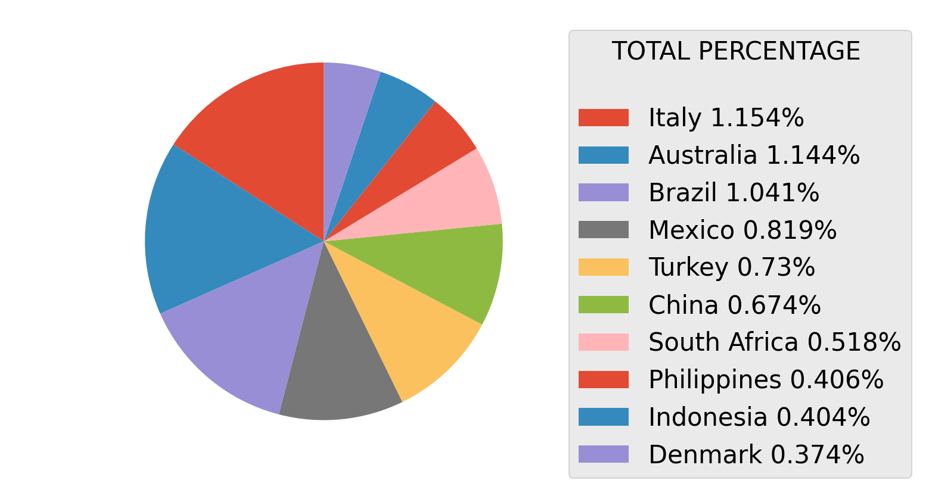
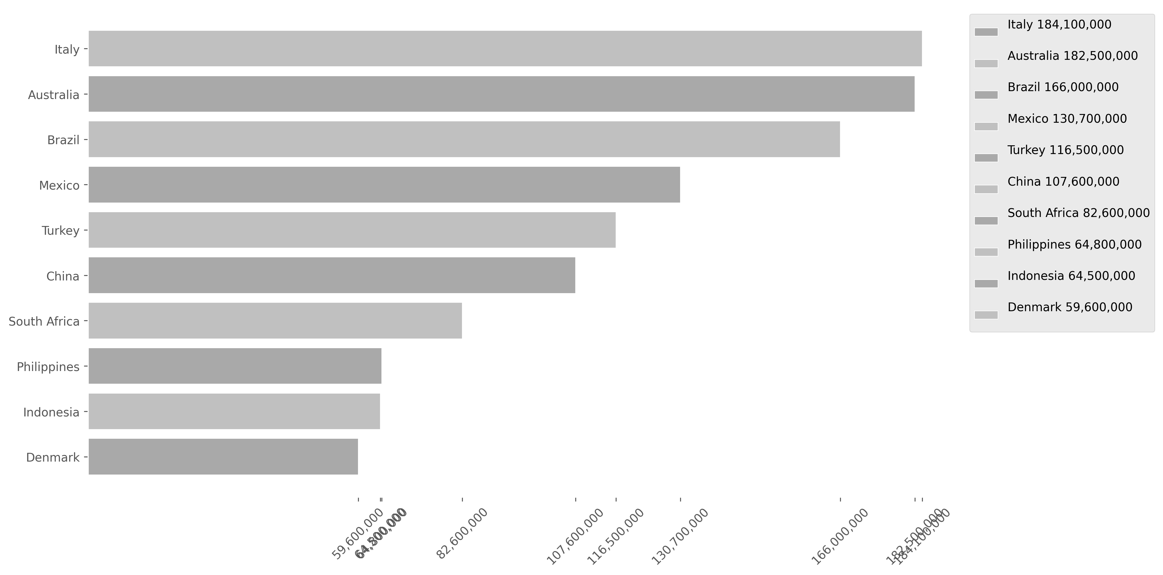
This bar and pie charts shows the popularity of the Producing Countries based on their total views. Keep in mind that the largest chart on one page is smaller than the last one on the previous page. There is a small error margin due to titles with missing countries data. (This margin varies depending on the analyzed Data Dump.) Titles With No Genres: 148 Error Margin: 1.581 %
49

Slide 50
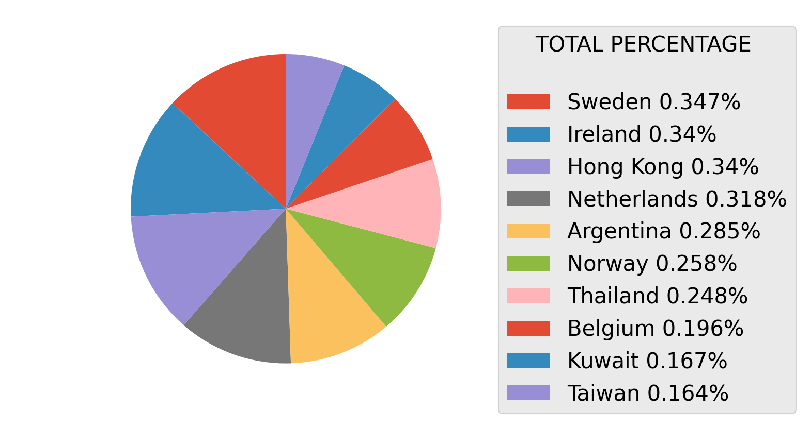
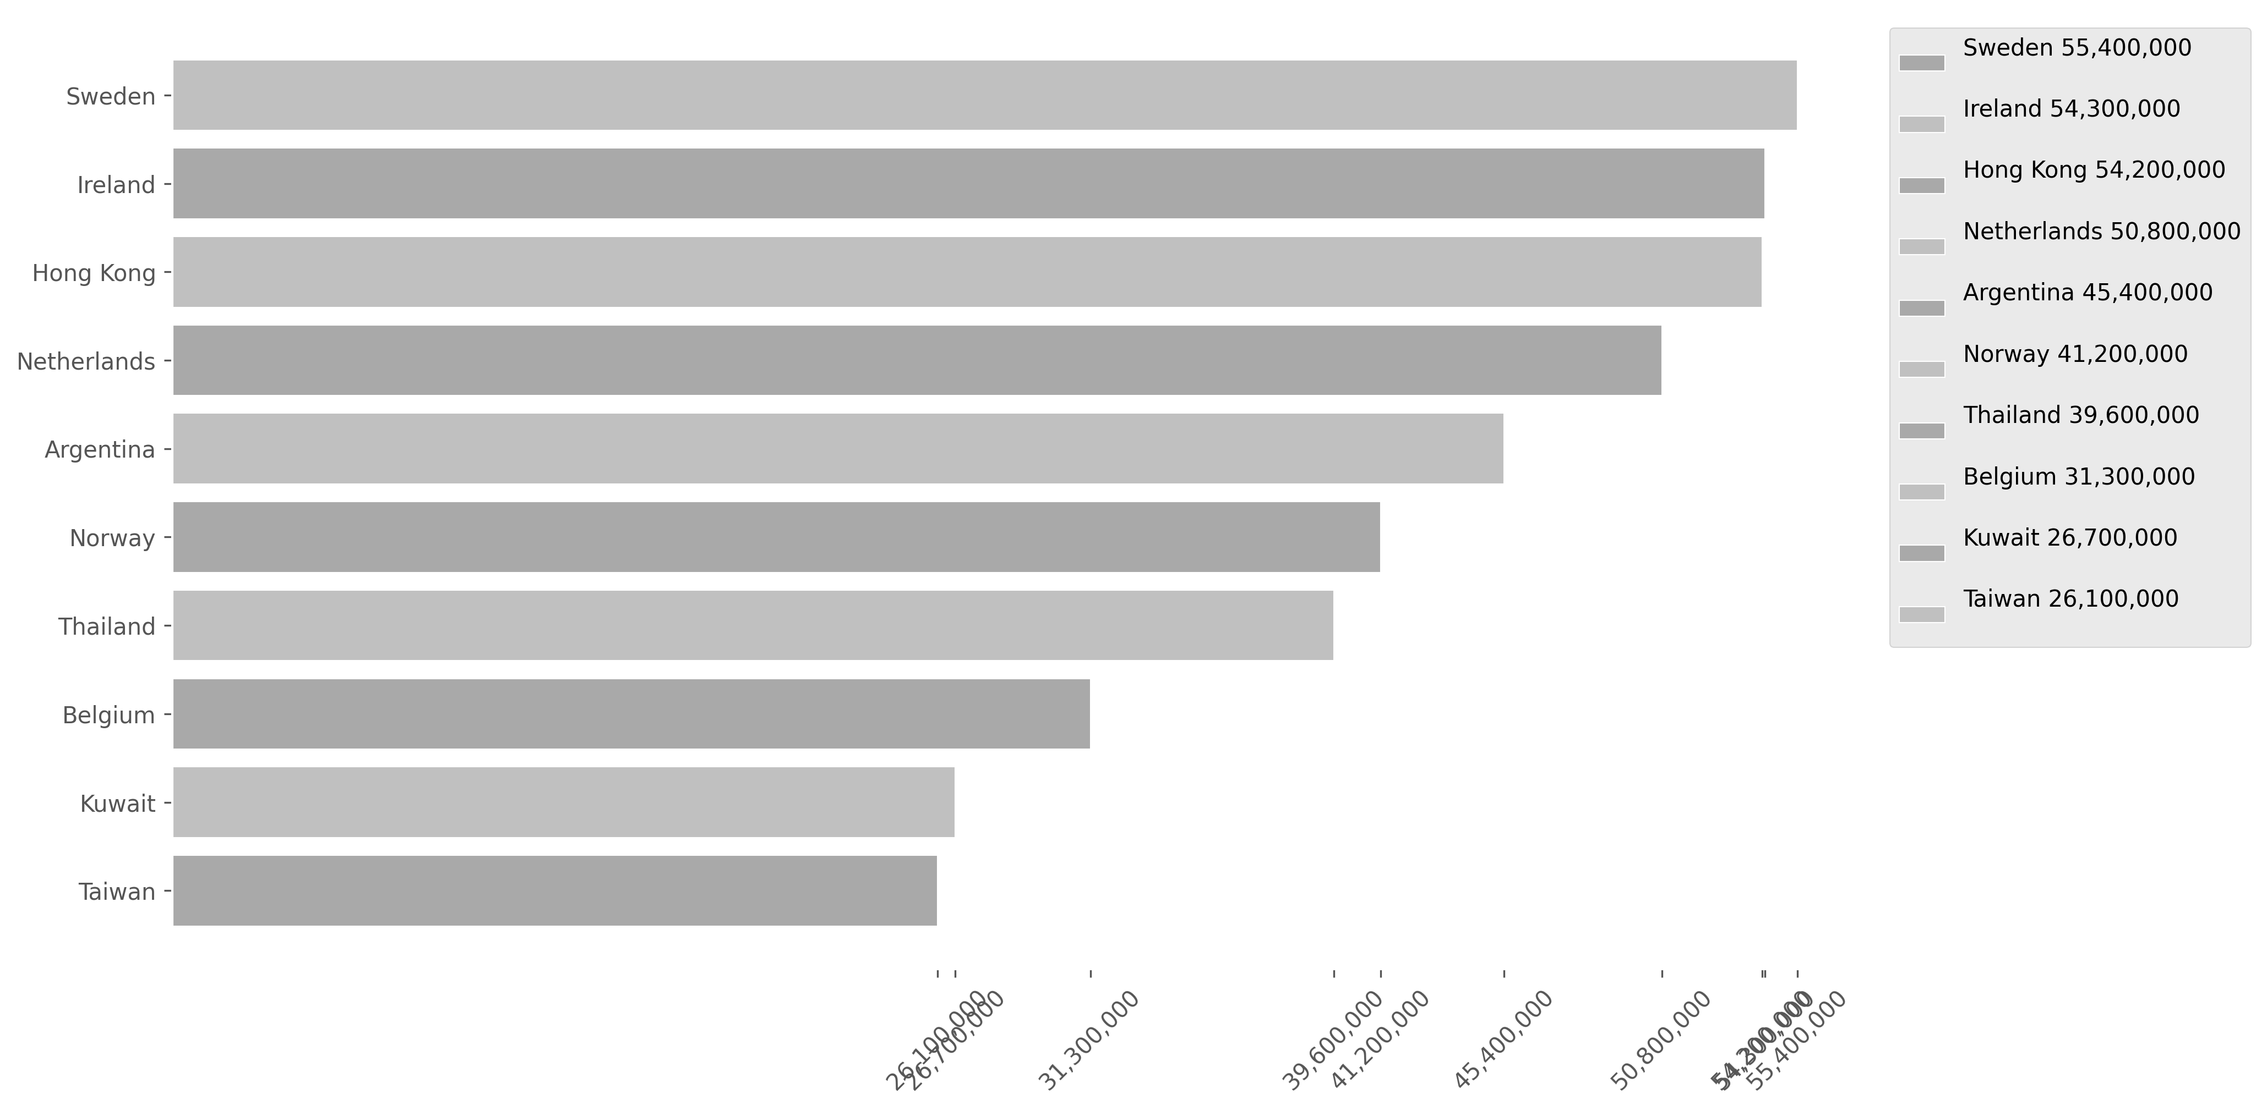
This bar and pie charts shows the popularity of the Producing Countries based on their total views. Keep in mind that the largest chart on one page is smaller than the last one on the previous page. There is a small error margin due to titles with missing countries data. (This margin varies depending on the analyzed Data Dump.) Titles With No Genres: 148 Error Margin: 1.581 %
50

Slide 51
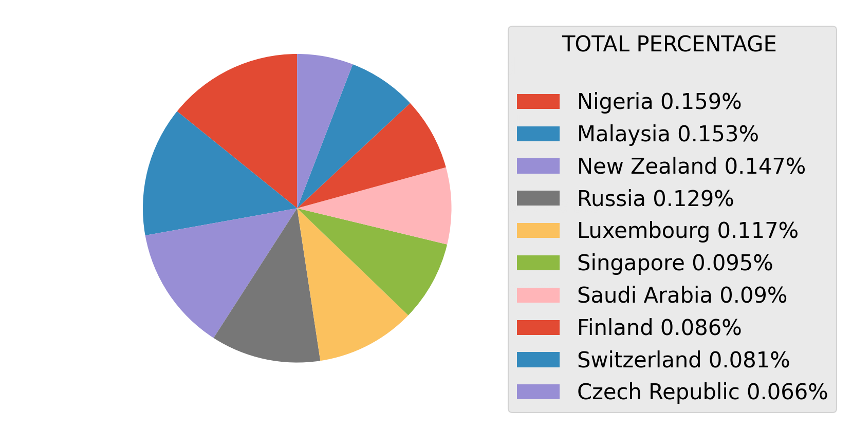
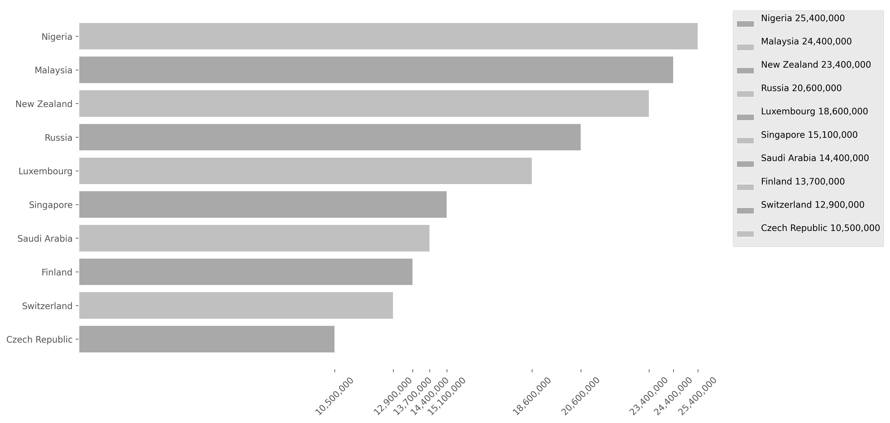
This bar and pie charts shows the popularity of the Producing Countries based on their total views. Keep in mind that the largest chart on one page is smaller than the last one on the previous page. There is a small error margin due to titles with missing countries data. (This margin varies depending on the analyzed Data Dump.) Titles With No Genres: 148 Error Margin: 1.581 %
51

Slide 52
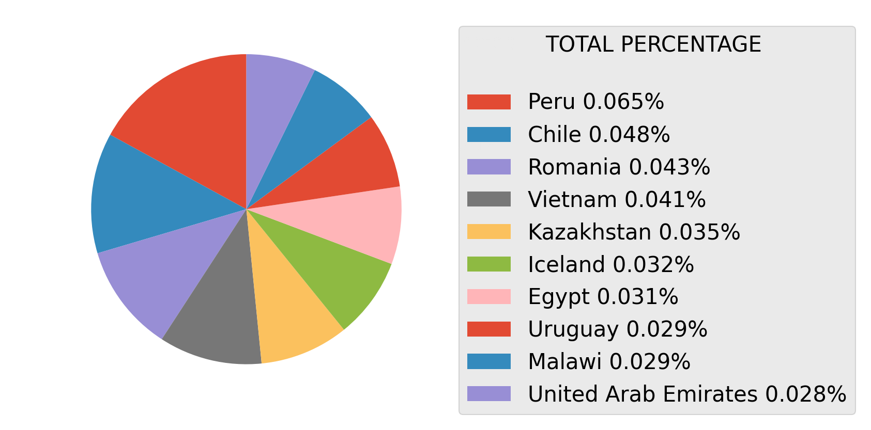
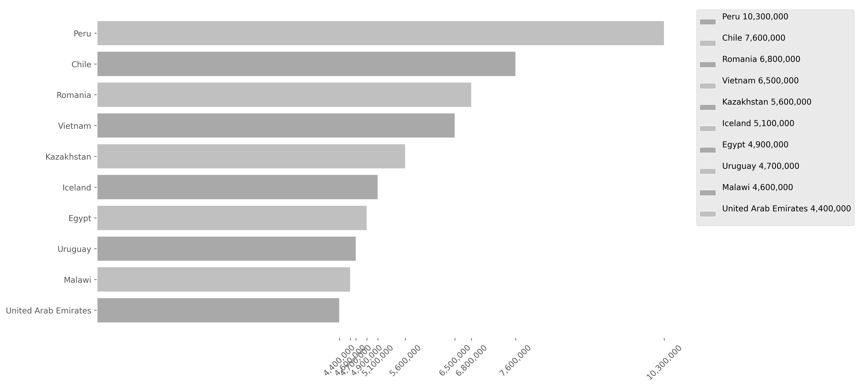
This bar and pie charts shows the popularity of the Producing Countries based on their total views. Keep in mind that the largest chart on one page is smaller than the last one on the previous page. There is a small error margin due to titles with missing countries data. (This margin varies depending on the analyzed Data Dump.) Titles With No Genres: 148 Error Margin: 1.581 %
52

Slide 53
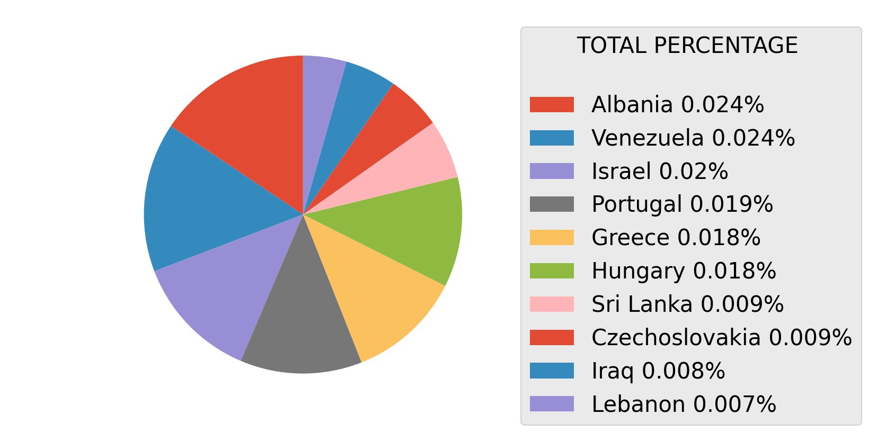
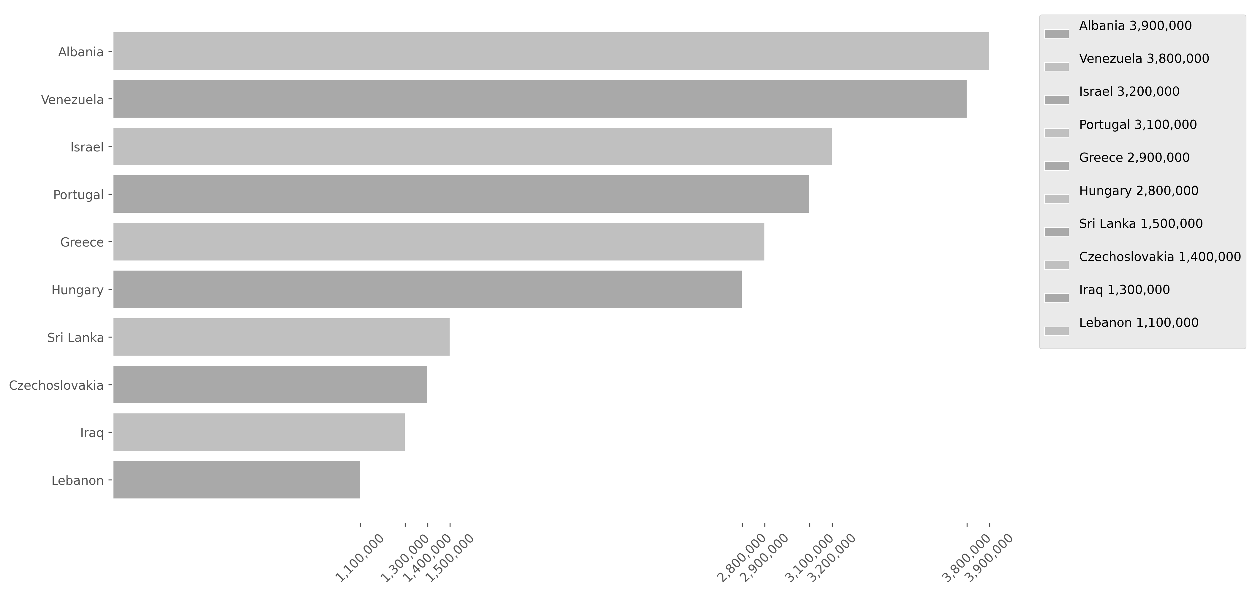
This bar and pie charts shows the popularity of the Producing Countries based on their total views. Keep in mind that the largest chart on one page is smaller than the last one on the previous page. There is a small error margin due to titles with missing countries data. (This margin varies depending on the analyzed Data Dump.) Titles With No Genres: 148 Error Margin: 1.581 %
53

Slide 54
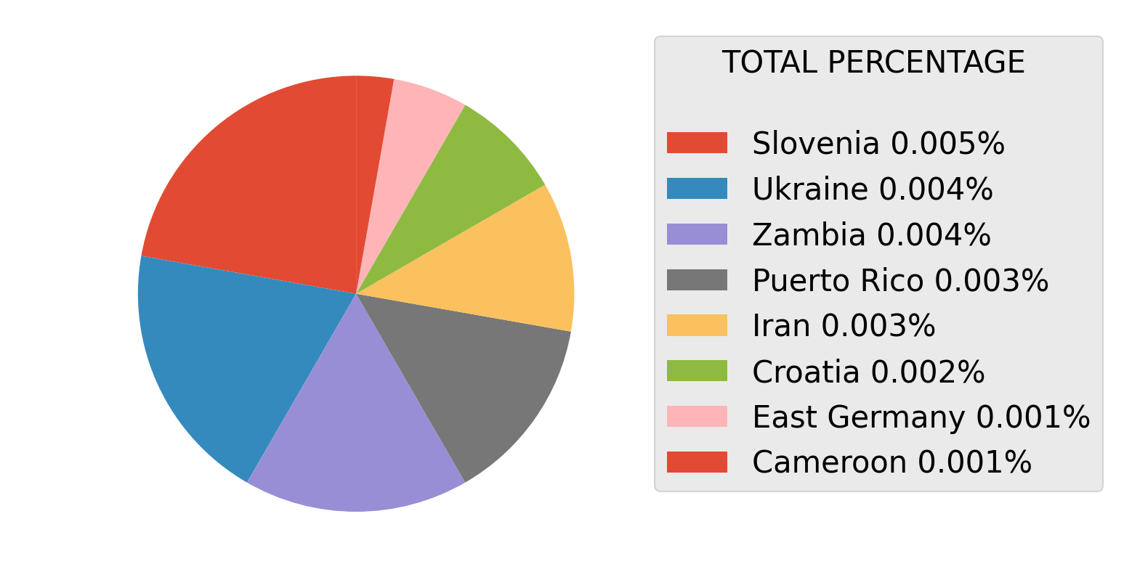
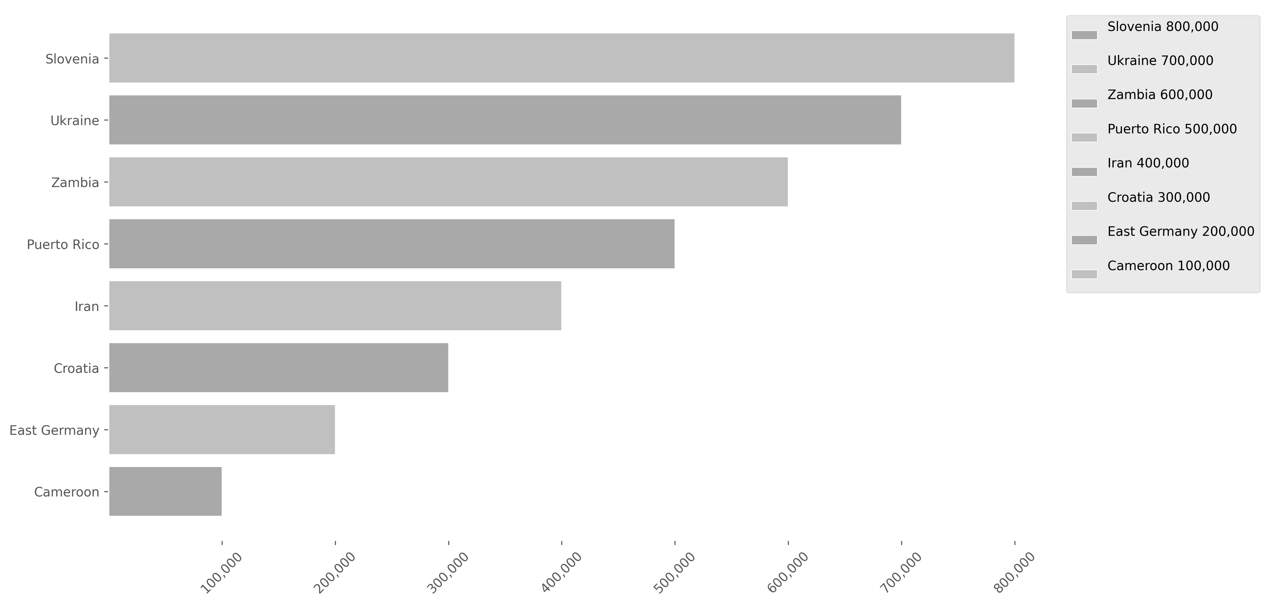
This bar and pie charts shows the popularity of the Producing Countries based on their total views. Keep in mind that the largest chart on one page is smaller than the last one on the previous page. There is a small error margin due to titles with missing countries data. (This margin varies depending on the analyzed Data Dump.) Titles With No Genres: 148 Error Margin: 1.581 %
54

Slide 55
55
Analysis of Movies Content Relationship Between Duration and Playback Popularity
This analysis examines the relationship between content duration and its popularity on Netflix. Averages of playback times will be calculated, and the number of views within each interval will be evaluated. The results will be presented in bar and scatter plots to illustrate these trends.

Slide 56
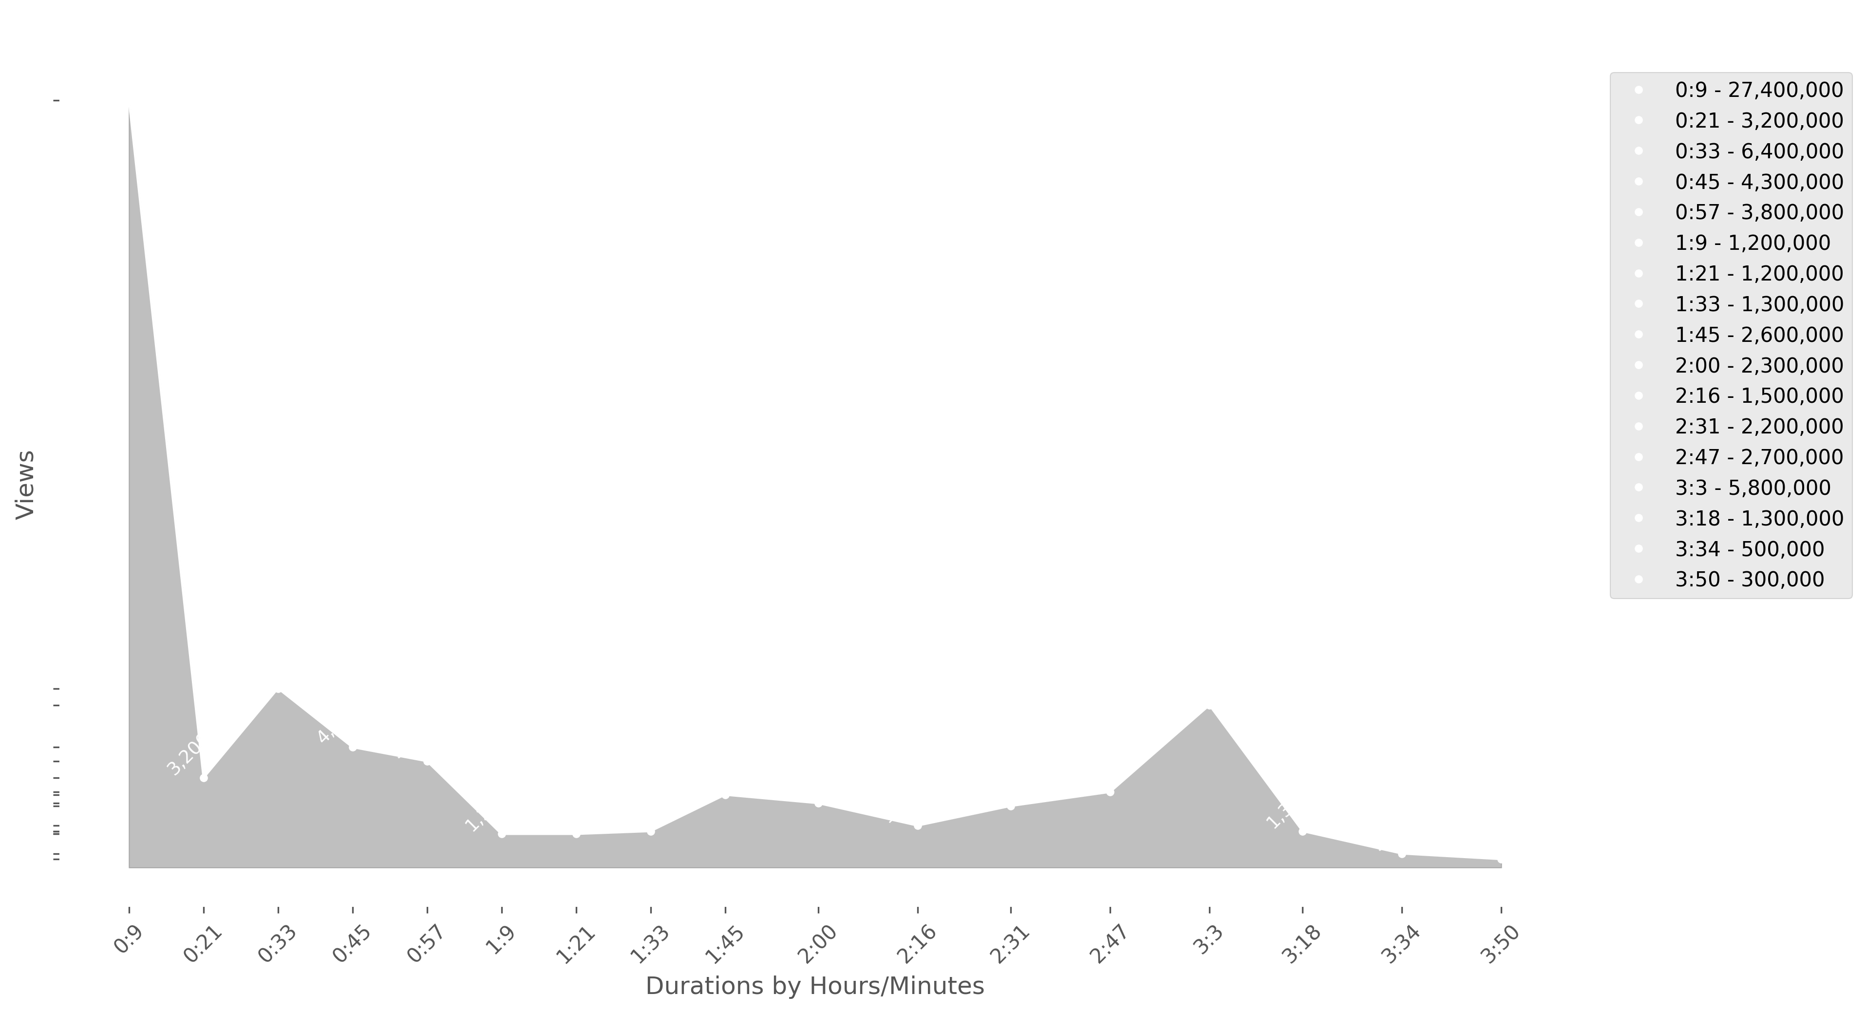
This line chart shows how popularity varies according to content duration, identifying trends as playback times change. It provides a clear view of the relationship between duration and the number of views over time.
56

Slide 57
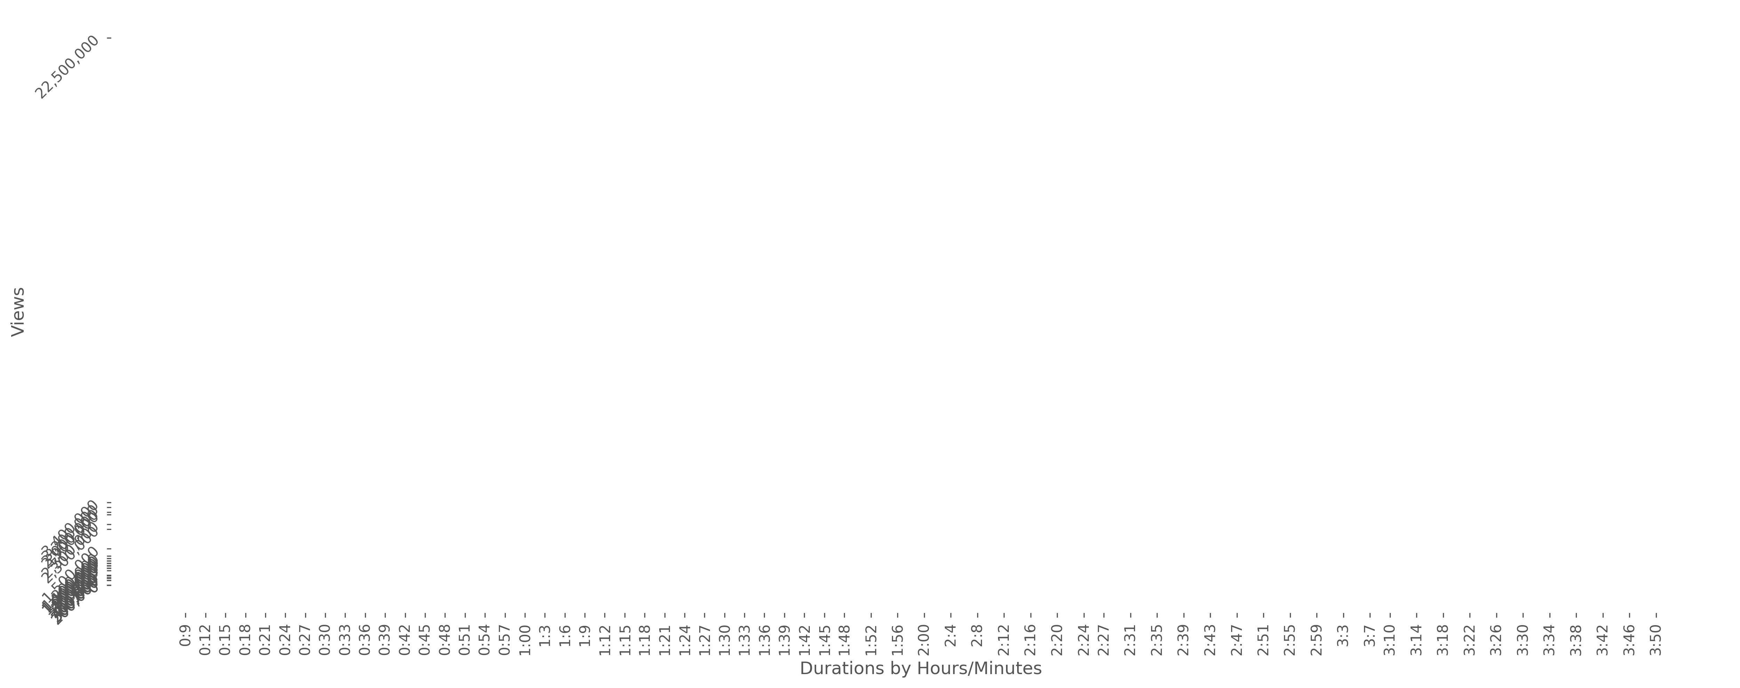
This scatter plot expands the analysis by showing the relationship between popularity and content duration, but with more reference points. By including more averages, it provides a more detailed and precise view of viewing trends across different time intervals.
57

Slide 58
The legend below details the different duration averages analyzed in the scatter plot, associating each point with a specific time interval to facilitate the interpretation of trends. The number of views for each average corresponds to the accumulated views between the previous time in the list and the represented average. - - Time is shownby Hours/Minutes - -
The last average in the list was not included in the charts because it represents extremely long durations with very few views. Its inclusion would distort the tables and make them difficult to read clearly -> 64:52 - 300,000
58
0:9 - 1,200,000
0:48 - 300,000
1:27 - 300,000
2:12 - 1,100,000
3:3 - 1,100,000
64:52 - 300,000
0:12 - 22,500,000
0:51 - 400,000
1:30 - 300,000
2:16 - 400,000
3:7 - 400,000
0:15 - 700,000
0:54 - 400,000
1:33 - 300,000
2:20 - 400,000
3:10 - 900,000
0:18 - 3,000,000
0:57 - 800,000
1:36 - 300,000
2:24 - 300,000
3:14 - 3,400,000
0:21 - 900,000
1:00 - 300,000
1:39 - 400,000
2:27 - 400,000
3:18 - 300,000
0:24 - 900,000
1:3 - 400,000
1:42 - 300,000
2:31 - 400,000
3:22 - 0
0:27 - 600,000
1:6 - 2,300,000
1:45 - 300,000
2:35 - 400,000
3:26 - 200,000
0:30 - 800,000
1:9 - 300,000
1:48 - 1,500,000
2:39 - 400,000
3:30 - 800,000
0:33 - 700,000
1:12 - 300,000
1:52 - 400,000
2:43 - 1,000,000
3:34 - 0
0:36 - 2,900,000
1:15 - 300,000
1:56 - 400,000
2:47 - 700,000
3:38 - 0
0:39 - 2,500,000
1:18 - 300,000
2:00 - 400,000
2:51 - 800,000
3:42 - 200,000
0:42 - 300,000
1:21 - 300,000
2:4 - 400,000
2:55 - 1,000,000
3:46 - 300,000
0:45 - 3,200,000
1:24 - 300,000
2:8 - 400,000
2:59 - 200,000
3:50 - 300,000

Slide 59

59
Analysis of Global Content Popularity
From this point onward, the information presented and the analyses conducted will be based on data from both movies and series, aiming to conclude with a global analysis that offers us broader insight. This analysis will allow us to explore the overall behavior of the content on the platform in terms of popularity.

Slide 60
60
Analysis of Global Content Genres Popularity
This analysis explores the popularity of genres across Netflix's entire catalog, using comprehensive viewership data. A bar chart highlights the total number of views for each genre, providing a clear comparison of audience preferences. Additionally, a pie chart presents the percentage share of views, offering a visual breakdown of each genre's popularity relative to the platform as a whole.

Slide 61
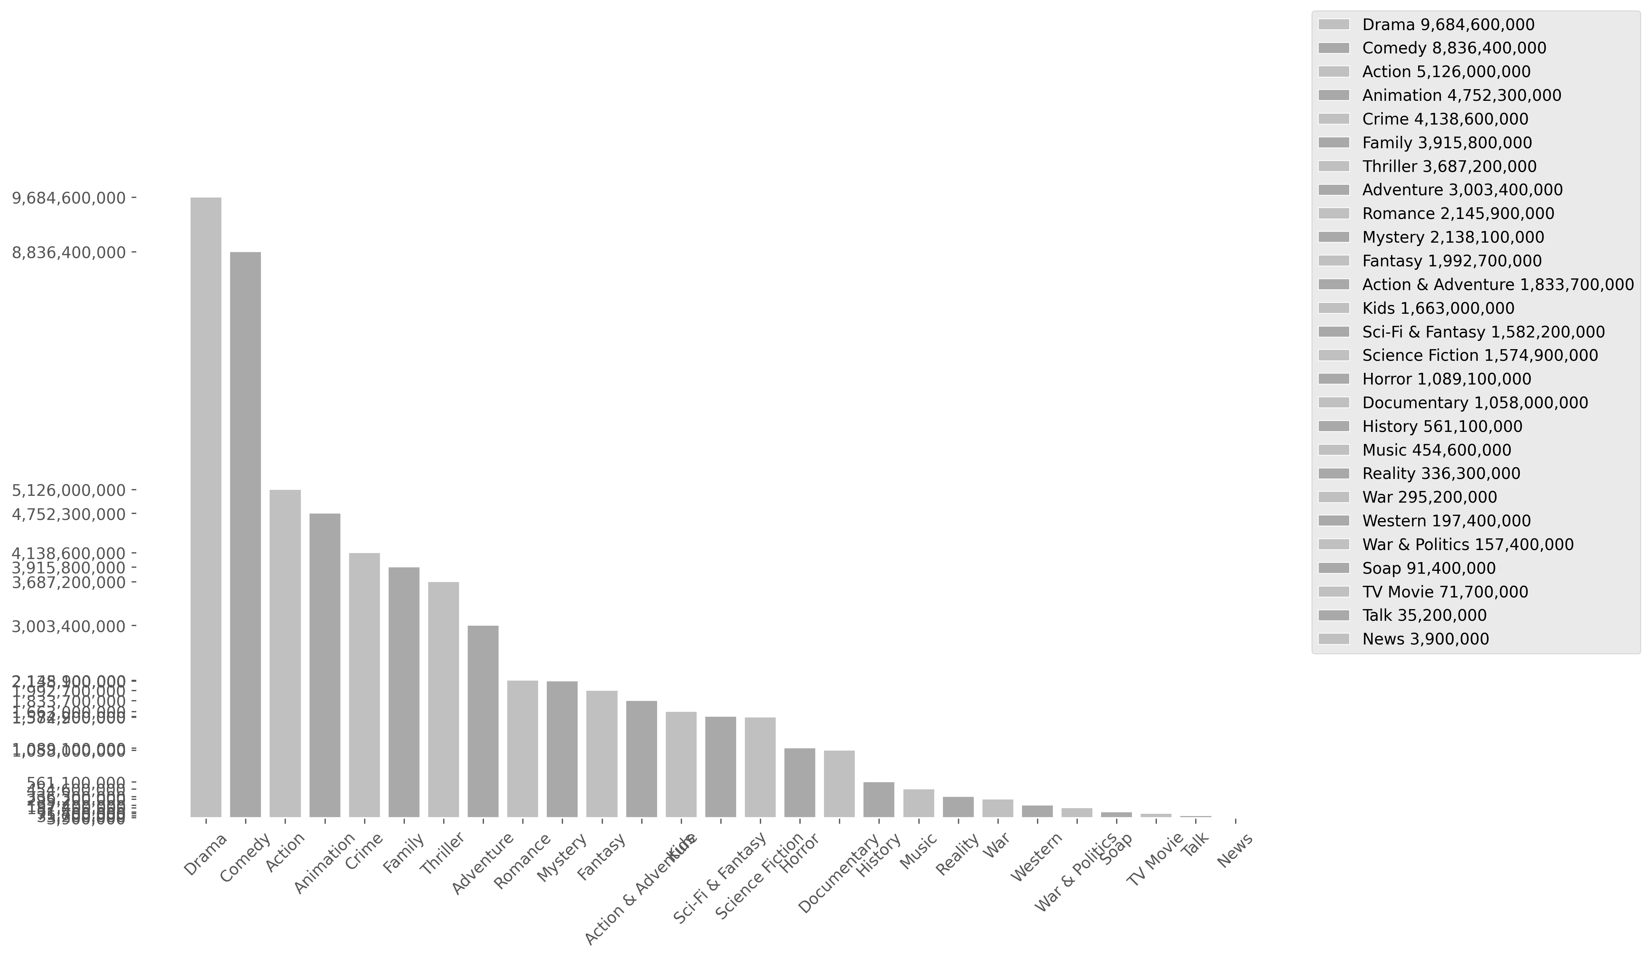
This bar chart shows the popularity of genres based on their total views. nThere is a small error margin due to titles with missing genre data. (This margin varies depending on the analyzed Data Dump.) Titles With No Genres: 266 Error Margin: 1.646 %
61

Slide 62
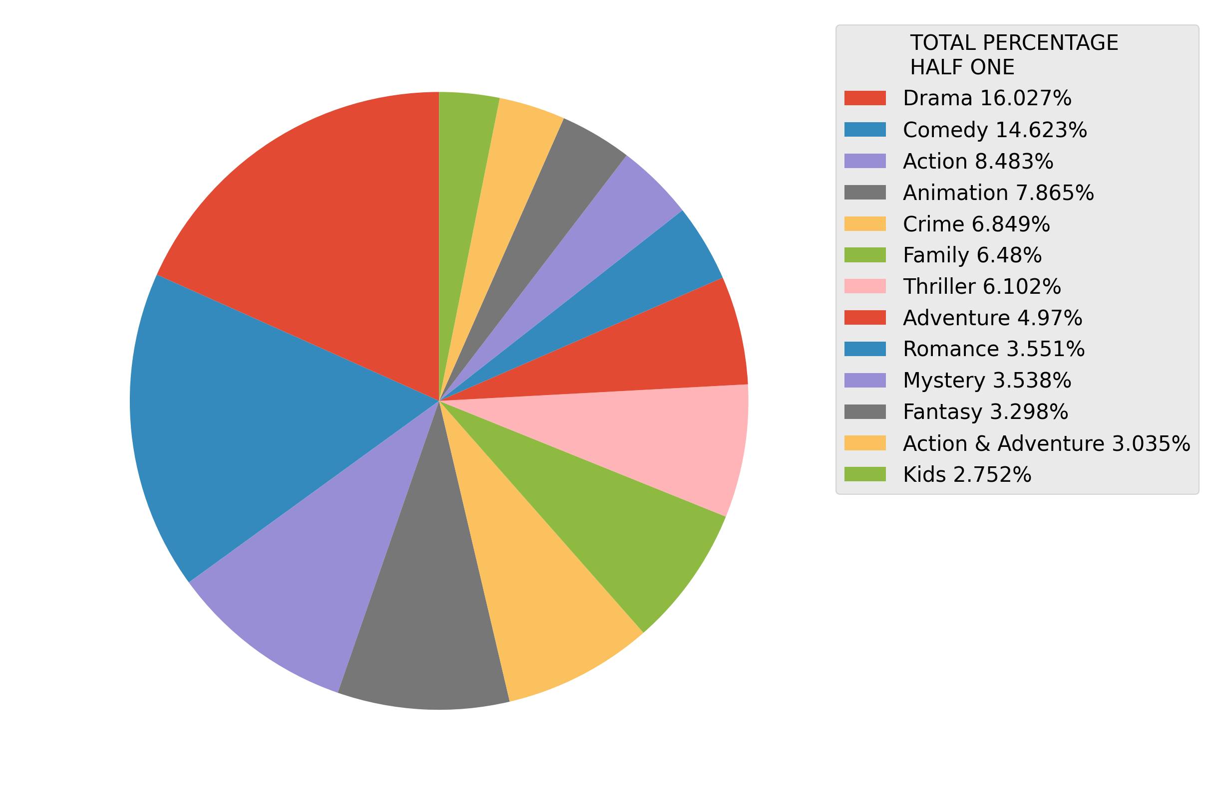
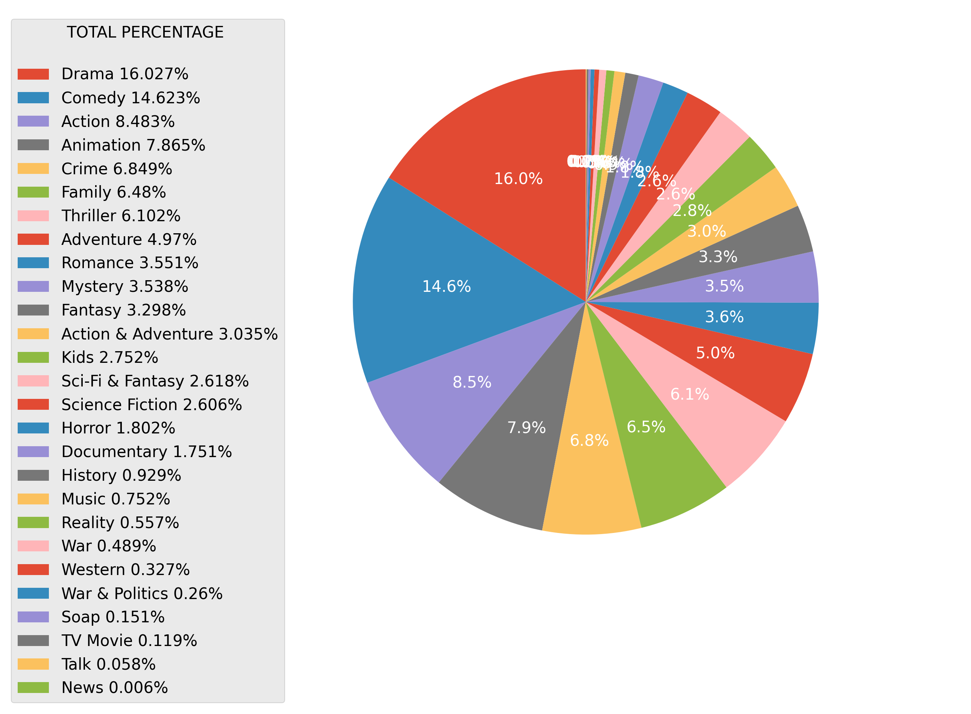
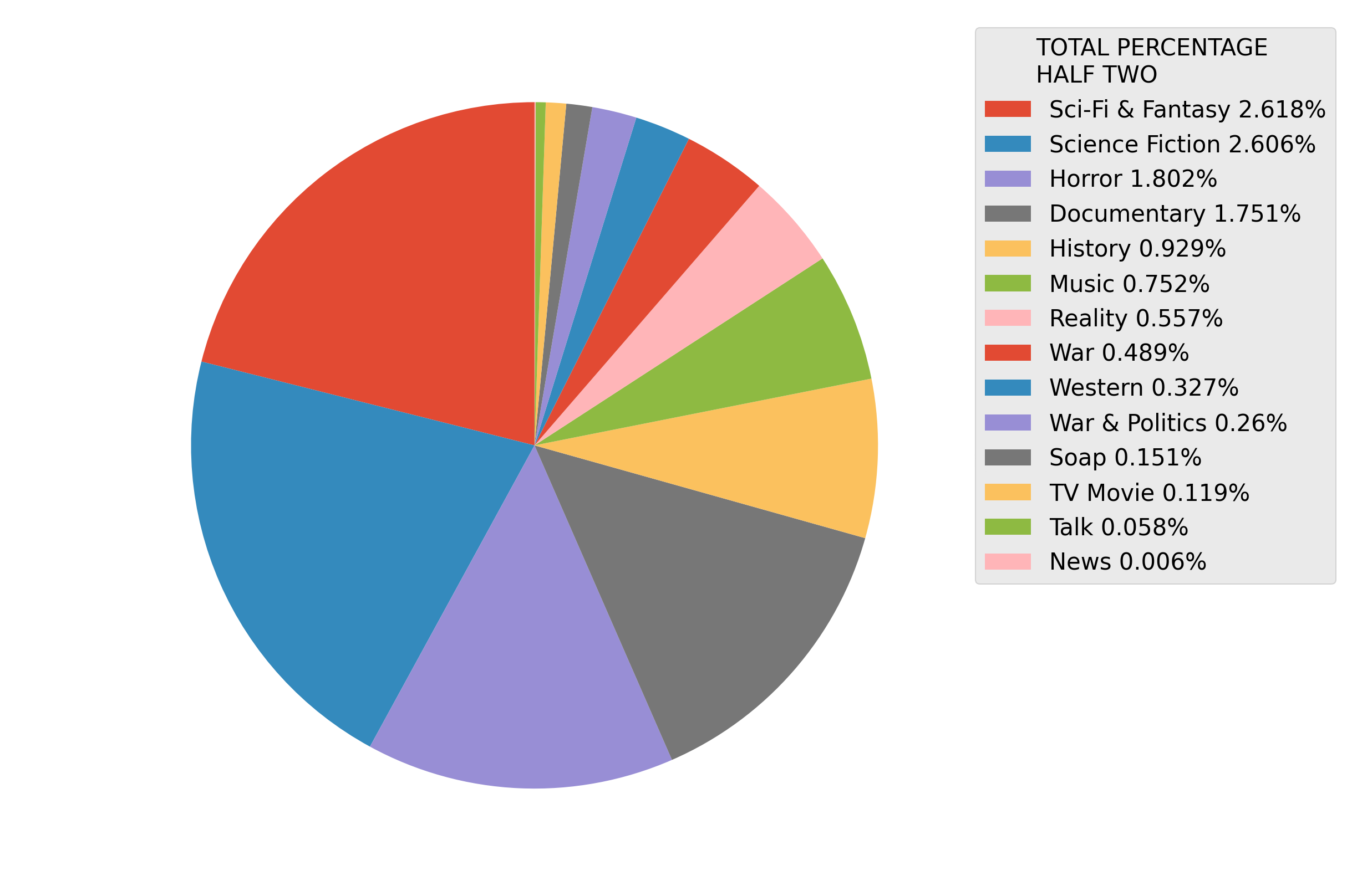
This pie charts shows the popularity of genres based on their total views. There is a full one, and to half of the same information cut in two. There is a small error margin due to titles with missing genre data. (This margin varies depending on the analyzed Data Dump.) Titles With No Genres: 266 Error Margin: 1.646 %
62

Slide 63

63
Analysis of Global Content Producing Countries Popularity
This analysis examines the popularity of producer countries in Netflix content, highlighting how productions from different countries impact the platform's global audience. Viewing trends and the impact of producer countries on user preferences will be analyzed.

Slide 64
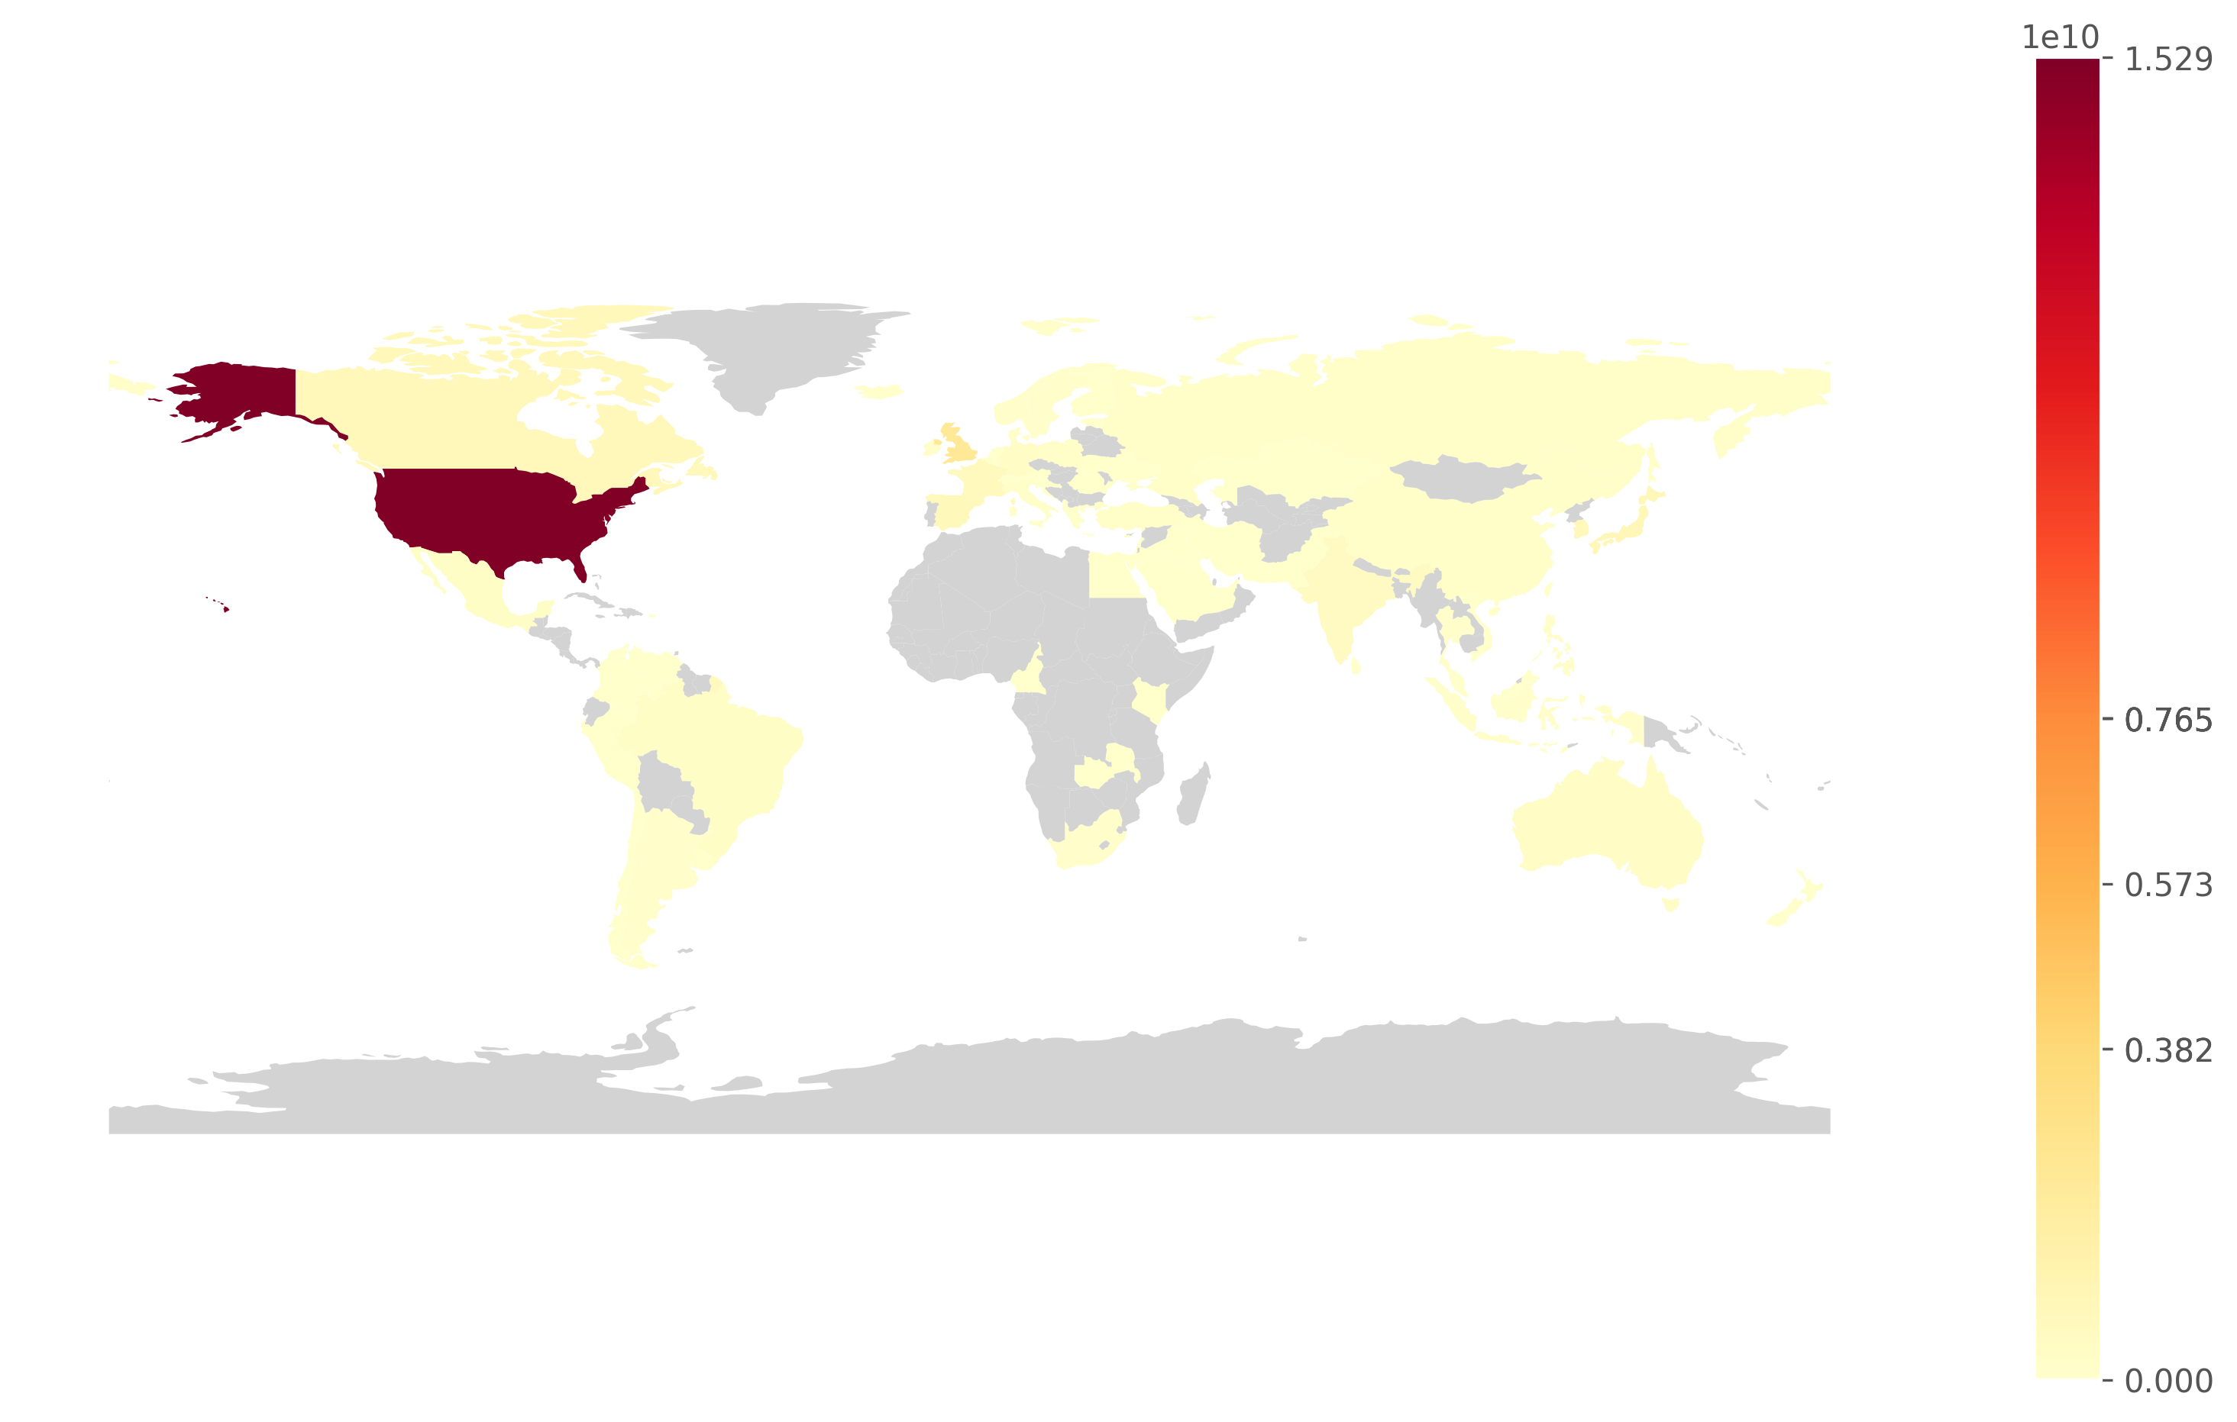
This heatmap shows the popularity of the Producing Countries based on their total views. There is a small error margin due to titles with missing countries data. (This margin varies depending on the analyzed Data Dump.) Titles With No Genres: 613 Error Margin: 3.793 %
64

Slide 65
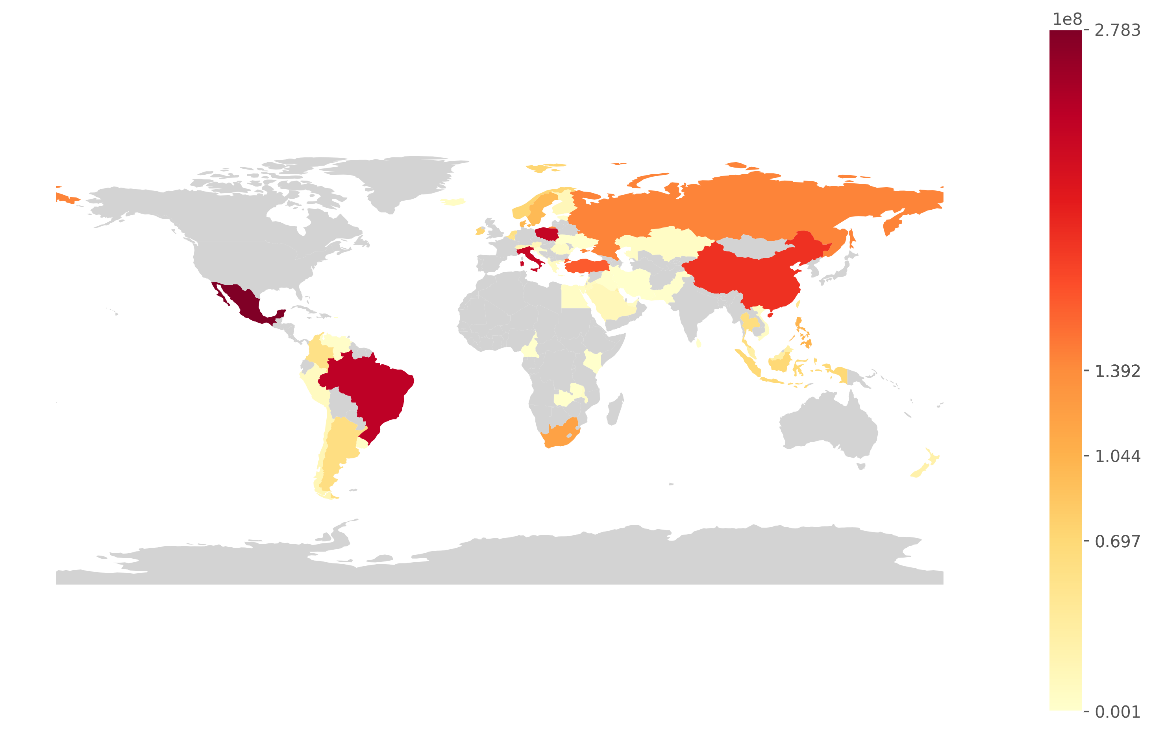
This heatmap shows the popularity of the Producing Countries based on their total views. There is a small error margin due to titles with missing countries data. (This margin varies depending on the analyzed Data Dump.) Titles With No Genres: 613 Error Margin: 3.793 %
IMPORTANT: In this second heatmap, we can better appreciate the popularity of lower-ranked countries by excluding the top 10 countries.
65

Slide 66
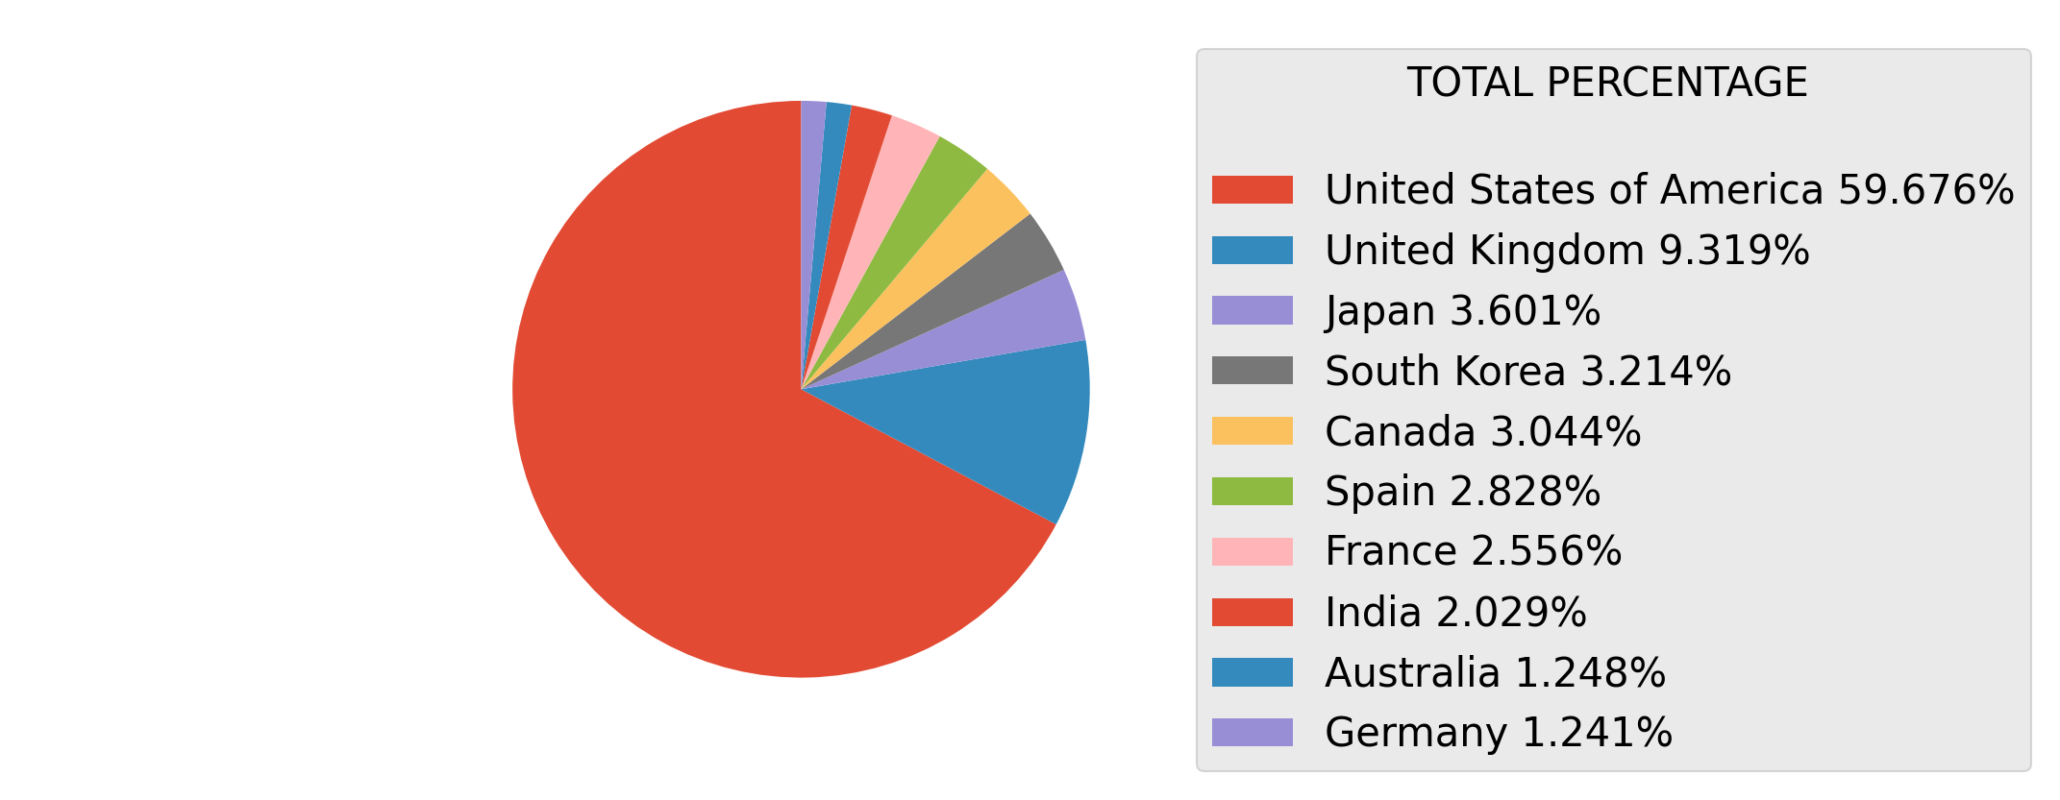
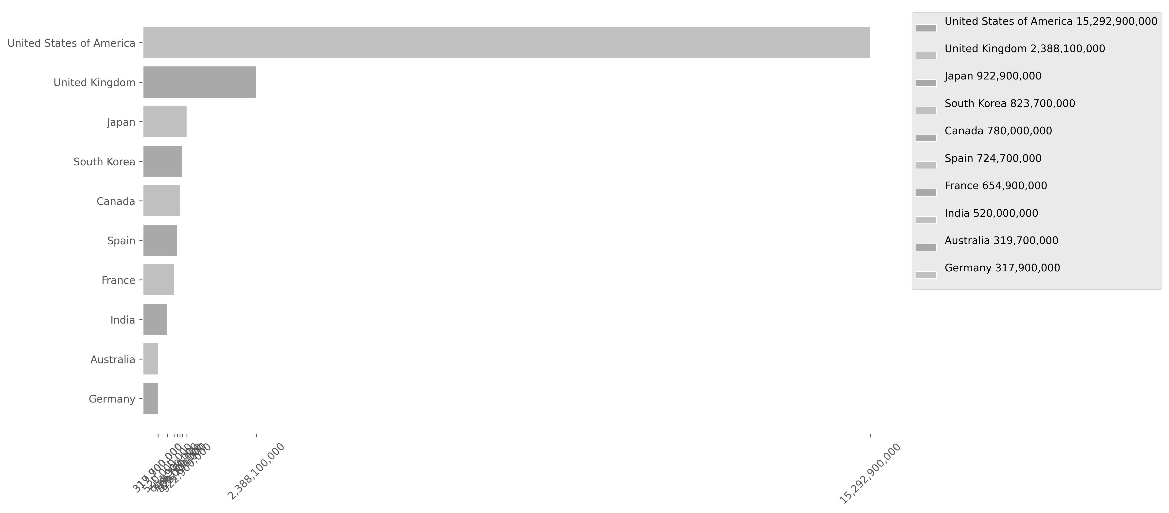
This bar and pie charts shows the popularity of the Producing Countries based on their total views. Keep in mind that the largest chart on one page is smaller than the last one on the previous page. There is a small error margin due to titles with missing countries data. (This margin varies depending on the analyzed Data Dump.) Titles With No Genres: 613 Error Margin: 3.793 %
66

Slide 67
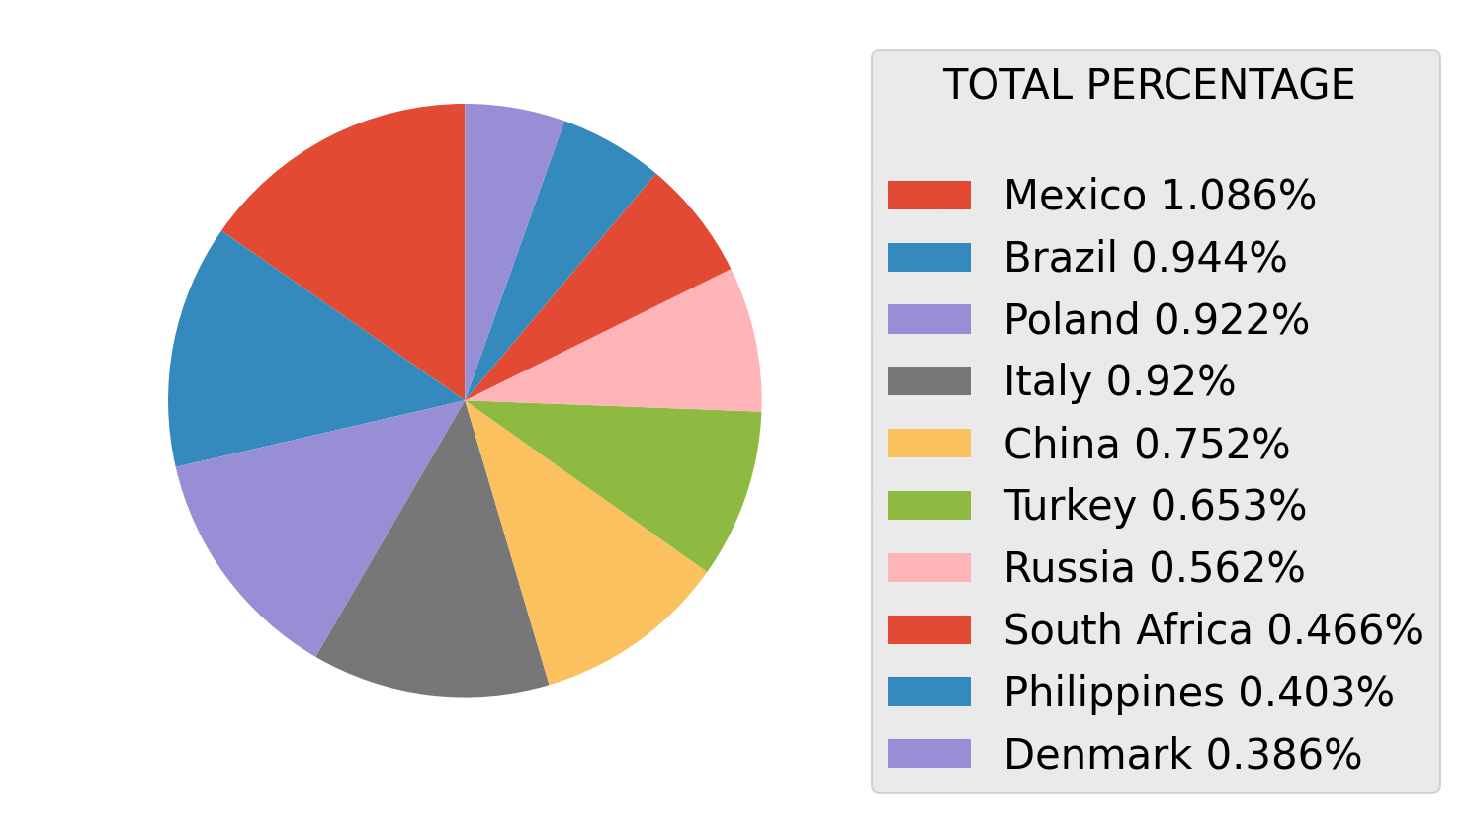
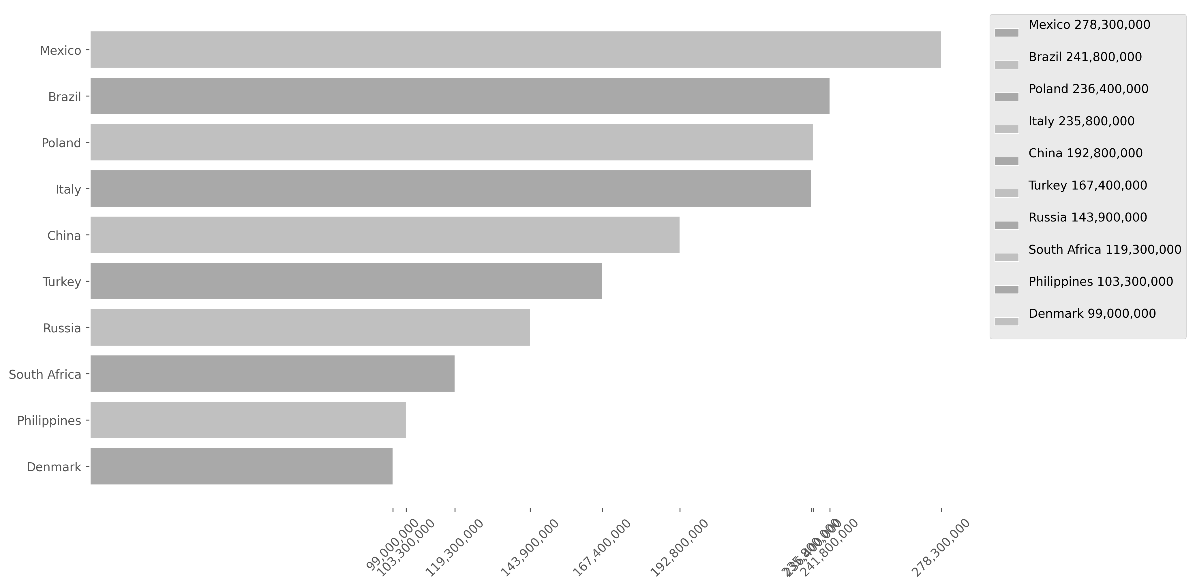
This bar and pie charts shows the popularity of the Producing Countries based on their total views. Keep in mind that the largest chart on one page is smaller than the last one on the previous page. There is a small error margin due to titles with missing countries data. (This margin varies depending on the analyzed Data Dump.) Titles With No Genres: 613 Error Margin: 3.793 %
67

Slide 68
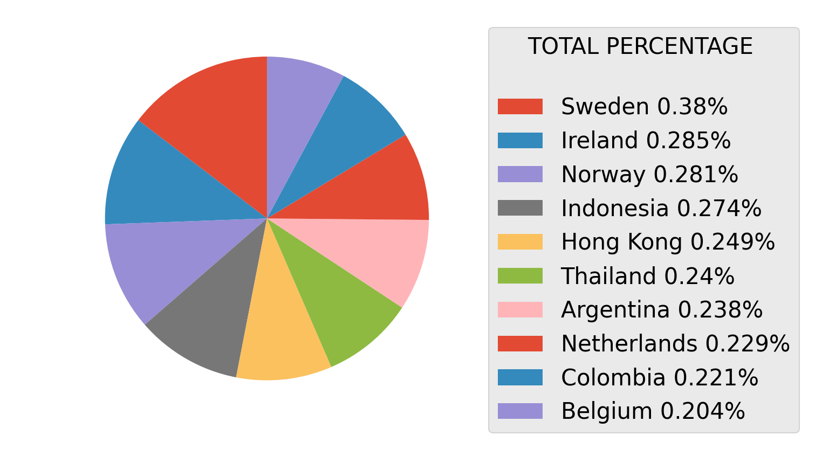
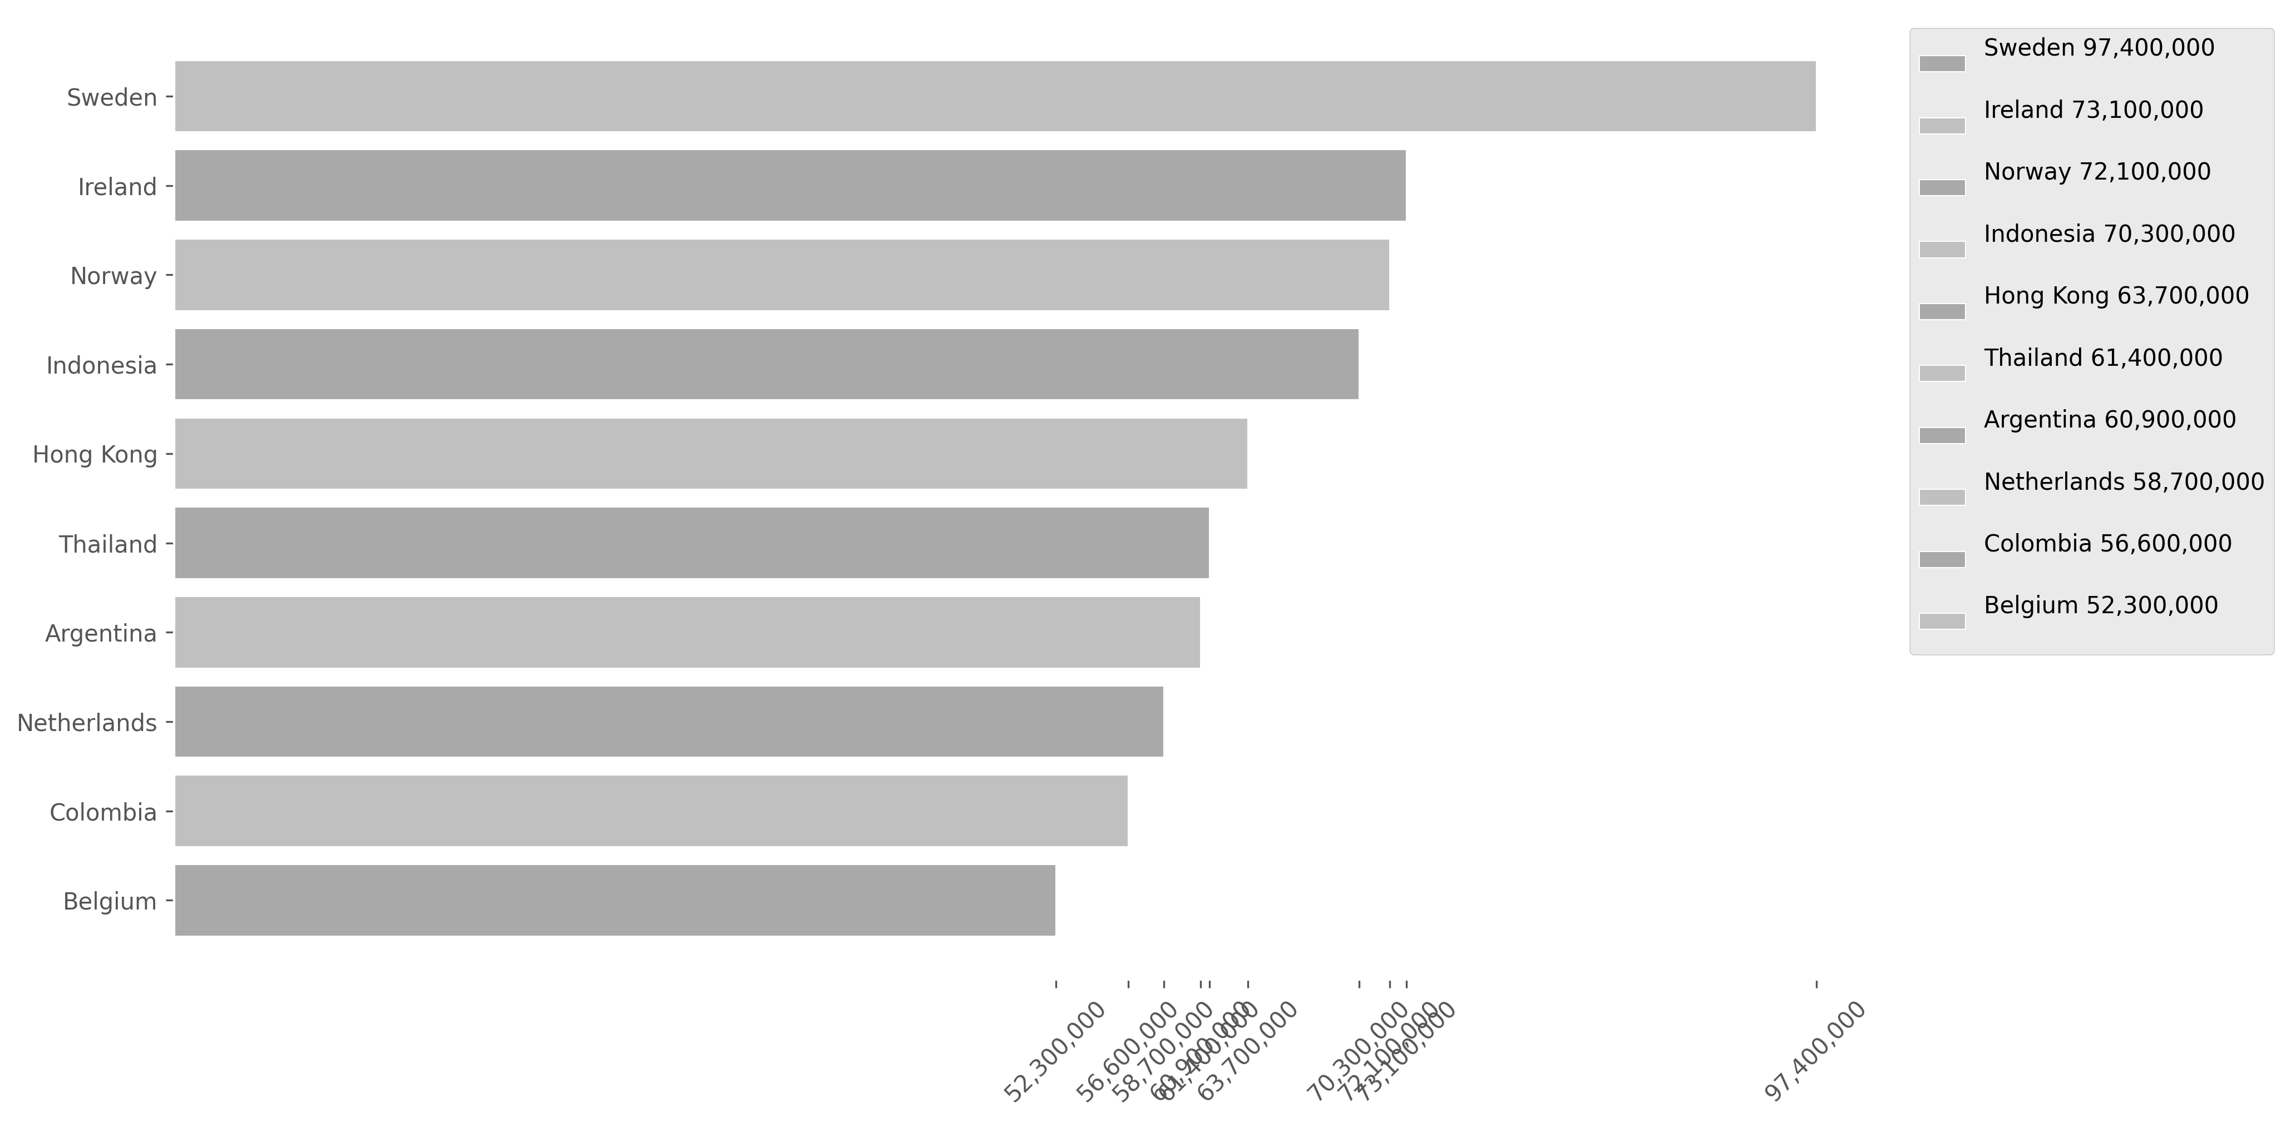
This bar and pie charts shows the popularity of the Producing Countries based on their total views. Keep in mind that the largest chart on one page is smaller than the last one on the previous page. There is a small error margin due to titles with missing countries data. (This margin varies depending on the analyzed Data Dump.) Titles With No Genres: 613 Error Margin: 3.793 %
68

Slide 69


This bar and pie charts shows the popularity of the Producing Countries based on their total views. Keep in mind that the largest chart on one page is smaller than the last one on the previous page. There is a small error margin due to titles with missing countries data. (This margin varies depending on the analyzed Data Dump.) Titles With No Genres: 613 Error Margin: 3.793 %
69

Slide 70


This bar and pie charts shows the popularity of the Producing Countries based on their total views. Keep in mind that the largest chart on one page is smaller than the last one on the previous page. There is a small error margin due to titles with missing countries data. (This margin varies depending on the analyzed Data Dump.) Titles With No Genres: 613 Error Margin: 3.793 %
70

Slide 71


This bar and pie charts shows the popularity of the Producing Countries based on their total views. Keep in mind that the largest chart on one page is smaller than the last one on the previous page. There is a small error margin due to titles with missing countries data. (This margin varies depending on the analyzed Data Dump.) Titles With No Genres: 613 Error Margin: 3.793 %
71

Slide 72


This bar and pie charts shows the popularity of the Producing Countries based on their total views. Keep in mind that the largest chart on one page is smaller than the last one on the previous page. There is a small error margin due to titles with missing countries data. (This margin varies depending on the analyzed Data Dump.) Titles With No Genres: 613 Error Margin: 3.793 %
72

Slide 73


This bar and pie charts shows the popularity of the Producing Countries based on their total views. Keep in mind that the largest chart on one page is smaller than the last one on the previous page. There is a small error margin due to titles with missing countries data. (This margin varies depending on the analyzed Data Dump.) Titles With No Genres: 613 Error Margin: 3.793 %
73

Slide 74

74
Analysis of Global Content Top_Best50_by_Views
This analysis highlights the 50 most-viewed titles on Netflix, offering insights into the platform's top-performing content. These selections reflect audience preferences and showcase the titles that have captivated viewers worldwide.

Slide 75
75
1
Views: 143,800,000 Title: Damsel Runtime: 1:50 Votes: 7.063 Reproduced Hours: 263,700,000 Country: United States of America Genres: Fantasy, Action, Adventure movie
2
Views: 129,400,000 Title: Lift Runtime: 1:47 Votes: 6.481 Reproduced Hours: 230,800,000 Country: United States of America Genres: Crime, Comedy, Action movie
3
Views: 107,500,000 Title: Fool Me Once: Limited Series Runtime: 6:25 Votes: 7.242 Reproduced Hours: 689,500,000 Country: United Kingdom Genres: Drama, Crime, Mystery tv
4
Views: 103,800,000 Title: Society of the Snow // La sociedad de la nieve Runtime: 2:26 Votes: 8.021 Reproduced Hours: 252,500,000 Country: Spain Genres: Drama, History movie
5
Views: 91,900,000 Title: Bridgerton: Season 3 Runtime: 7:59 Votes: 8.1 Reproduced Hours: 733,800,000 Country: United States of America Genres: Drama tv
6
Views: 87,600,000 Title: Baby Reindeer: Limited Series Runtime: 3:58 Votes: 7.624 Reproduced Hours: 347,600,000 Country: United Kingdom Genres: Drama tv
7
Views: 84,700,000 Title: Under Paris // Sous la Seine Runtime: 1:44 Votes: 5.998 Reproduced Hours: 146,800,000 Country: France Genres: Drama, Action, Horror, Thriller movie
8
Views: 80,300,000 Title: The Super Mario Bros. Movie Runtime: 1:32 Votes: 7.642 Reproduced Hours: 123,100,000 Country: United States of America Genres: Comedy, Family, Animation, Fantasy, Adventure movie
9
Views: 77,700,000 Title: Mother of the Bride Runtime: 1:30 Votes: 5.907 Reproduced Hours: 116,500,000 Country: United States of America Genres: Comedy, Romance movie
10
Views: 77,100,000 Title: Atlas Runtime: 2:00 Votes: 6.8 Reproduced Hours: 154,200,000 Country: United States of America Genres: Action, Science Fiction movie
11
Views: 75,900,000 Title: The Gentlemen: Season 1 Runtime: 6:41 Votes: 7.887 Reproduced Hours: 507,300,000 Country: United Kingdom Genres: Drama, Crime, Comedy tv
12
Views: 72,700,000 Title: Minions Runtime: 1:31 Votes: 6.412 Reproduced Hours: 110,200,000 Country: United States of America Genres: Comedy, Family, Animation, Adventure movie
13
Views: 72,100,000 Title: Irish Wish Runtime: 1:34 Votes: 6.213 Reproduced Hours: 113,000,000 Country: United States of America Genres: Comedy, Romance, Fantasy movie
14
Views: 71,100,000 Title: Avatar The Last Airbender: Season 1 Runtime: 7:15 Votes: 7.931 Reproduced Hours: 515,300,000 Country: United States of America Genres: Drama, Sci-Fi & Fantasy, Action & Adventure tv
15
Views: 69,200,000 Title: Griselda: Limited Series Runtime: 5:32 Votes: 7.322 Reproduced Hours: 383,000,000 Country: United States of America Genres: Drama, Crime tv
16
Views: 63,600,000 Title: The Boss Baby Runtime: 1:38 Votes: 6.4 Reproduced Hours: 103,800,000 Country: United States of America Genres: Comedy, Family, Animation movie
17
Views: 61,600,000 Title: Despicable Me 3 Runtime: 1:30 Votes: 6.469 Reproduced Hours: 92,400,000 Country: United States of America Genres: Comedy, Family, Animation, Action, Adventure movie
18
Views: 57,400,000 Title: Woody Woodpecker Goes to Camp Runtime: 1:40 Votes: 6.525 Reproduced Hours: 95,600,000 Country: United States of America Genres: Comedy, Family, Animation movie
19
Views: 56,900,000 Title: Shrek Runtime: 1:30 Votes: 7.7 Reproduced Hours: 85,300,000 Country: United States of America Genres: Comedy, Family, Animation, Fantasy, Adventure movie
20
Views: 55,800,000 Title: Rebel Moon — Part Two: The Scargiver Runtime: 2:04 Votes: 6.1 Reproduced Hours: 115,300,000 Country: United States of America Genres: Action, Science Fiction movie
21
Views: 55,000,000 Title: American Nightmare: Season 1 Runtime: 2:15 Votes: 7.394 Reproduced Hours: 123,700,000 Country: United Kingdom Genres: Crime, Documentary tv
22
Views: 54,200,000 Title: Rebel Moon — Part One: A Child of Fire Runtime: 2:16 Votes: 6.309 Reproduced Hours: 122,800,000 Country: United States of America Genres: Drama, Action, Science Fiction, War movie
23
Views: 53,900,000 Title: Leo Runtime: 1:47 Votes: 7.477 Reproduced Hours: 96,200,000 Country: United States of America Genres: Comedy, Family, Animation movie
24
Views: 53,600,000 Title: Badland Hunters // 황야 Runtime: 1:49 Votes: 6.728 Reproduced Hours: 97,300,000 Country: South Korea Genres: Action, Science Fiction movie
25
Views: 53,500,000 Title: The Equalizer 3 Runtime: 1:49 Votes: 7.3 Reproduced Hours: 97,200,000 Country: United States of America Genres: Crime, Action, Thriller movie

Slide 76
76
26
Views: 52,800,000 Title: Mea Culpa Runtime: 2:00 Votes: 5.7 Reproduced Hours: 105,500,000 Country: United States of America Genres: Drama, Crime, Thriller movie
27
Views: 52,700,000 Title: The Tearsmith // Fabbricante di lacrime Runtime: 1:45 Votes: 6.526 Reproduced Hours: 92,200,000 Country: Italy Genres: Drama, Romance movie
28
Views: 52,400,000 Title: 3 Body Problem: Season 1 Runtime: 7:24 Votes: 7.496 Reproduced Hours: 388,100,000 Country: United States of America Genres: Drama, Mystery, Sci-Fi & Fantasy tv
29
Views: 52,100,000 Title: Trigger Warning Runtime: 1:47 Votes: 5.795 Reproduced Hours: 92,900,000 Country: United States of America Genres: Action movie
30
Views: 49,500,000 Title: The Abyss // Avgrunden Runtime: 1:43 Votes: 7.351 Reproduced Hours: 84,900,000 Country: United States of America Genres: Action, Adventure, Thriller, Science Fiction movie
31
Views: 48,500,000 Title: Berlin: Season 1 // Berlín: Temporada 1 Runtime: 6:34 Votes: 7.646 Reproduced Hours: 318,400,000 Country: Spain Genres: Drama, Crime, Action & Adventure tv
32
Views: 47,500,000 Title: What Jennifer Did Runtime: 1:27 Votes: 6.3 Reproduced Hours: 68,900,000 Country: United Kingdom Genres: Crime, Documentary movie
33
Views: 47,300,000 Title: The Wages of Fear // Le salaire de la peur Runtime: 1:46 Votes: 6.231 Reproduced Hours: 83,500,000 Country: France Genres: Action movie
34
Views: 46,300,000 Title: Orion and the Dark Runtime: 1:33 Votes: 6.583 Reproduced Hours: 71,700,000 Country: United States of America Genres: Comedy, Family, Animation, Fantasy movie
35
Views: 45,700,000 Title: Code 8 Part II Runtime: 1:40 Votes: 6.396 Reproduced Hours: 76,100,000 Country: United States of America, Canada Genres: Crime, Action, Science Fiction movie
36
Views: 42,700,000 Title: Trolls Runtime: 1:33 Votes: 6.6 Reproduced Hours: 66,200,000 Country: United States of America Genres: Comedy, Family, Animation, Fantasy, Adventure, Music movie
37
Views: 42,200,000 Title: Colors of Evil: Red // Kolory zła: Czerwień Runtime: 1:52 Votes: 6.769 Reproduced Hours: 78,700,000 Country: Poland Genres: Crime, Mystery, Thriller movie
38
Views: 40,500,000 Title: Leave the World Behind Runtime: 2:22 Votes: 6.426 Reproduced Hours: 95,900,000 Country: United States of America Genres: Drama, Mystery, Thriller movie
39
Views: 40,400,000 Title: Sing 2 Runtime: 1:50 Votes: 7.9 Reproduced Hours: 74,000,000 Country: United States of America Genres: Comedy, Family, Animation, Music movie
40
Views: 40,100,000 Title: Sixty Minutes // 60 Minuten Runtime: 1:30 Votes: 6.8 Reproduced Hours: 60,100,000 Country: Germany Genres: Action movie
41
Views: 39,400,000 Title: One Day: Limited Series Runtime: 6:40 Votes: 6.7 Reproduced Hours: 263,000,000 Country: United States of America Genres: Comedy tv
42
Views: 38,400,000 Title: Bridgerton: Season 1 Runtime: 8:12 Votes: 8.1 Reproduced Hours: 314,500,000 Country: United States of America Genres: Drama tv
43
Views: 37,100,000 Title: Top Gun: Maverick Runtime: 2:10 Votes: 7.056 Reproduced Hours: 80,400,000 Country: United States of America Genres: Drama, Action movie
44
Views: 36,900,000 Title: Lover, Stalker, Killer Runtime: 1:31 Votes: 6.861 Reproduced Hours: 55,900,000 Country: United Kingdom Genres: Crime, Documentary movie
45
Views: 36,500,000 Title: Hotel Transylvania 2 Runtime: 1:30 Votes: 6.775 Reproduced Hours: 54,700,000 Country: United States of America Genres: Comedy, Family, Animation, Fantasy movie
46
Views: 34,900,000 Title: Players Runtime: 1:45 Votes: 6.1 Reproduced Hours: 61,100,000 Country: United States of America Genres: Comedy, Romance movie
47
Views: 34,600,000 Title: Heart of the Hunter Runtime: 1:47 Votes: 6.0 Reproduced Hours: 61,700,000 Country: South Africa Genres: Action movie
48
Views: 34,200,000 Title: Bridgerton: Season 2 Runtime: 8:30 Votes: 8.1 Reproduced Hours: 290,900,000 Country: United States of America Genres: Drama tv
49
Views: 34,200,000 Title: Despicable Me 2 Runtime: 1:38 Votes: 6.9 Reproduced Hours: 55,800,000 Country: United States of America Genres: Comedy, Family, Animation movie
50
Views: 33,600,000 Title: Sing (2016) Runtime: 1:48 Votes: 7.113 Reproduced Hours: 60,500,000 Country: United States of America Genres: Comedy, Family, Animation, Music movie

Slide 77
__________________________________________________ Code Author: Daniel Sanchez Velasquez - TakuSan. Email: daniel.sanchez.velasquez090@gmail.com __________________________________________________

